Slide 1
So, you want to be an EP…? Introduction to the process of applying for initial training courses 1st September 2022
Caroline Bond
Mike Dagnell
Kate Fallon
Emma Smith

Slide 2
Introduction & what we’ll cover today…
How to apply to train as an EP across the UK - with particular focus upon applying for initial training in England
Roles of the DfE, the training courses and the AEP within the EPFT process
A step-by-step introduction to the EPFT system
Some top tips when preparing your application
Help and information from the AEP provide information

Slide 3
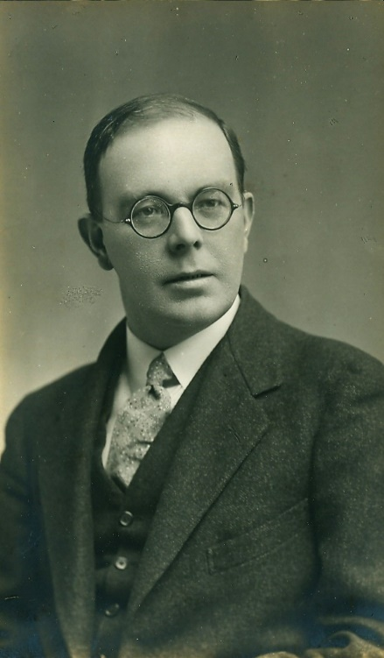
Educational Psychology in the England
A brief history of initial EP training in England
Roles of the DfE, the training courses and the AEP within the EPFT application process

Slide 4
Educational Psychology Funded Training: The Department for Education (DfE) role
DfE has funded the training since 2012, previously through the executive agency- the National College for Teaching and Learning - and directly through the department since 2017
The current training contracts are held by two consortiums led by the University of Manchester and University College London, and offer funding for 203 trainee places each year
DfE fund the three years tuition fees and the first year bursary – local authorities fund the bursaries or salaries for the other two years whilst a trainee is on placement with them
Once qualified, trainees are required to work in a local authority in England for at least two years

Slide 7
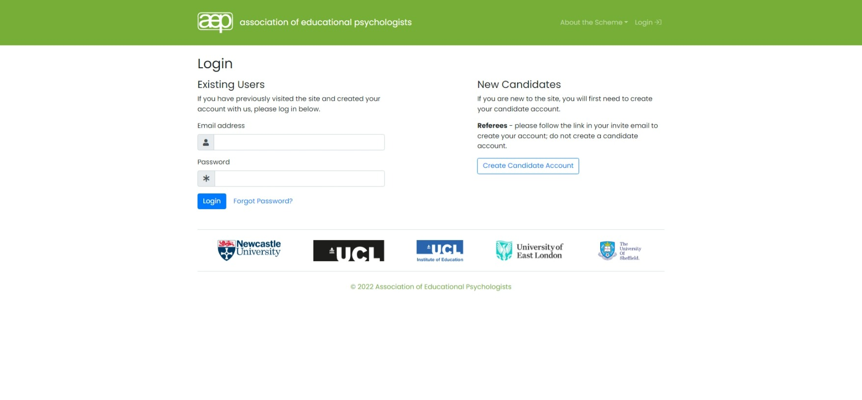

Slide 8
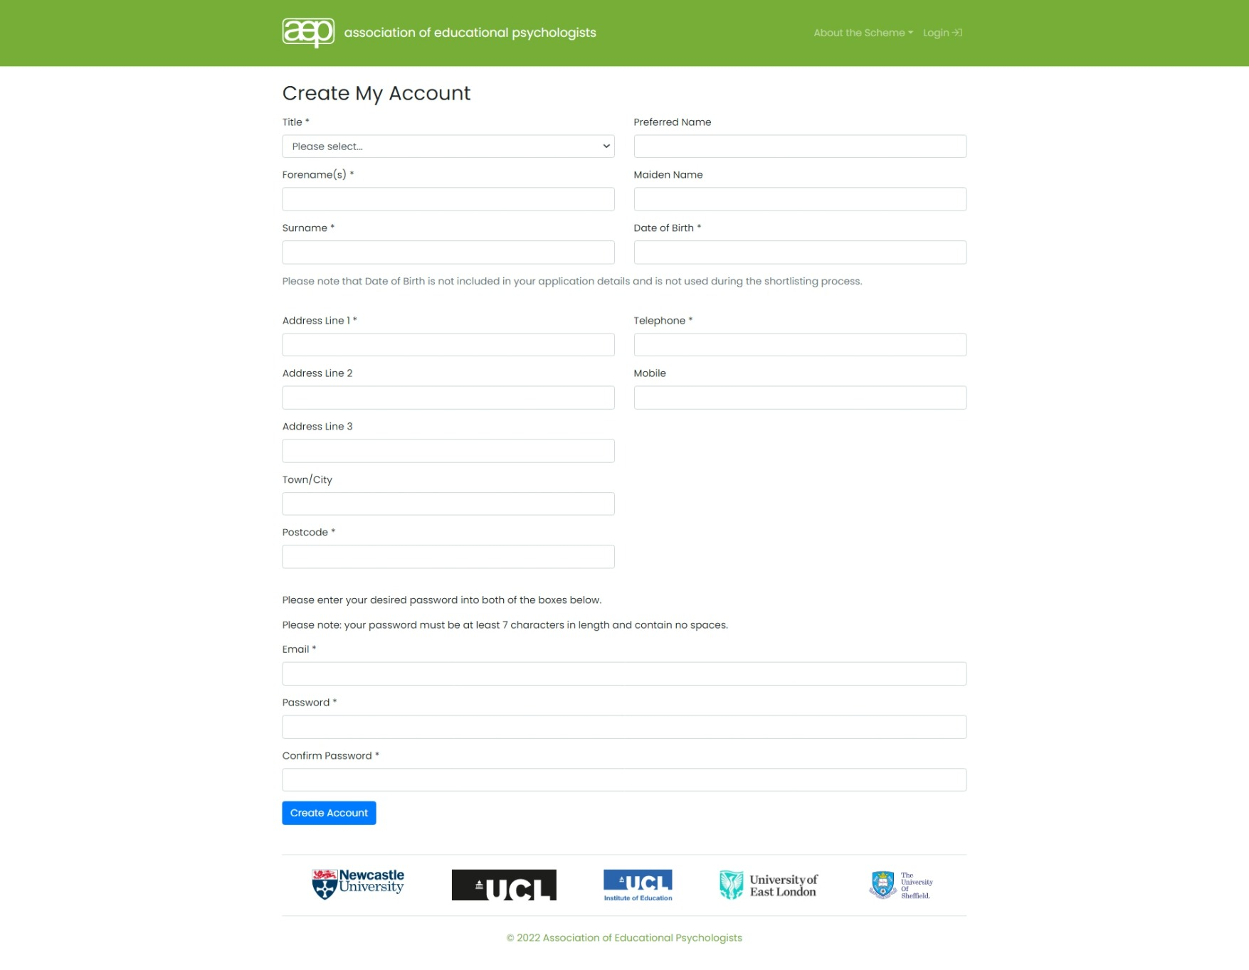

Slide 9
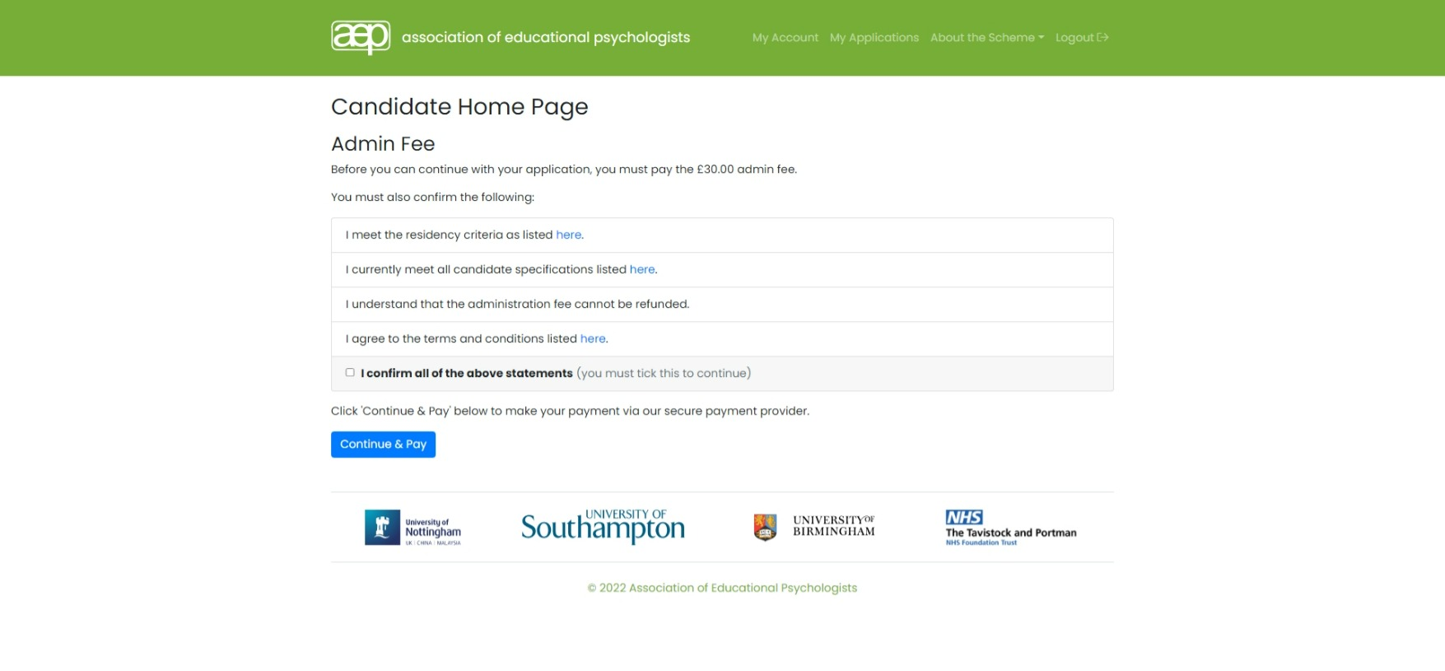

Slide 10
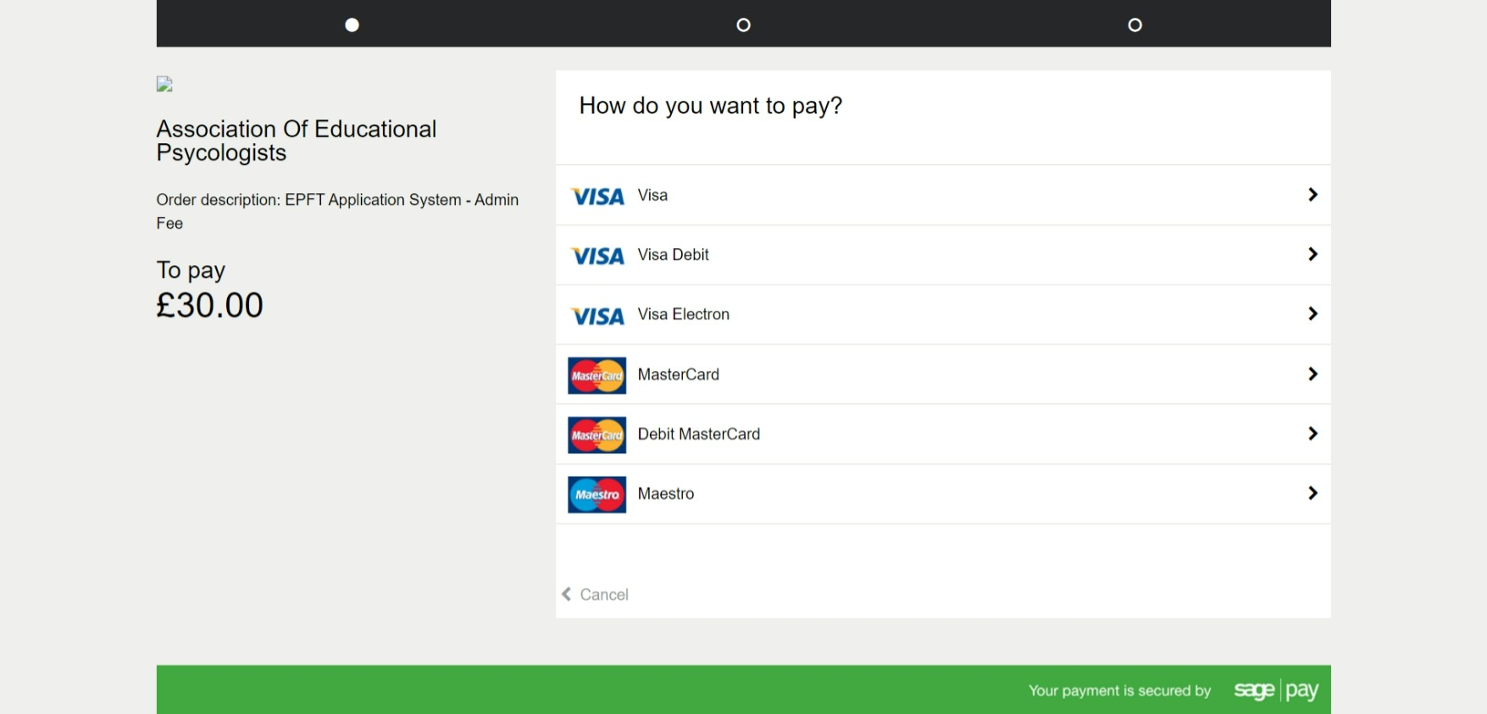

Slide 12
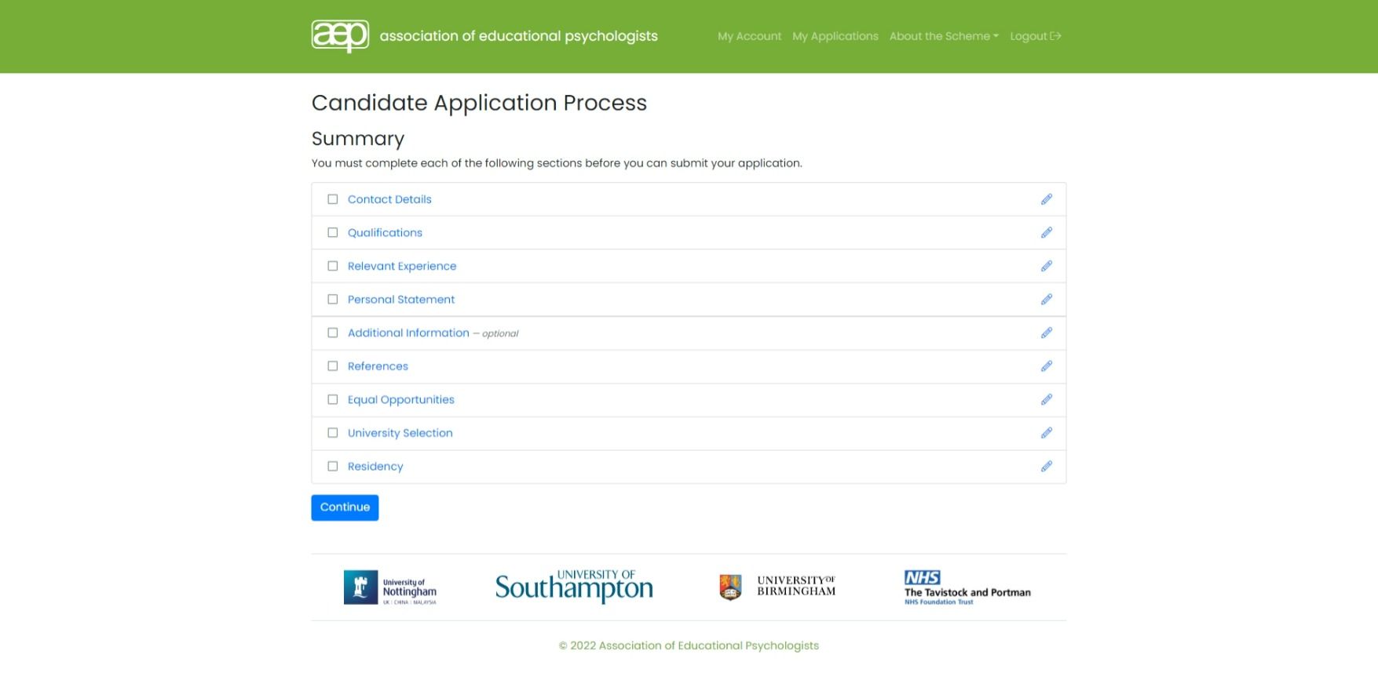

Slide 13
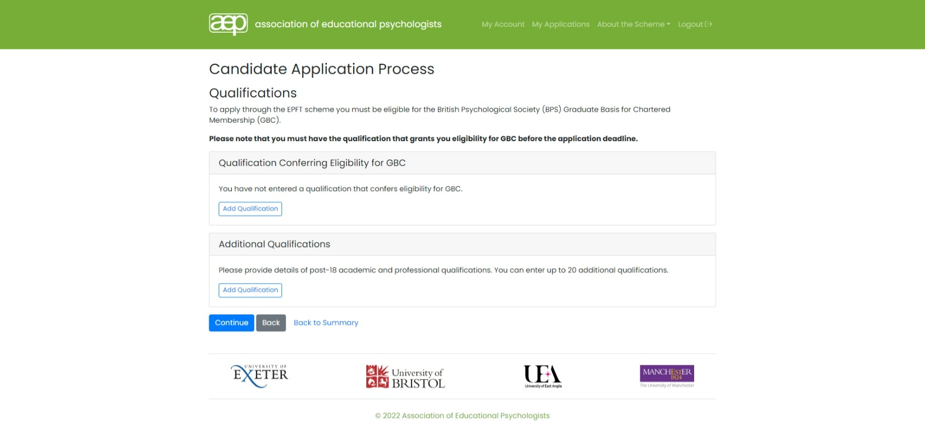

Slide 16
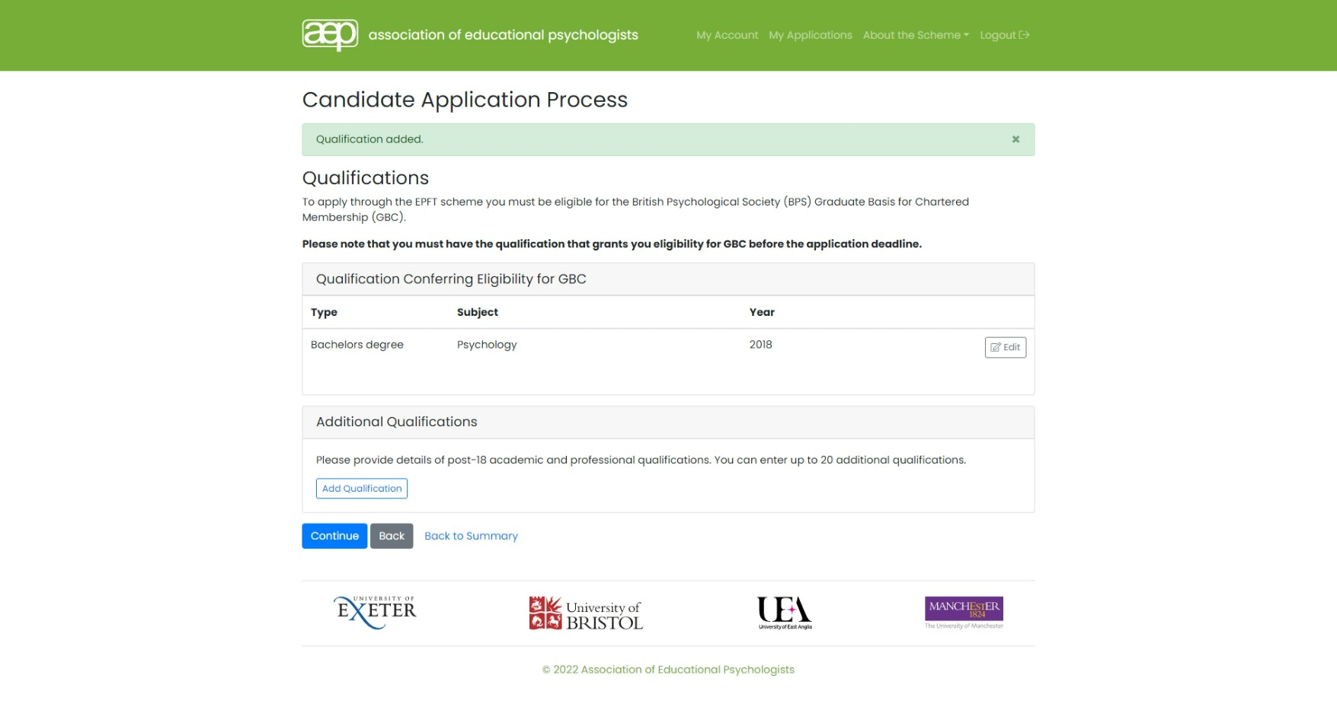

Slide 19
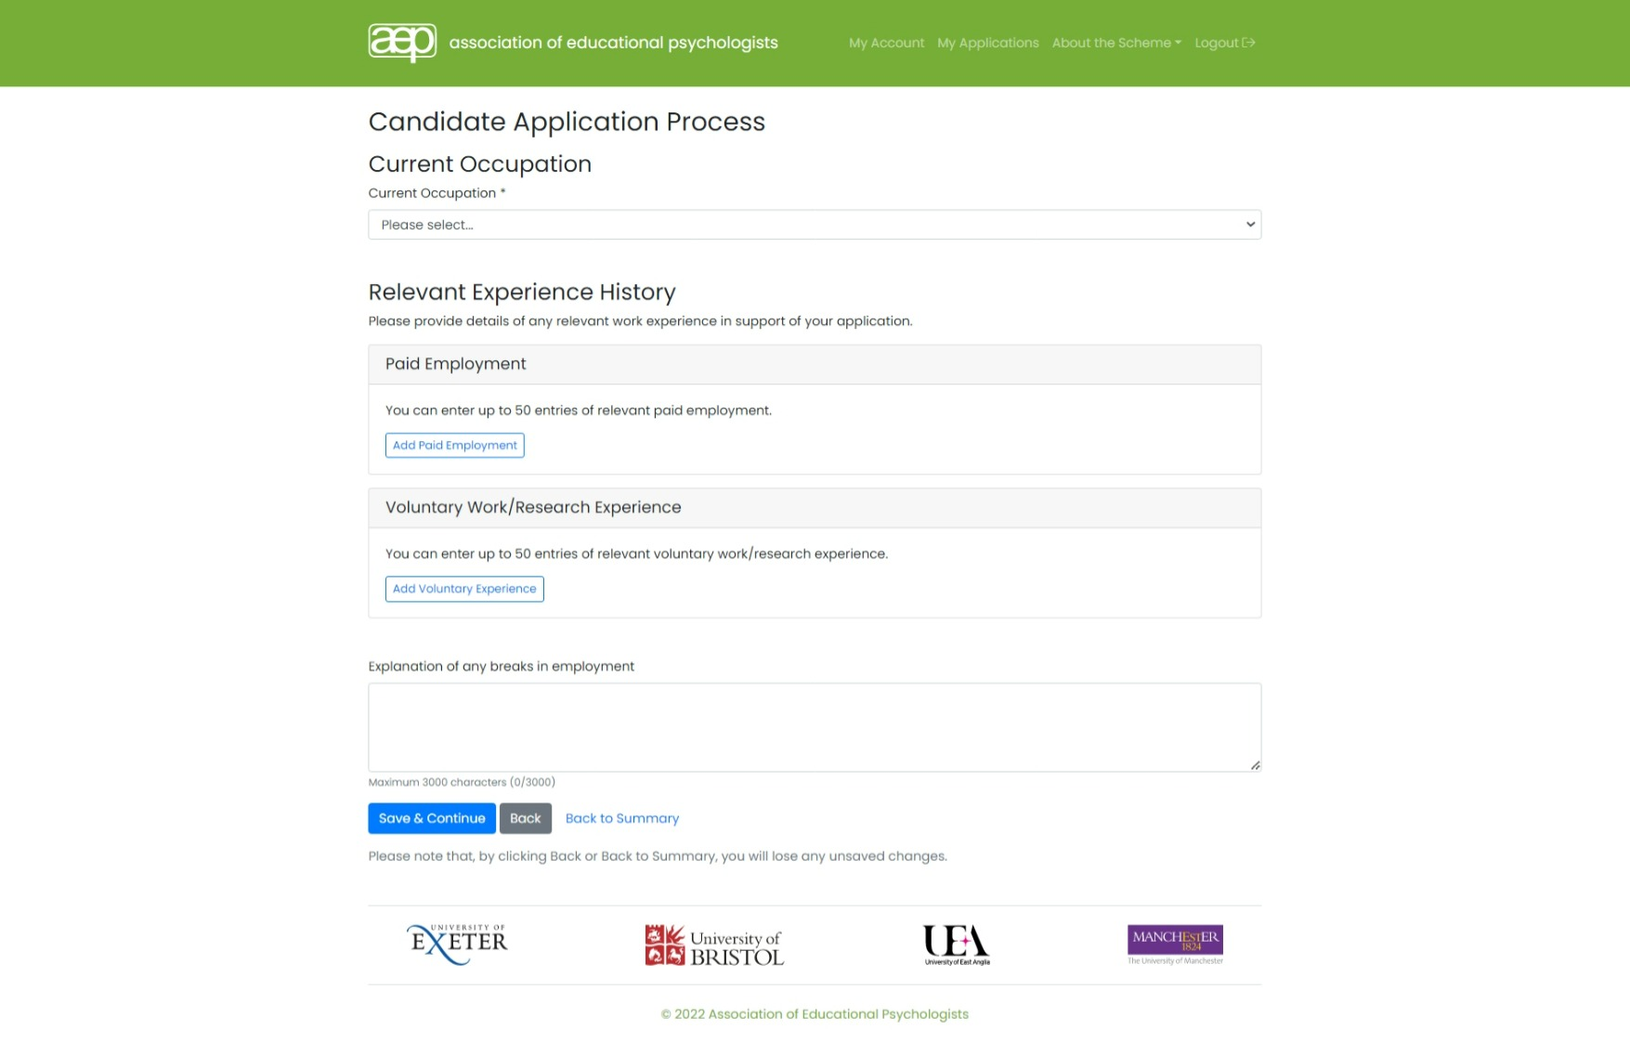

Slide 22
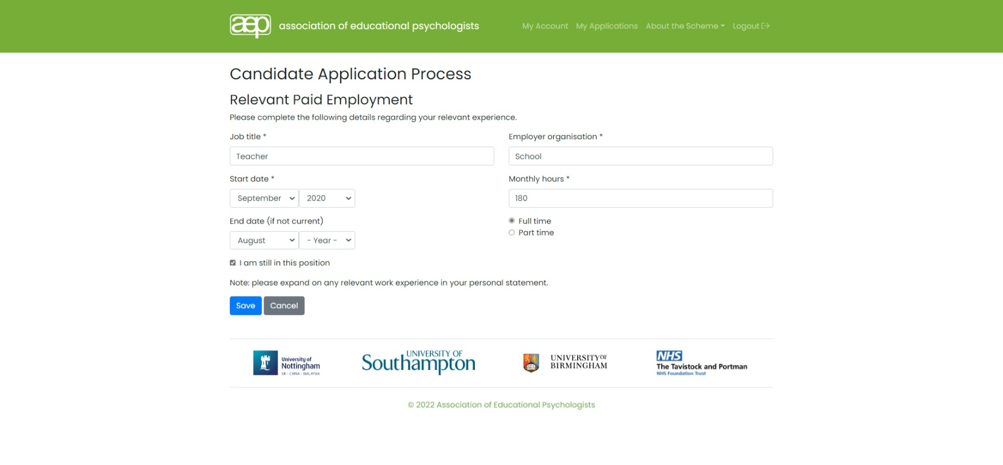

Slide 23
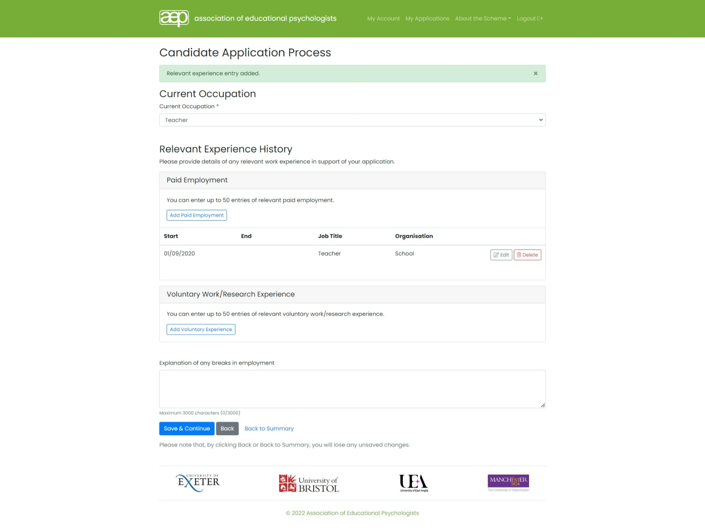

Slide 26
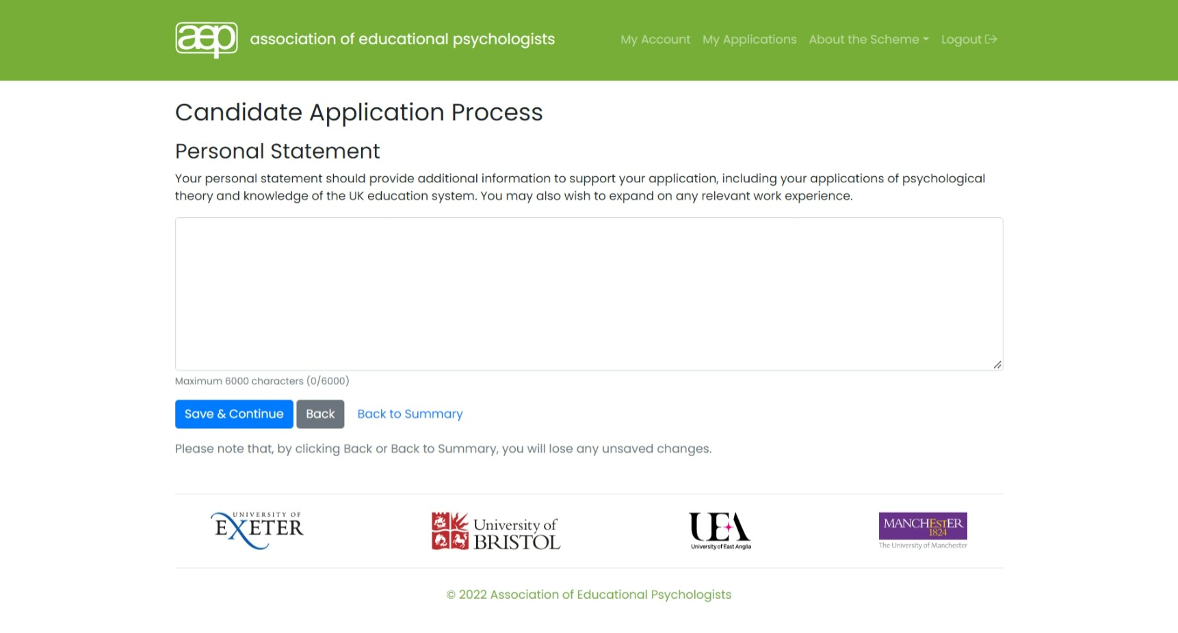

Slide 28
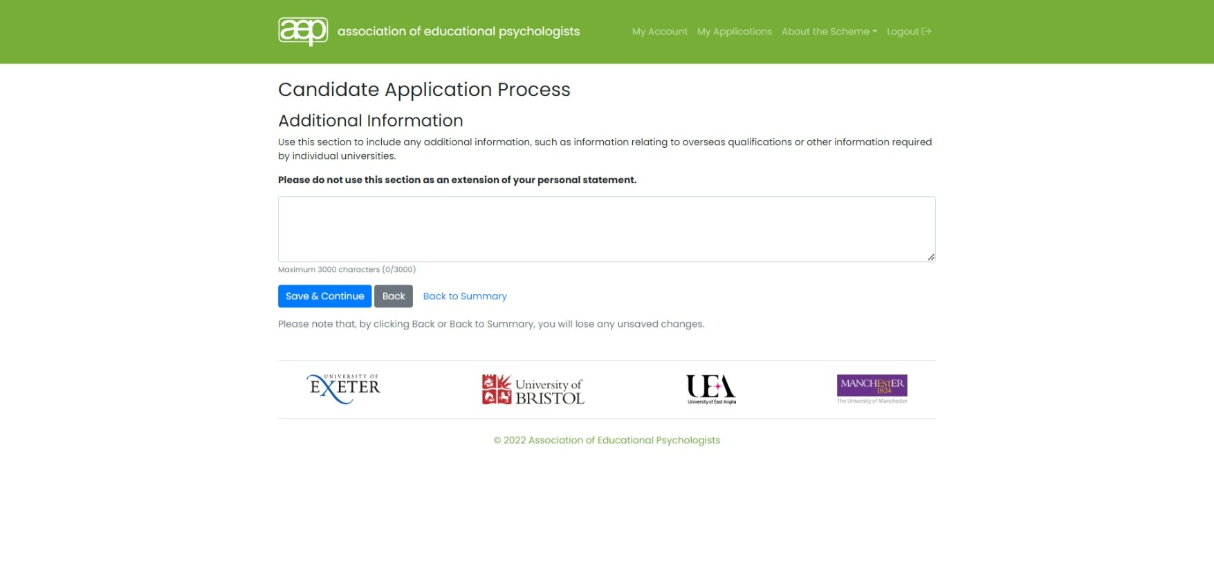

Slide 29
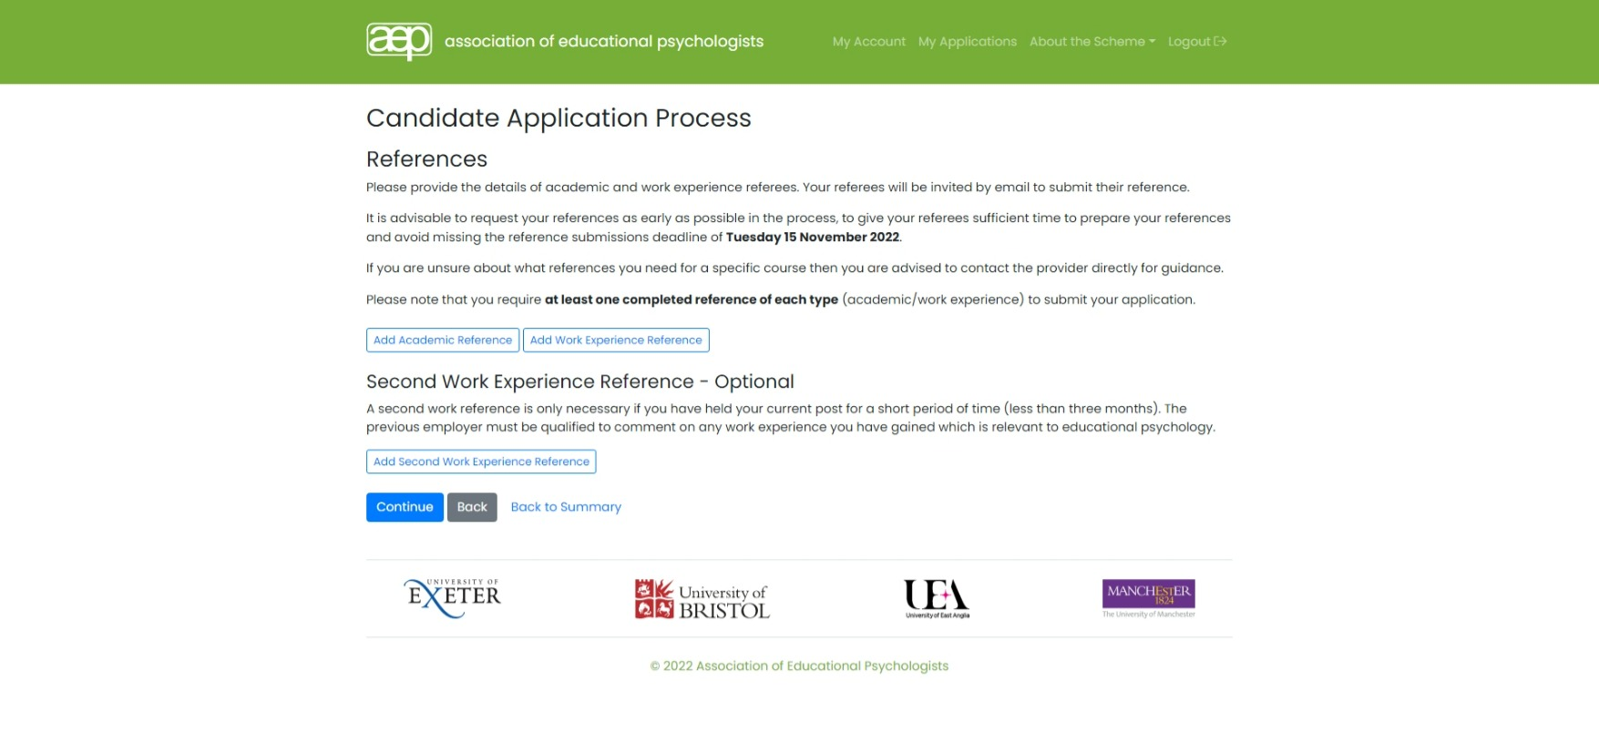

Slide 34
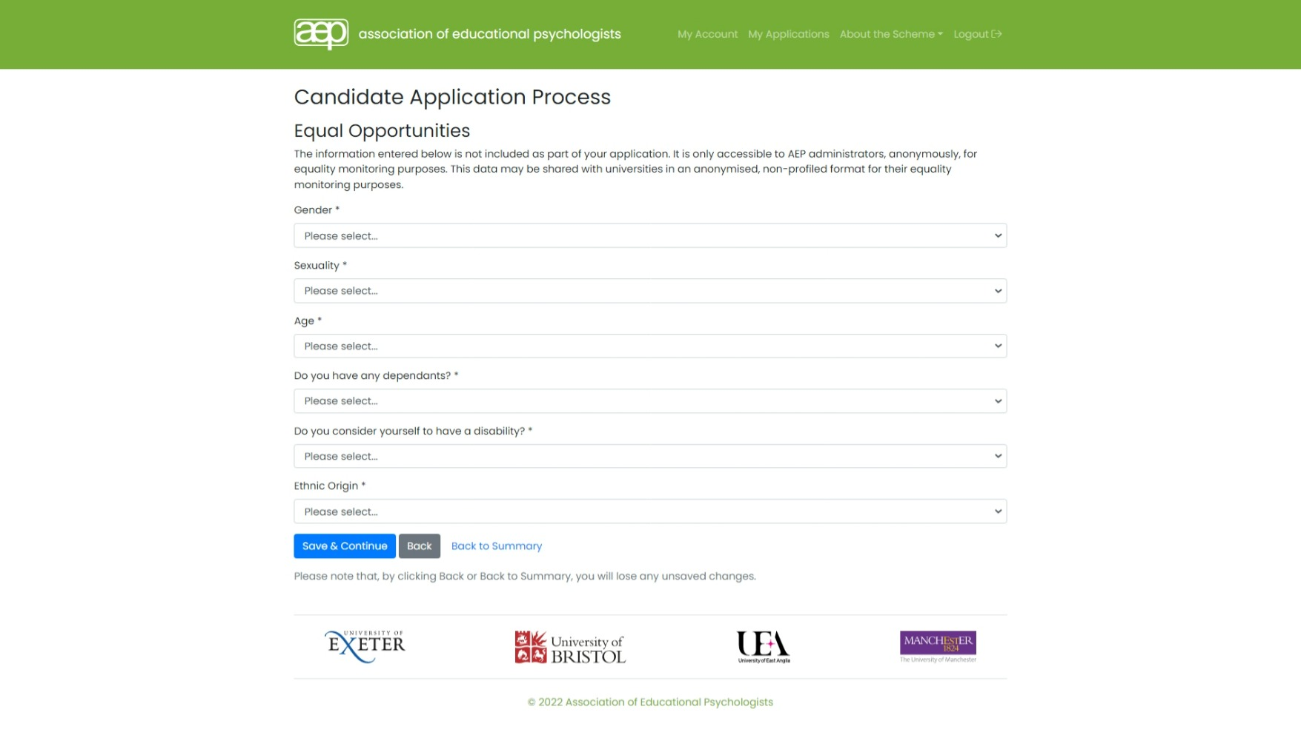

Slide 36
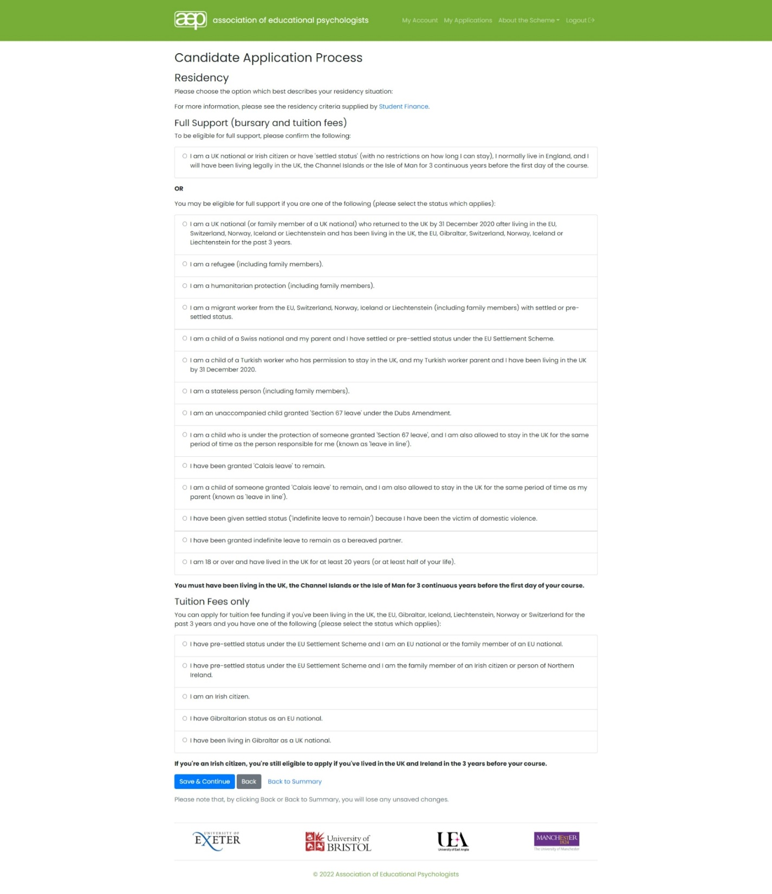

Slide 38
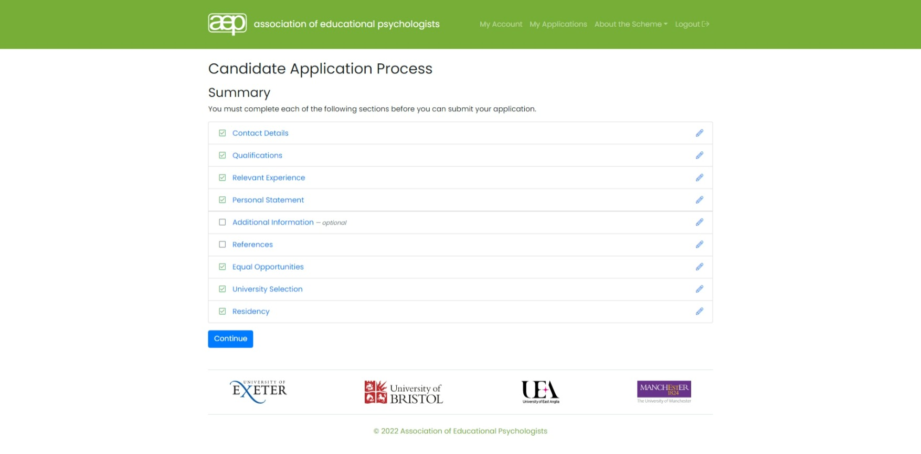

Slide 40
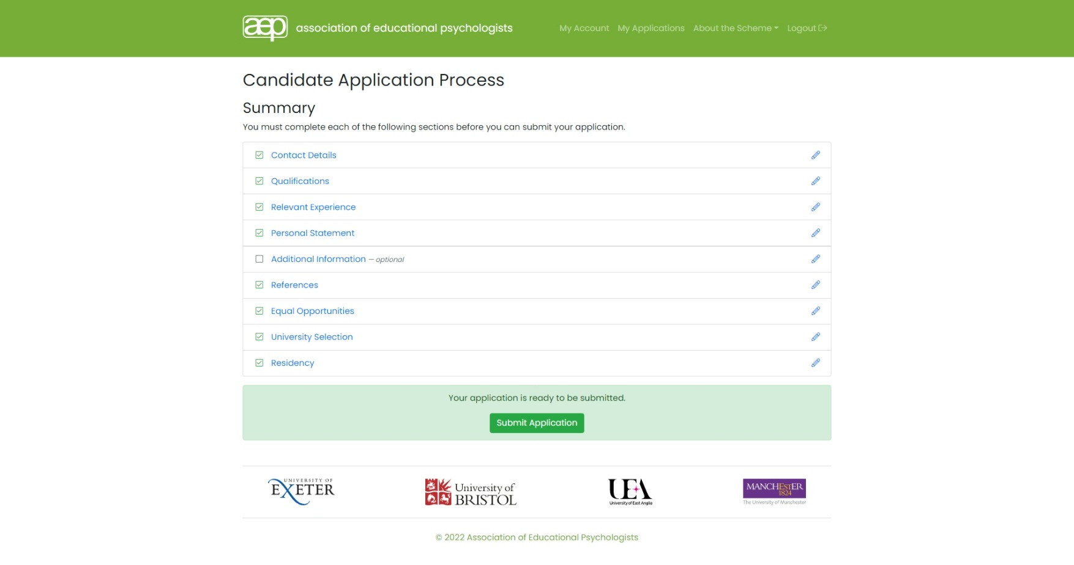

Slide 42
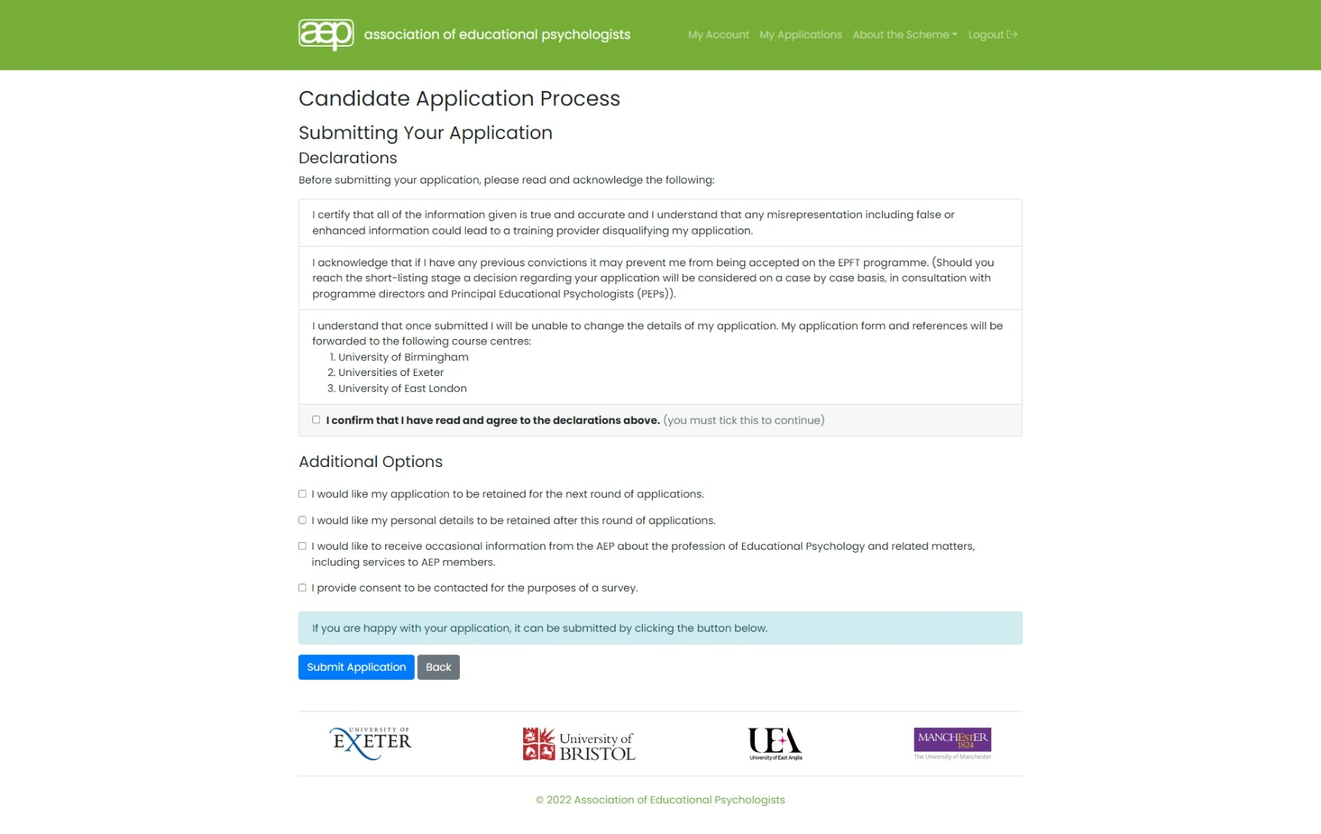

Slide 45
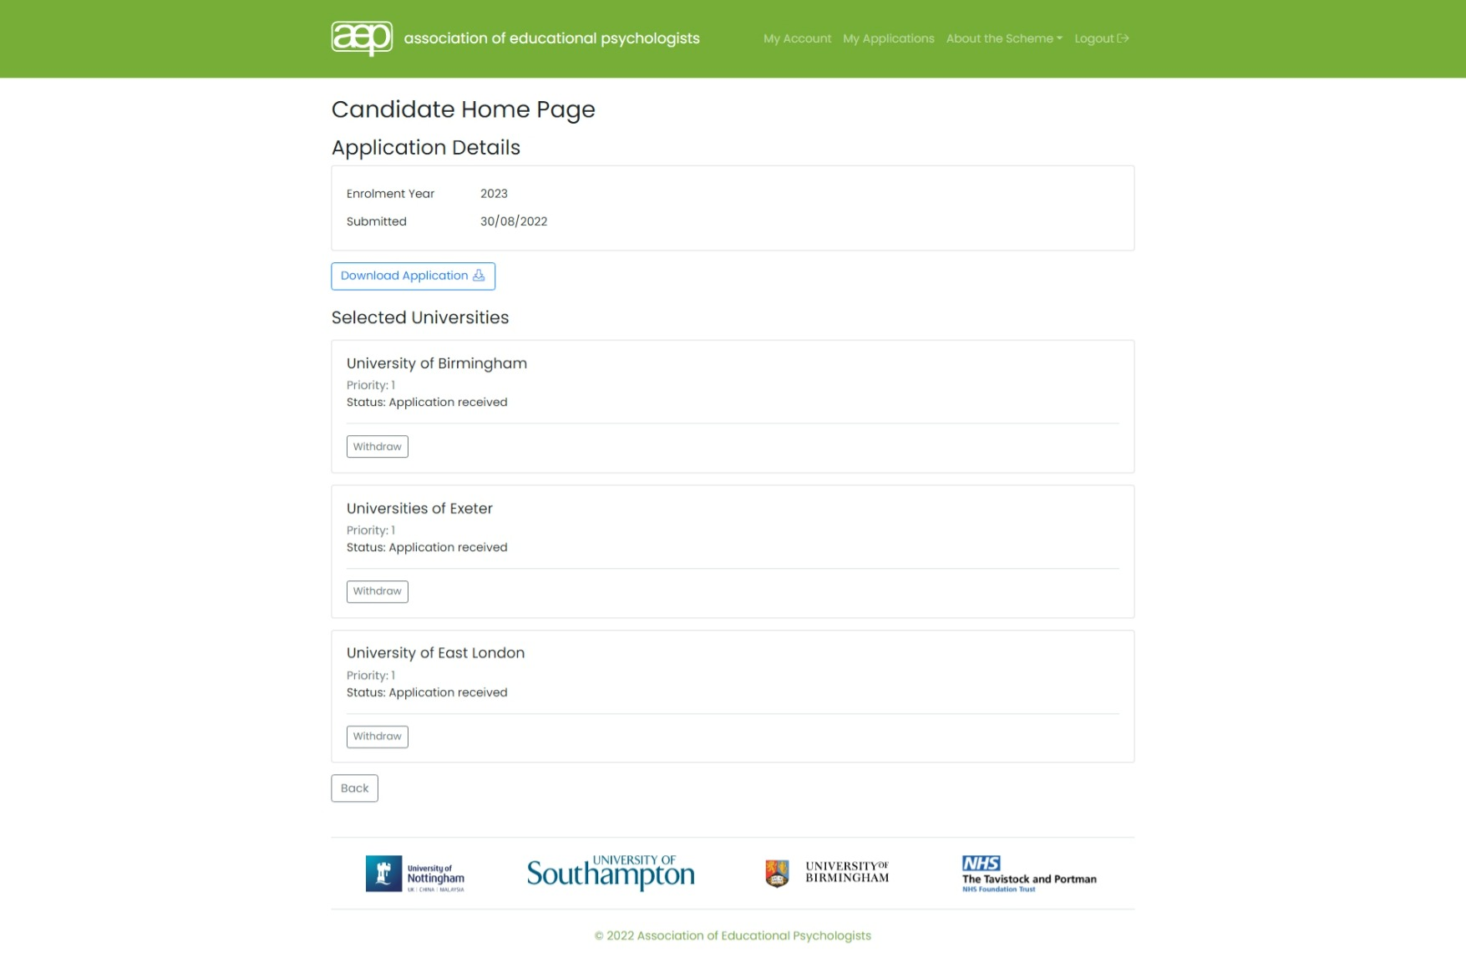

Slide 50
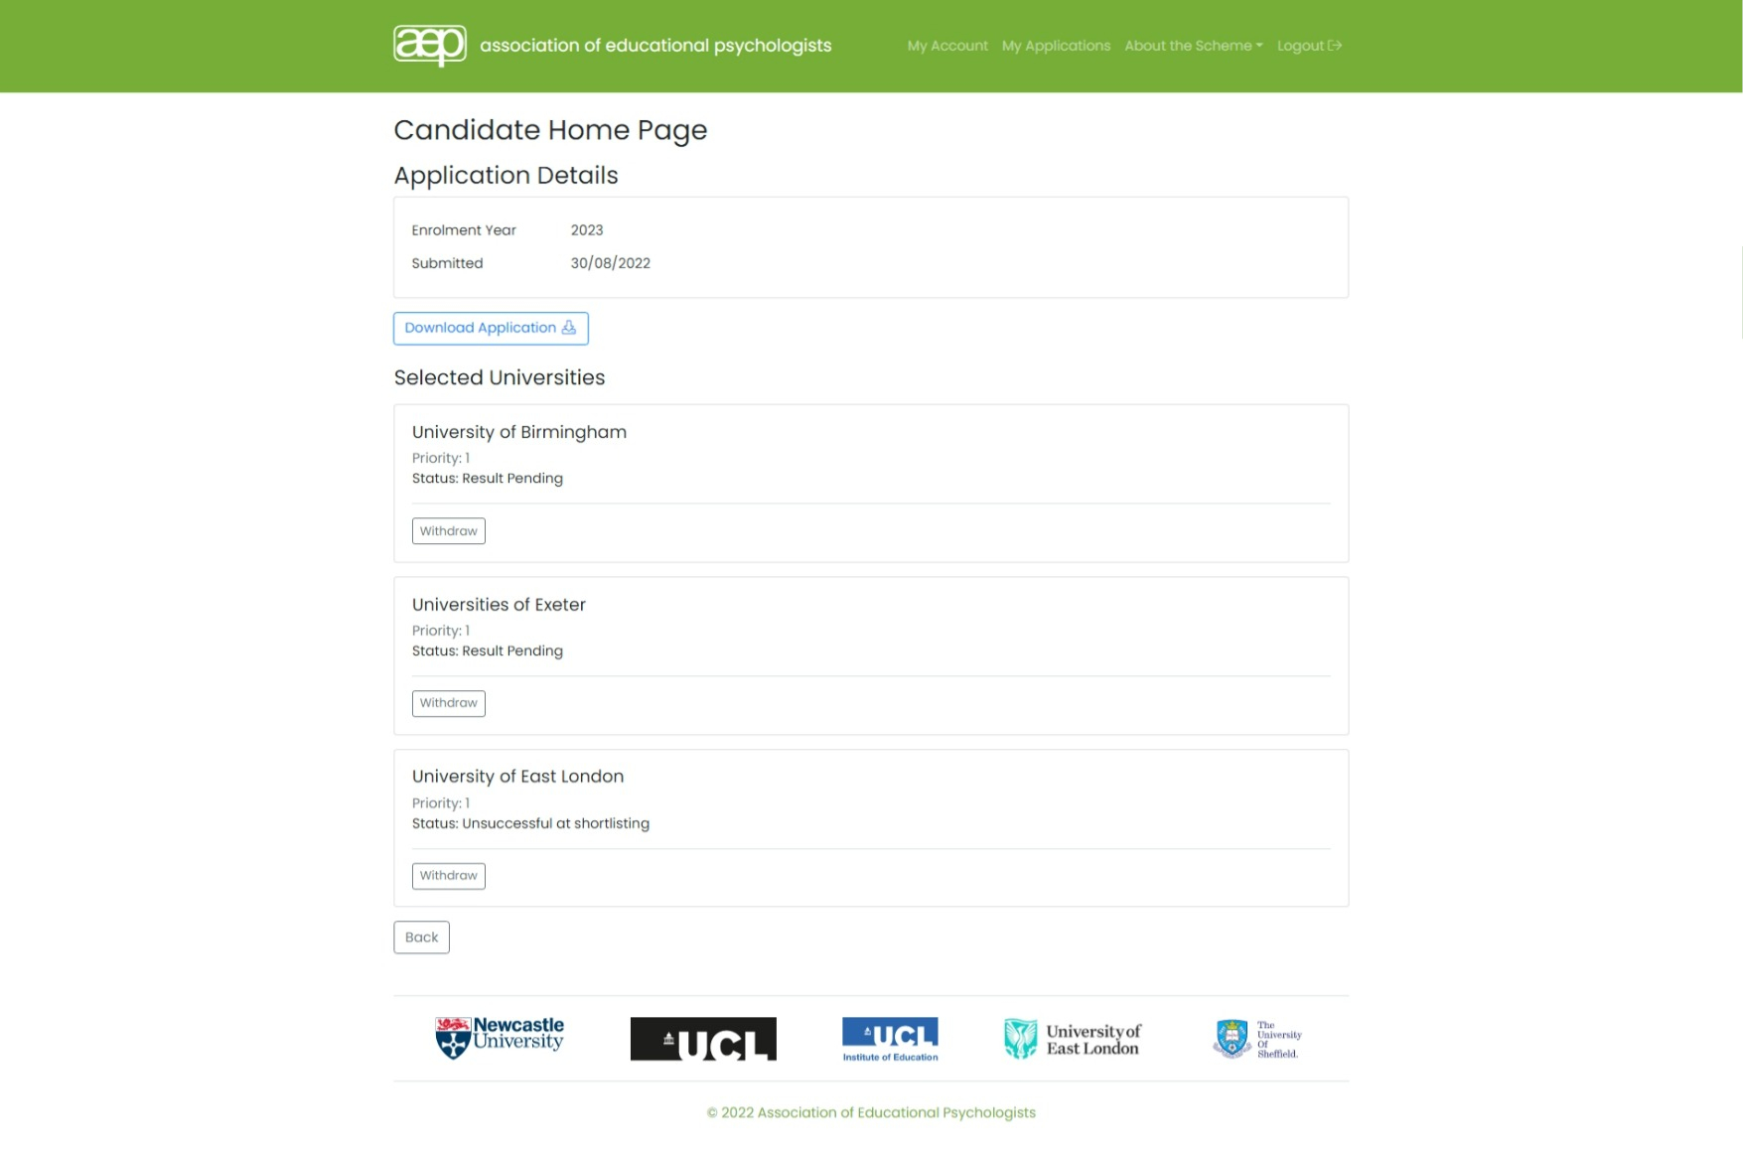

Slide 55
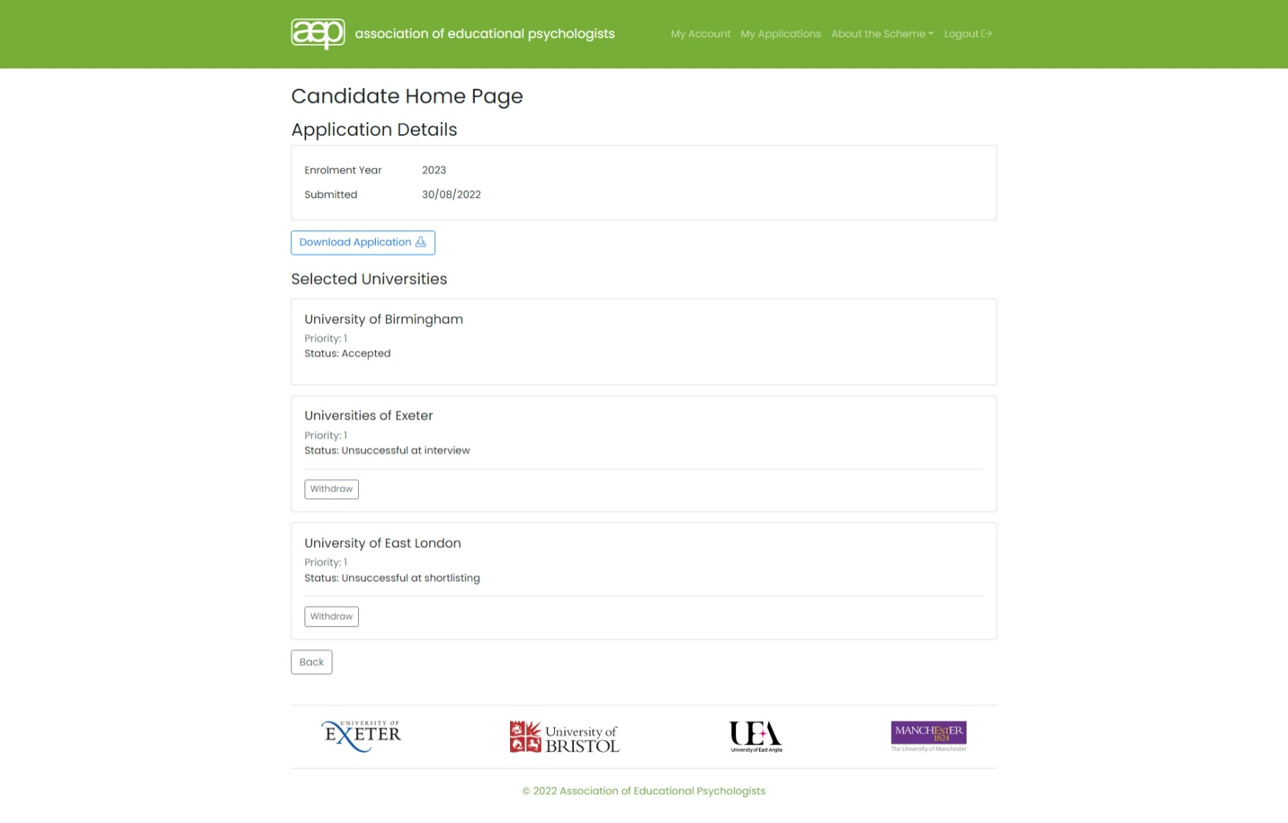

Slide 56
The process – applying for EP training
Most frequently asked questions:
Graduates with 2:2s
Residency
Incomplete qualification by deadline date
Teachers training to be EPs
Overseas qualifications
Preparing to apply
Application deferral
Part-time and distance learning

Slide 57
A few tips…..think about
How you tailor your experience to the EP role
How have you applied psychology? What psychology did you use and why?
How do you know what you have done has worked/or not?
How do you work effectively with others? (different groups e.g. CYP, parents, professionals and those from diverse backgrounds)
A few well chosen examples which showcase your decision making and reflection can more effectively convey your skills than a list of lots of different experiences (less is more!)

Slide 58
Any other questions… Please refer to www.aep.org.uk/epft – if you can’t find what you’re looking for, email enquiries@aep.org.uk

Slide 59
More information…
We have lots of information on our website: www.aep.org.uk/epft
Links to all the training courses’ websites in England
Detailed information on applying & criteria
Useful links & information on training in Scotland & Wales
We are currently re-developing our website to help us provide the best experience for members & anyone interested in the profession. We’d love for you to take part in our survey & let us know which information you’d like to see both now and as you progress through your journey.
Scan the QR code to complete a quick survey (we will email a link to everyone too)

Slide 60
Thanks for listening! Visit us at www.aep.org.uk/epft Twitter : @AEPsychologists

