Slide 1
When Punishment doesn’t work, what does? The Power of Relationship Building and Joint Problem-Solving for Secondary Students at risk of school exclusion
Dr Enrique Childress
Buckinghamshire County Council
UCL Honorary Researcher

Slide 2
Outline
The Context
The Theory
The Approach
The Method
The Results
Implications
Next Steps

Slide 3
The Context
UK 2018/2019 data (DfE, 2021):
7,894 permanent exclusions
438,265 fixed period exclusions
Main reason for exclusion: Persistent disruptive behaviour (35%)
Timpson Report (2019) stated need for effective and feasible interventions to prevent issues from escalating to exclusion (DfE, 2019a)

Slide 4
Aims
Identify whether a relationship-oriented, problem-solving. proactive intervention is effective at:
Reducing externalising behaviours
Enhancing the adaptive executive functioning skills
Understand wider impact
For students at risk of school exclusion in an inner London mainstream secondary school.

Slide 5
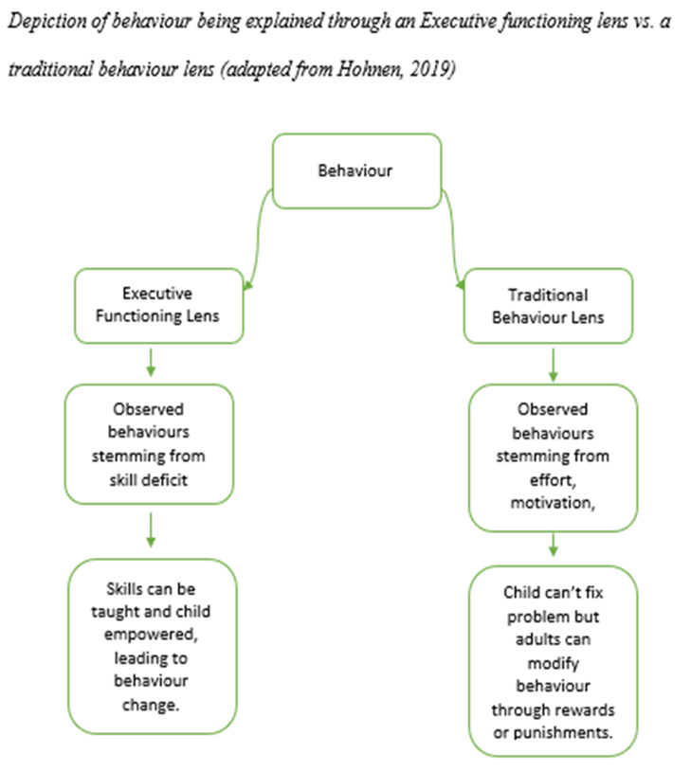
Why Executive Functioning Skills (EFs)?
Multi-dimensional construct of skills that directs cognition/behaviour (Diamond & Ling, 2020, Jurado & Rosselli, 2007)
Linked to behavioural difficulties (Weyandt et al., 2014)
Shifts focus from problem behaviour to skills that may underpin them
Trainable with real-world challenge and suppressed by stress & negative emotions (Diamond, 2013; Diamond & Ling, 2016)

Slide 6
Why Secondary Students?
Adolescent brain development – prefrontal cortex (Blakemore, 2019)
Age 14 - peak age for both fixed-term and permanent exclusions (DfE, 2021).
Very little research (Alexander & Baggetta, 2019)
In adolescence, what works:
empowerment
training of executive functions
building self efficacy
(Yaeger et al., 2017)

Slide 7
Why a Proactive, Relationship based, Problem-Solving approach?
Proactive – skill-building during non-reactive state (Siegel & Bryson, 2012).
Relationship-Based – positive feelings improve EFs (Diamond & Ling, 2016) and good relationship fuel intrinsic motivation (Ryan & Deci, 2010)
Problem-Solving – social problem-solving interventions linked to improved behaviour (Merrill et el., 2017) + link between executive functioning and problem solving

Slide 8
Why Collaborative and Proactive Solutions (Greene, 2013)
US evidence base
Emphasis on working upstream – focusing on skill development
Proactive not reactive
Collaborative not unilateral problem solving

Slide 9
Why Collaborative and Proactive Solutions (Greene, 2013)
Guiding Principles
Why are they challenging?
Lack of skills
When are they challenging?
When expectations outstrip skills
So… we collaboratively modify expectations till we upskill at problem solving
Understanding first – through the prism of lagging skills and unsolved problems

Slide 10
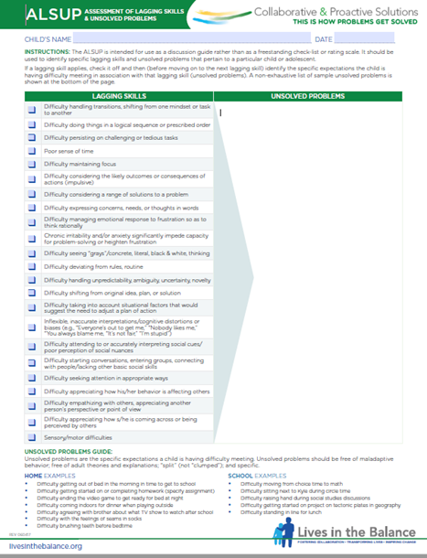
Intervention Phase 1 Collaborative assessment

Slide 11
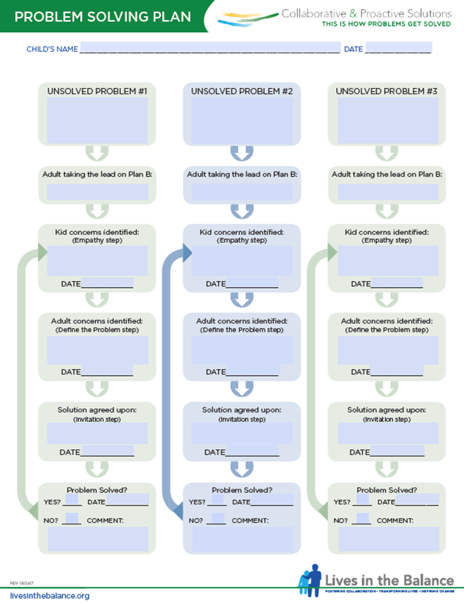
Intervention Phase 2 Collaborative Problem Solving

Slide 12
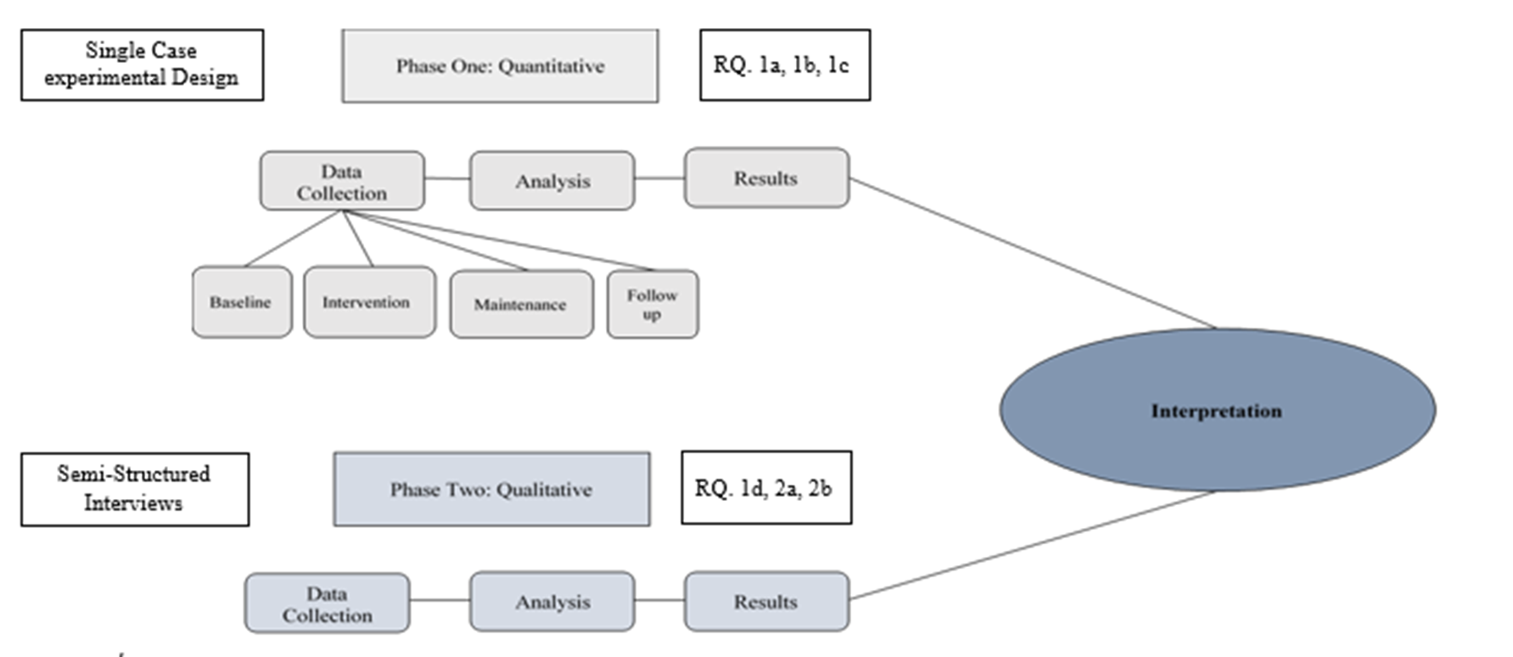
Method

Slide 13
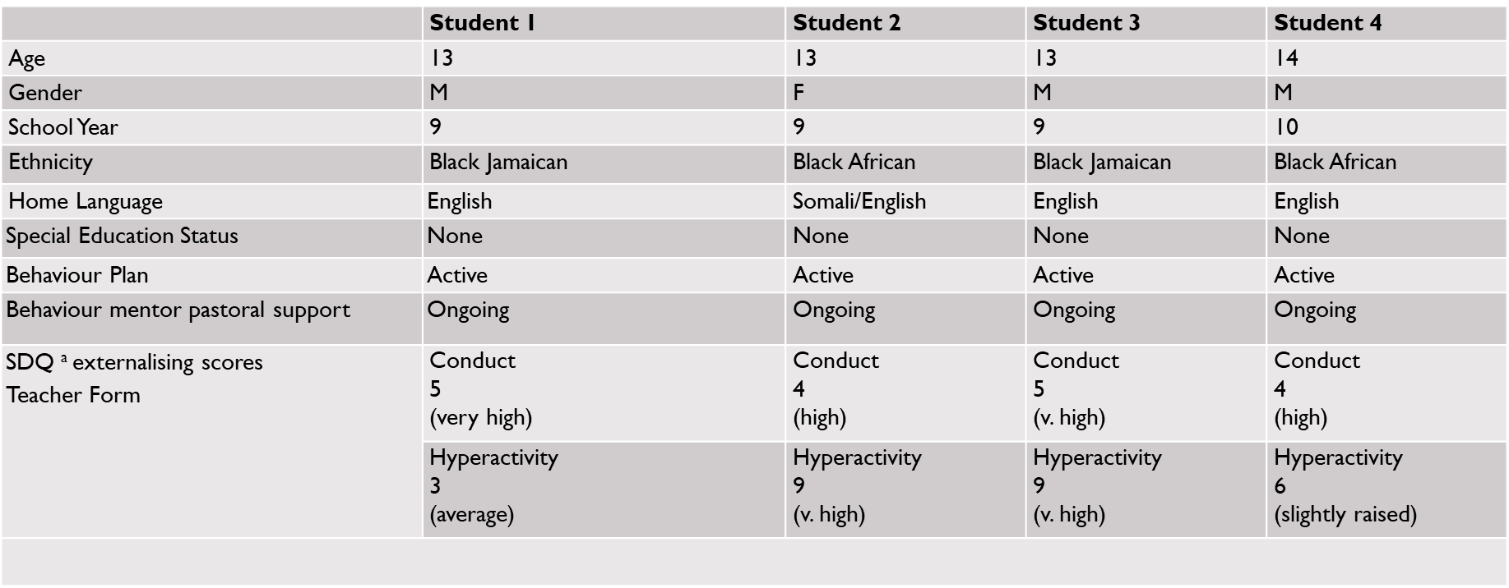
Participants

Slide 14
Impact on Externalising Behaviours

Slide 15
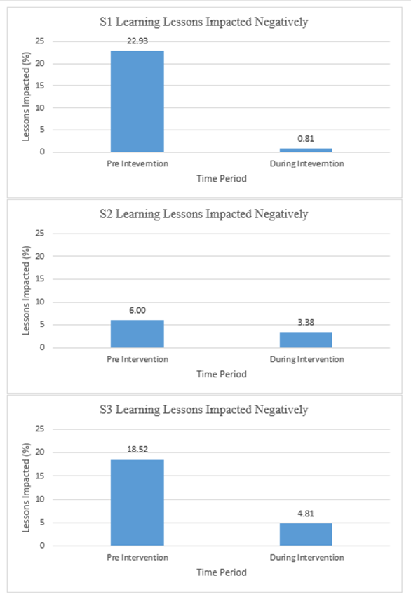
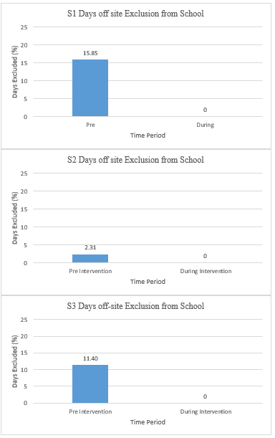
School Data

Slide 16
Meeting Behaviour Targets
Target Monitoring Evaluation
All students improved compared to baseline on 100% of targets
45% of targets ‘some progress’
27% of targets ‘met’ at expected level
27% of targets exceeded

Slide 17
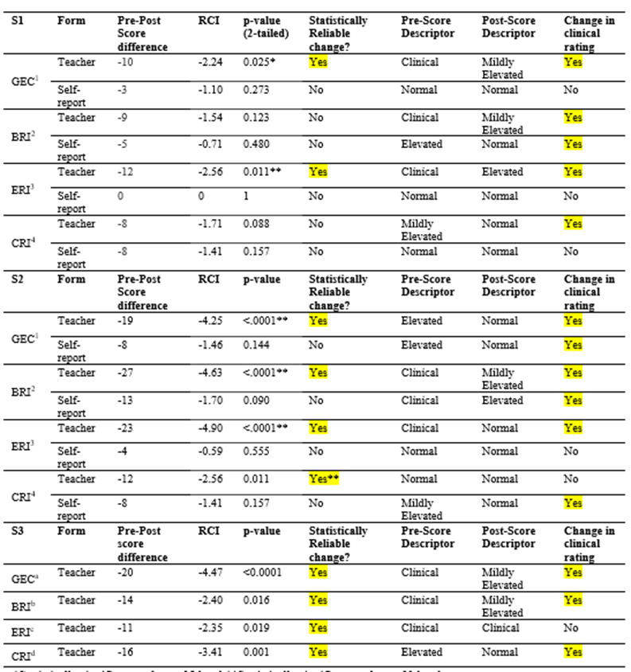
Impact on EFs
Clinical Category reduction for every elevated score at pre-intervention.
(other than S3 ERI – sig. reduction but not clinical descriptor reduction)
Indication of initial impact on adaptive executive functioning (Reliable Change Index) – with a more pronounced effect on teacher ratings which were also more elevated at pre-intervention.

Slide 18
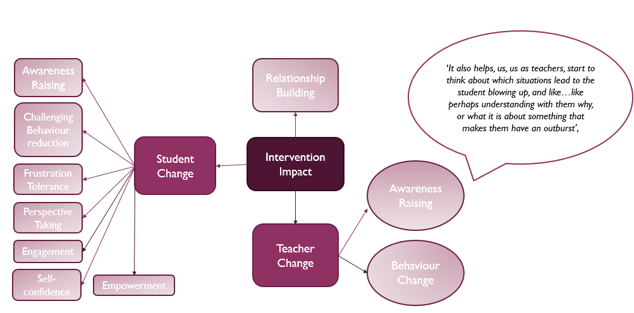
Wider Impact

Slide 19
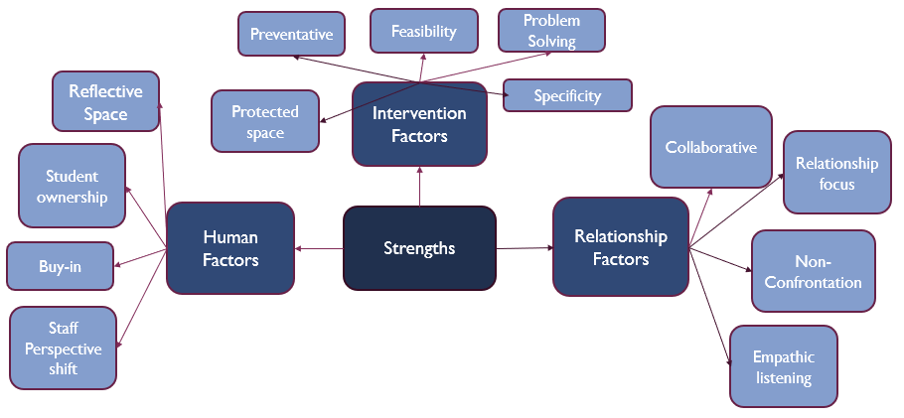
Strengths
‘the more it is done, the more sort of relationships will be formed’
‘it really fosters a better sense of community’

Slide 20
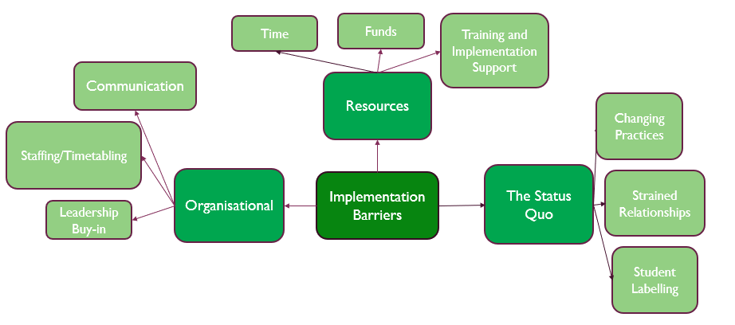
Implementation Barriers
It’s time I think.. Time is the biggest thing’
‘it takes time and patience, mostly time’

Slide 21
Summary of Findings
Externalizing behaviours Quantitative + Qualitative
Adaptive executive functioning skills
Targeted ‘unsolved problems’
Qualitative Impact
Teachers
Relationships
Students
Intervention strengths
Empowerment/Ownership
Teacher upskilling
Relationships
Time/Space
Barriers
Systems & Structures
Status Quo
Resource Constraints

Slide 22
Conclusions
Extends CPS evidence base and applicability & generalizability to UK secondary school context for reduction of externalizing behaviours
Highlights the holistic and wide ranging positive impact and strengths
Initial indications to the enhancement of adaptive executive functioning skills (further research needed)
Highlights the implementation barriers
Continues to highlight importance of empathic relationships and relational approaches

Slide 23
Replicability across a larger sample across schools and key stages
Broadening our understanding of the role of EFs
Maintenance and follow up designs to inform implementation
Exploring the factors highlighted in the qualitative data which have not been studied yet (e.g. teacher change)

Slide 24
Implications for practice
Advocate for proactive discipline models
Helps EPs reframe behaviour as unmet needs and shift the language and narrative when consulting with schools
Upskilling teachers and mentors
Helps us consider implementation barriers when consulting with schools

Slide 26
Contact
Enrique.Childress@buckscc.gov.uk

