Slide 1
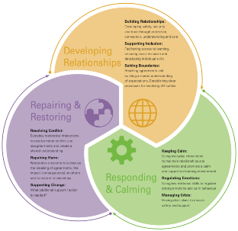
A way of working, learning and being together

Slide 2
Plan for the session
Setting the scene for a Relational Approach
Background to the project and current context
The role relationships play in development, learning and well-being
The Relational model: A structure for applying relational approaches
Developing Relationships
Responding and Calming
Repairing and Restoring
Relational systems and a relational graduated response
Challenges, Impact and Future Evaluation

Slide 3
Why do we need Relational Practice and Policies
Up to date research in the fields of neuroscience and psychology has led to a greater understanding of behaviour.
Analysis of behavioural management practice and systems has led to the development of recommended evidence based practice.
Reviews of exclusion highlight long term trends of those most vulnerable to exclusion and the short and long-term impact.
Previous work on supporting children vulnerable to exclusion highlighted the need for a more universal approach

Slide 4
The need for relational based approaches
Research has demonstrated that investing time and resources into improving relationships in schools leads to positive outcomes around inclusion, engagement, attainment and achievement in the short term and community safety and cohesion in the longer term.
(Behaviour in Scottish Schools Research BISSR).
In addition positive teacher student relationships have been shown to be central to the well-being of both students and teachers
(Sue Roffey University of Exeter).

Slide 5
“Quality relationships provide the necessary vehicles for adaption and recovery… every relationship has the power to confirm or challenge everything that has gone before”.
Dan Hughes and Louise Bomber - Settling to Learn. (2013)

Slide 6
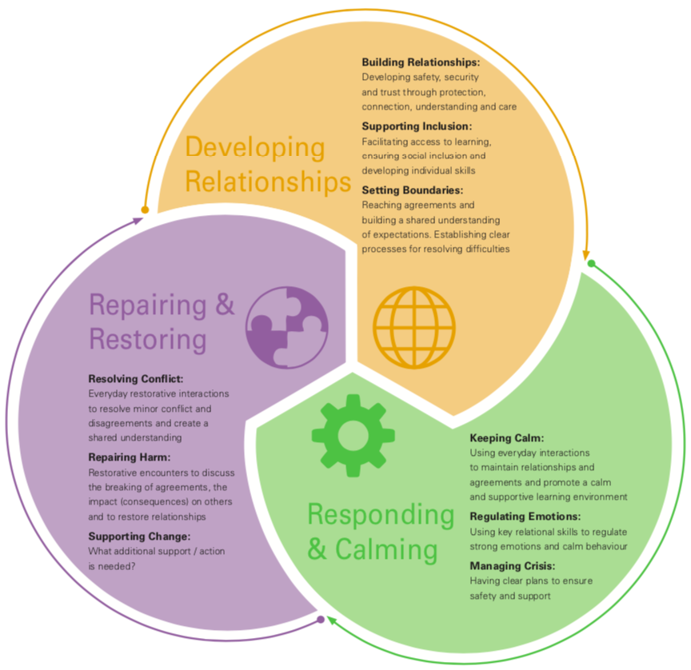
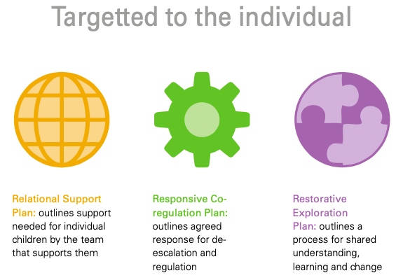
The Relational Approach

Slide 7
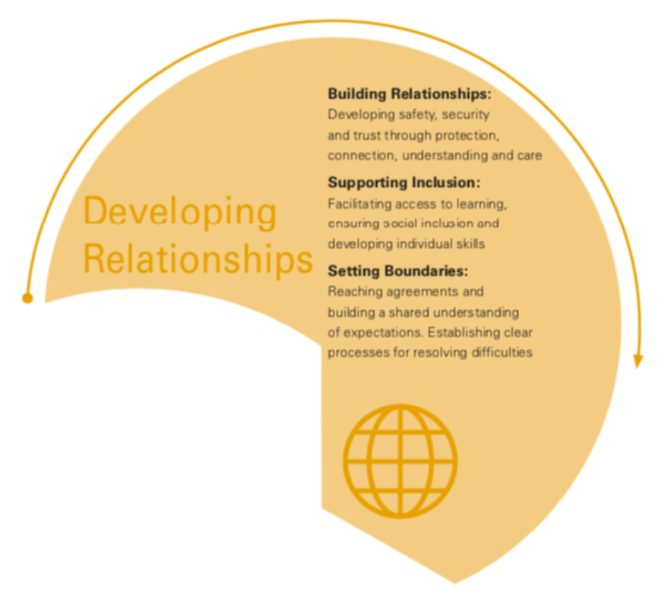
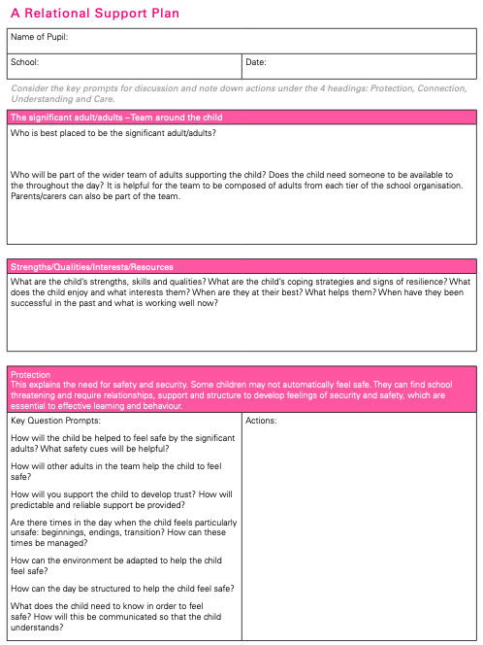
Developing Relationships

Slide 8
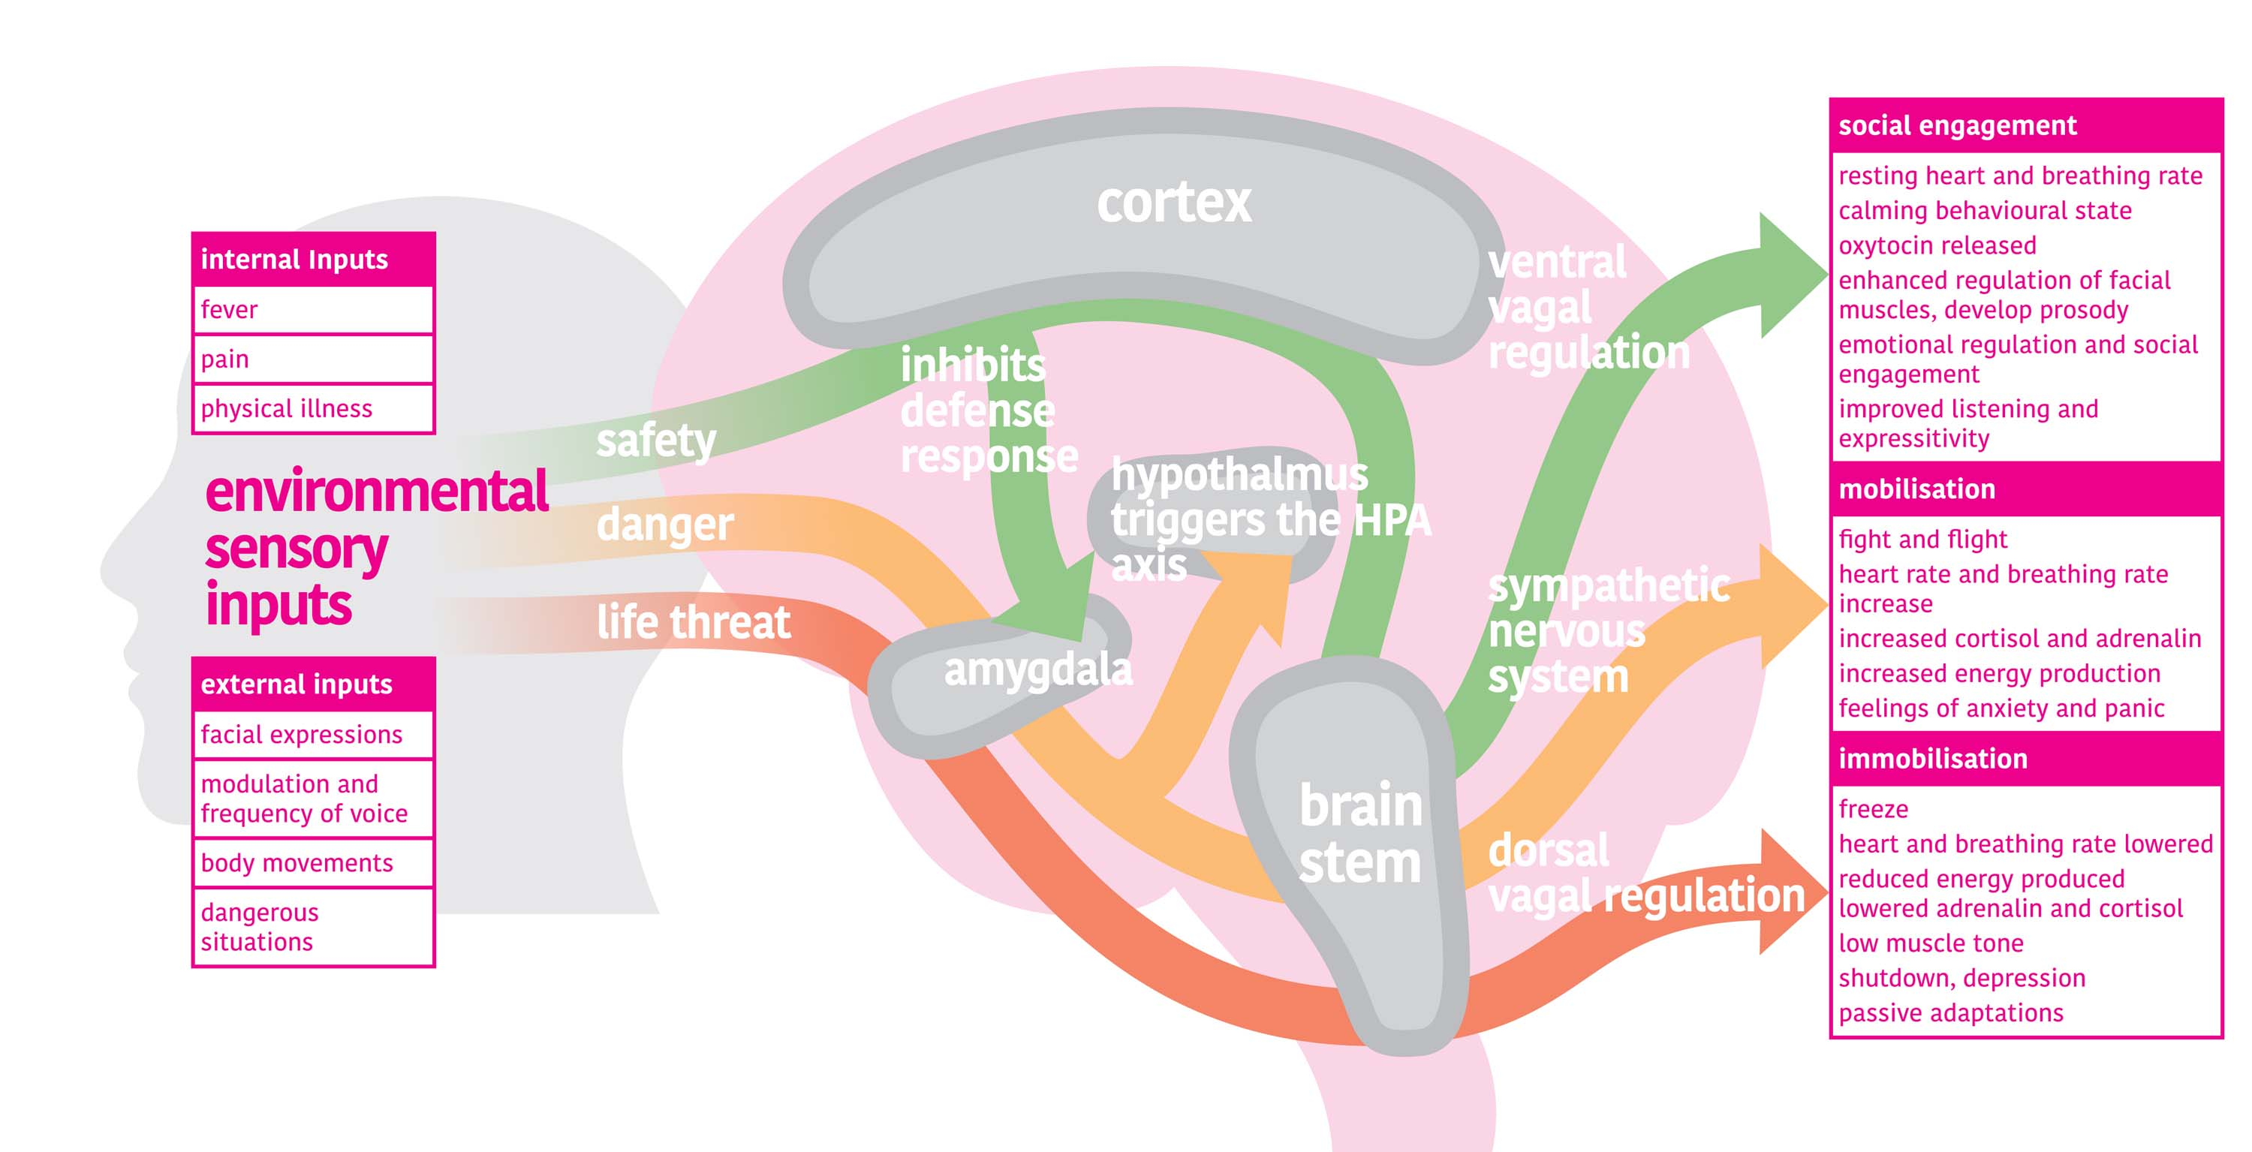
Neuroception

Slide 9
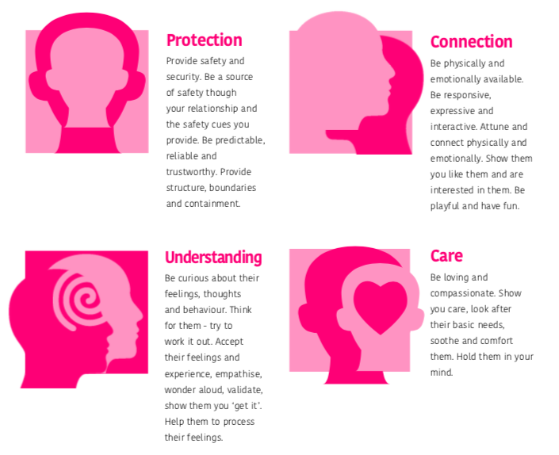
Building Relationships that make a difference

Slide 10
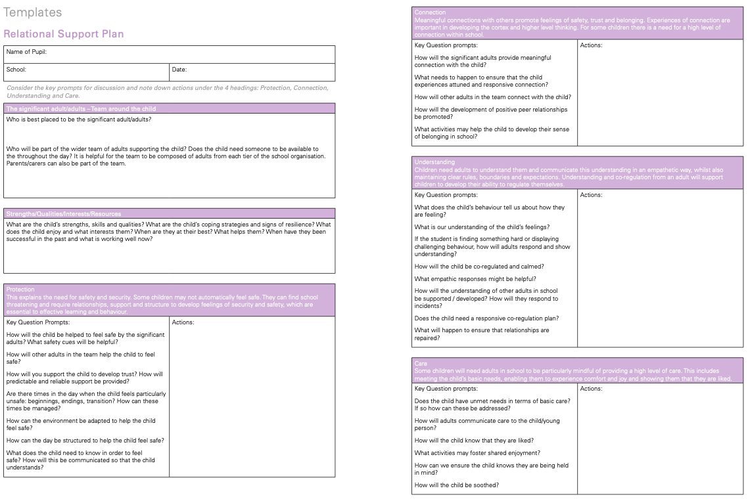

Slide 11
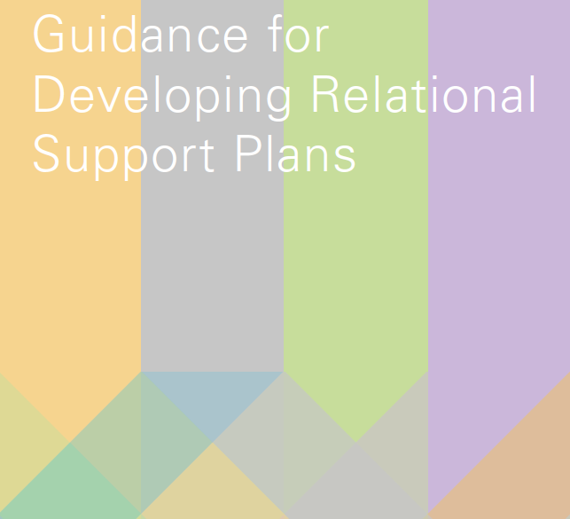
The Relational Support Plan

Slide 12
Supporting Inclusion
It is vital to assess learning needs which may be blocking inclusion. In particular literacy, language, communication and interaction needs as children with these needs are more likely to be excluded than those who do not have SEN.
Children require practical support to ensure that their difficulties do not block access to the curriculum and opportunities to develop these skills.
Schools need to ensure equal opportunities for all children, this will mean providing additional support/ opportunities for groups of children who are vulnerable to exclusion (children known to social care, children in receipt of FSM, children from some ethnic groups).

Slide 13
Setting Boundaries and Community Building
Agreements are best established through a collaborative process with adults and children.
Seeing agreements as the protection of children’s fundamental human rights supports children to develop a shared understanding of the roles and responsibilities.
Agreements should be few in number, as simple as possible, phrased positively and clearly communicated and displayed.
Agreements should be regularly referred to, revisited and amended accordingly.
Processes should be in place to discuss the breaking of agreements. This could be through regular class meetings, circle time and small group discussions. The expression of feelings, the identification of needs and conflict resolution can be modelled and practised through these meetings.

Slide 14
The Relational Approach

Slide 15
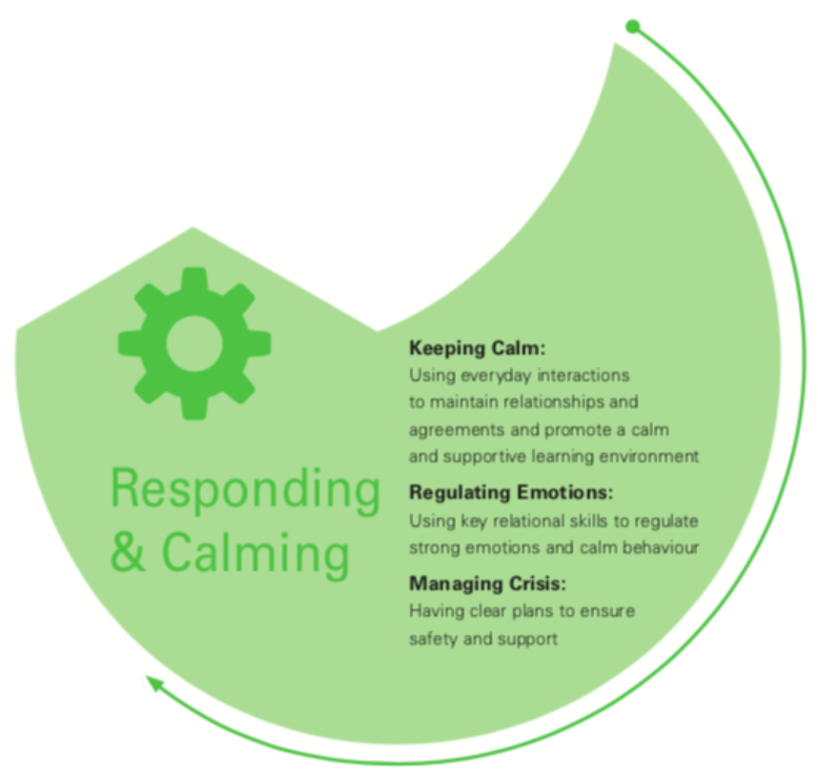
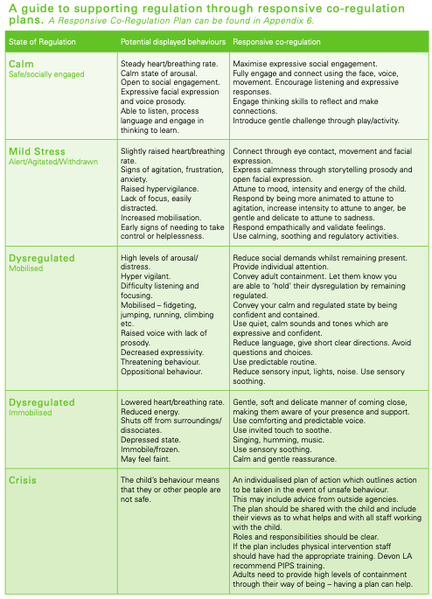
Responding and Calming

Slide 16
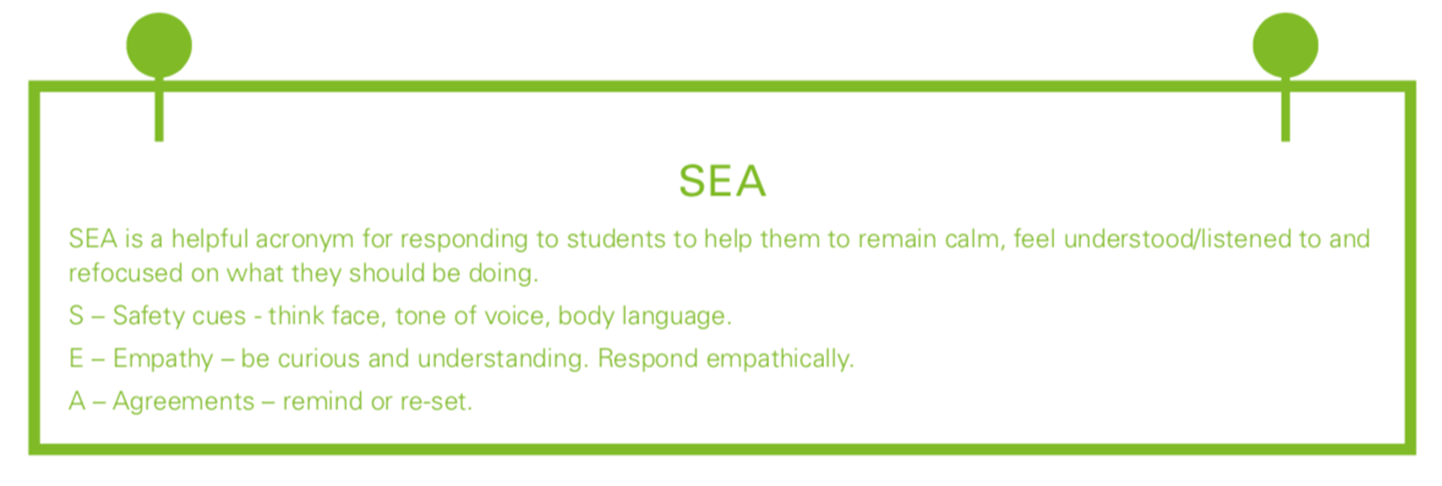
Low level disruption - keeping things calm
At times of low level disruption it is important to use our relational skills and formulated agreements to create calm and avoid confrontation and escalation.

Slide 17
Key relational needs for co-regulation
Margot Sunderland 2007
Attuning to the child’s feelings and reflecting them back.
Accepting and validating the child’s feelings and emotions.
Containing the child’s feelings so they feel safe and held.
Soothing the child so they are able to calm.
Classification:UNCLASSIFIED
Notes:
Attunement
Meeting the child’s /teenager’s emotional intensity (positive or negative) on an energetic level, so as to connect with the child in their pain or their joy. Riding the same emotional energy
Contour (Moments of meeting – Daniel Stern). The child will experience this as a deep enlivening connection with the other.
Accepting and validating
Validating how the child is experiencing the event, even if it’s very different to how you are experiencing it. Not trying to persuade the child out of having the feeling they are having. Rather affirming, understanding and recognising that s/he is
feeling what s/he is feeling. Not just empathy, but finding the right words/ language of feeling/tone of voice to convey that
empathy
Containment of Feelings
Being able to stay thinking and feeling about a child’s intense feelings (e.g. rage, power plays, terror, distress) without deflecting into action, distraction, getting angry etc. At times this will mean being able to bear their unbearable pain. Also
containment through clear structures, boundaries and carried through consequences. Otherwise a “limit deprived child”.
Soothing (emotional regulation)
Soothing and calming the child’s emotionally dysregulated states. Soothing in conjunction with addressing the other relational needs above, can develop actual stress regulating systems in the brain and good vagal tone in the body. These
systems are still forming after birth. When the child is not soothed and calmed during intense dysregulated states, they
may fail to develop effective stress regulating systems in brain and body. This leaves them vulnerable to developing
depressive, anxiety or aggression disorders in later life. They are also far more vulnerable to using alcohol, smoking, or drugs
in order to calm themselves down or just to feel normal

Slide 18
A personalised response plan for co-regulation
(part 2 of the RSP, the plan for regulation)
A simple scale of planned response for an individual child. Consider displayed behaviours and agreed responses for regulation when:
Calm (Safe / Socially Engaged)
Mild Stress (Alert / Aroused / Agitated)
Dysregulated (Mobilised / Immobilised)
Crisis (Unsafe)
Classification:UNCLASSIFIED
Notes:
Attunement
Meeting the child’s /teenager’s emotional intensity (positive or negative) on an energetic level, so as to connect with the child in their pain or their joy. Riding the same emotional energy
Contour (Moments of meeting – Daniel Stern). The child will experience this as a deep enlivening connection with the other.
Accepting and validating
Validating how the child is experiencing the event, even if it’s very different to how you are experiencing it. Not trying to persuade the child out of having the feeling they are having. Rather affirming, understanding and recognising that s/he is
feeling what s/he is feeling. Not just empathy, but finding the right words/ language of feeling/tone of voice to convey that
empathy
Containment of Feelings
Being able to stay thinking and feeling about a child’s intense feelings (e.g. rage, power plays, terror, distress) without deflecting into action, distraction, getting angry etc. At times this will mean being able to bear their unbearable pain. Also
containment through clear structures, boundaries and carried through consequences. Otherwise a “limit deprived child”.
Soothing (emotional regulation)
Soothing and calming the child’s emotionally dysregulated states. Soothing in conjunction with addressing the other relational needs above, can develop actual stress regulating systems in the brain and good vagal tone in the body. These
systems are still forming after birth. When the child is not soothed and calmed during intense dysregulated states, they
may fail to develop effective stress regulating systems in brain and body. This leaves them vulnerable to developing
depressive, anxiety or aggression disorders in later life. They are also far more vulnerable to using alcohol, smoking, or drugs
in order to calm themselves down or just to feel normal

Slide 19
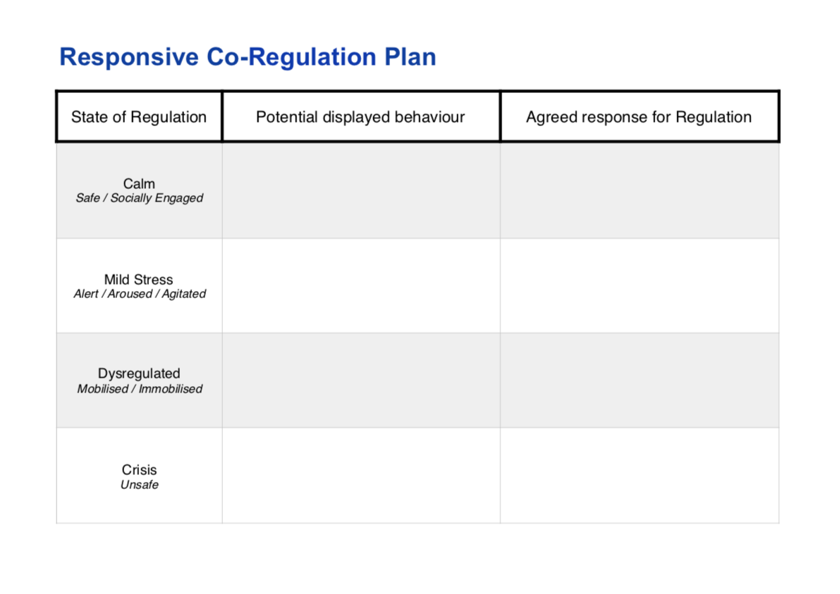

Slide 20
The Relational Approach

Slide 21
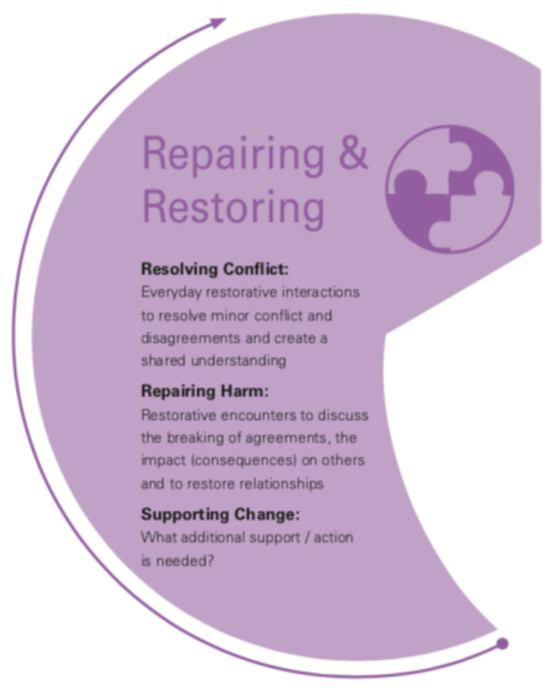
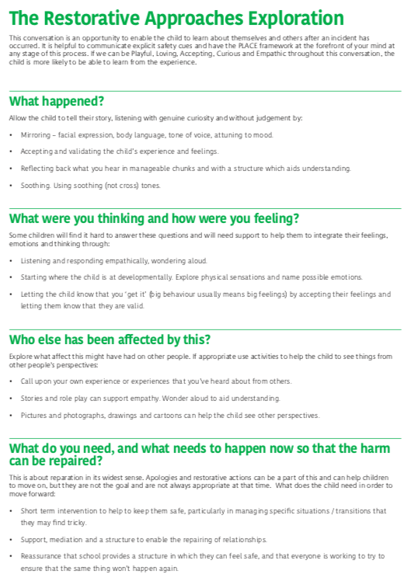
Repairing and Restoring

Slide 22
“Too often we forget that discipline really means to teach, not to punish. A disciple is a student, not a recipient of behavioural consequences”.
Daniel Siegel and Tina Payne Bryson – The Whole Brain Child. (2012)

Slide 23
Conversations to support de-escalation
Are you okay? Checking in / assessing the situation:
Attuning, validating, showing empathy and judging what happens now*
What’s going on? Explore what’s happening:
Describe the behaviour you have noticed from the child
Wondering aloud, with empathy, what you think might be going on
Invite the child to contribute their thoughts and feelings
Share your thoughts and feelings
What do we both need? Express what your needs are
“I need…”
What are we going to do now? Explore what is going to help to get things back on track
“I need you to…” / “Would you be willing to…”

Slide 24
Reparative conversations following conflict
A conversation / an exploration
Sharing our stories, feeling heard
Making sense of what happened
Understanding each other and each others needs
Working out together what needs to happen to repair
Consider:
Who is best placed to support this conversation?
When is the best time to do it?
Where is the best place to do this?

Slide 25
Restorative Questions / Prompts
What Happened?
What were you thinking? And since?
How were you feeling? And since?
How has it affected you? Who else has been affected and how?
What do you need and what needs to happen now so that harm can be repaired? What do you think might make things better?

Slide 26
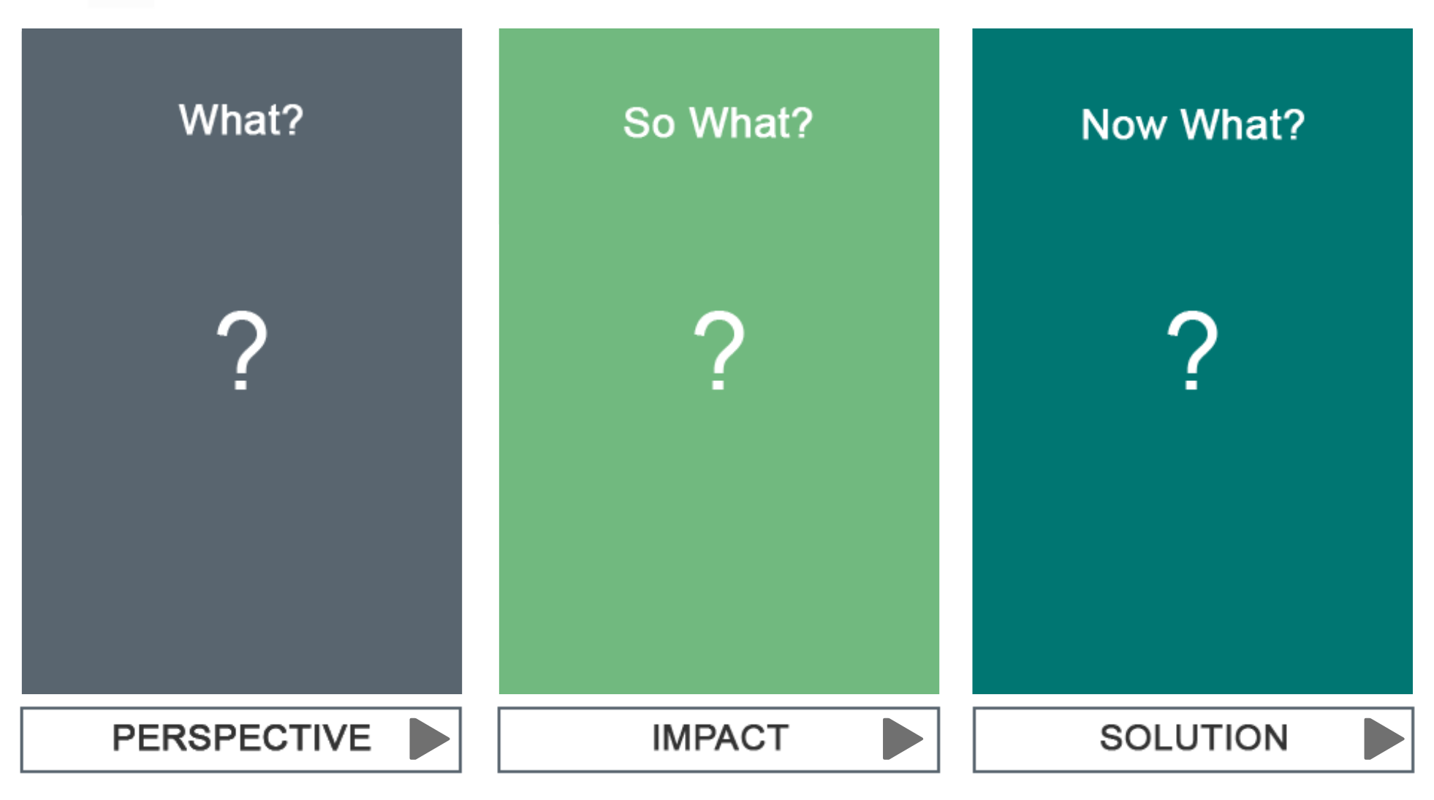

Slide 27
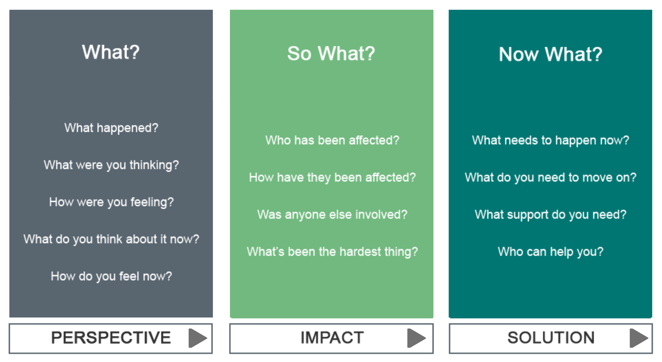

Slide 28
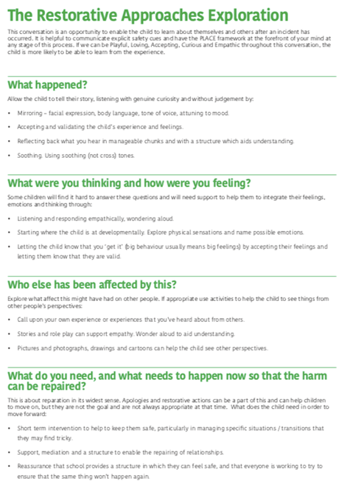
Repairing
Relationships

Slide 29
The Relational Approach in Practice
The second half of the guidance is about putting this work into practice, both universally and as a targeted approach. This includes sections on:
Relationships in the classroom – includes Relational skills and interactions as well as supporting processes and systems
A graduated response – includes a description of the assess, plan, do, review process.
Further supporting tools, frameworks and documents – including an amendable Relational Audit Tool for whole school use.

Slide 30
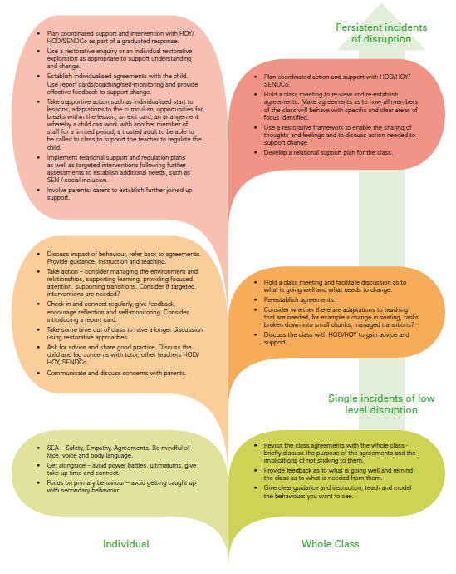
In the classroom

Slide 31
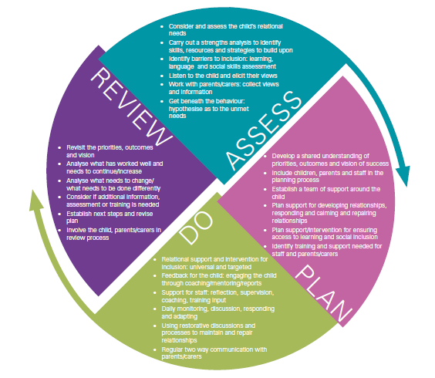
Graduated Response

Slide 32
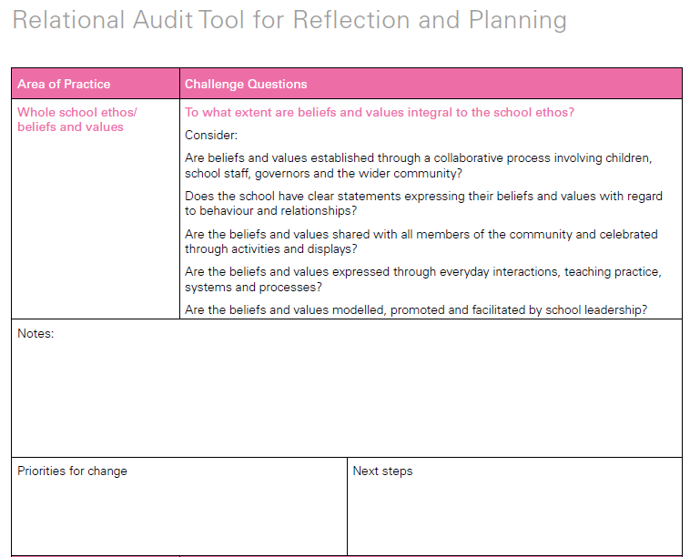
Audit Tool

Slide 33
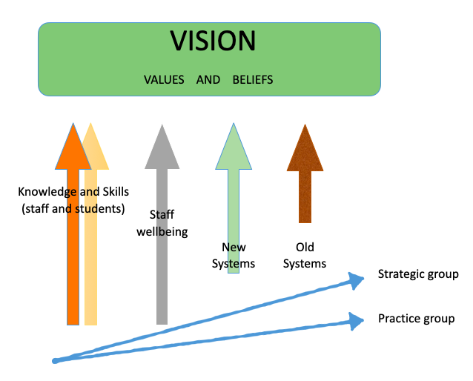
Supporting Change

Slide 34
Support for Schools
Schools expressed their interest at one of the following levels of support:
LEVEL ONE: Access to all RPP materials including four online modules exploring & explaining the Relational Approaches Model.
LEVEL TWO: Access to the above as well as bespoke consultancy, supervision and training in the Relational Approaches Model (estimated to be equivalent to 12 hours per school).
LEVEL THREE: Access to the above with an intensive and extended support package in order to become a beacon school in Relational Practice (estimated to be equivalent to 48 hours per school).

Slide 35
Challenges
There is no government agenda for this type of approach
Staff shortages.
Lack of co-ordinated support within the local authority and/or groups pf schools.
Perceived need for ‘quick’ results.
Lack of confidence in using restorative approaches when harm has been caused.

Slide 36
Impact and Evaluation
Impact to date:
Relational support plans and responsive co-regulation plans are working well – reduction in fixed and permanent exclusions and an increase in placement stability.
Where this approach has been used most extensively (virtual school) there has been a decrease in exclusions and most recently an increase in attainment.
Anecdotal evidence to suggest a positive impact regarding school ethos in the pathfinder schools.
Ongoing Evaluation:
Survey of the use of RSP and Co-Reg plans.
Termly headteacher/senior leadership interviews to document change.
Staff/student/parent focus groups.
Case studies of students most vulnerable to exclusion.

Slide 37
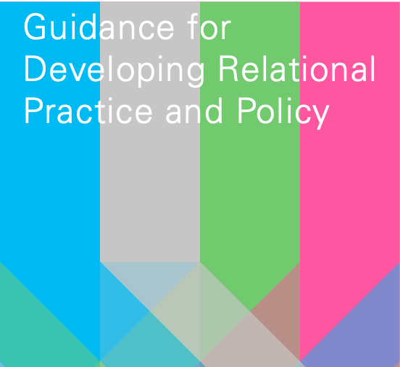

Slide 38
Further Reading
Settling to Learn: Why Relationships Matter in School - by Louise Bomber and Dan Hughes
The Boy who was Raised as a Dog - by Bruce Perry
The Polyvagal Theory - by Stephen Porges
Conversations that Matter: Talking with Children and Teenagers in Ways that Help - by Margot Sunderland
The Developing Mind - by Daniel Siegel
Just Schools: A Whole School Approach to Restorative Justice - by Belinda Hopkins

Slide 39
Additional info
The guidance document, as well as all supporting documents are available to download here:
devon.cc/relational-learning
catherine.dunnett@devon.gov.uk
matt.jones@devon.gov.uk

