Slide 1
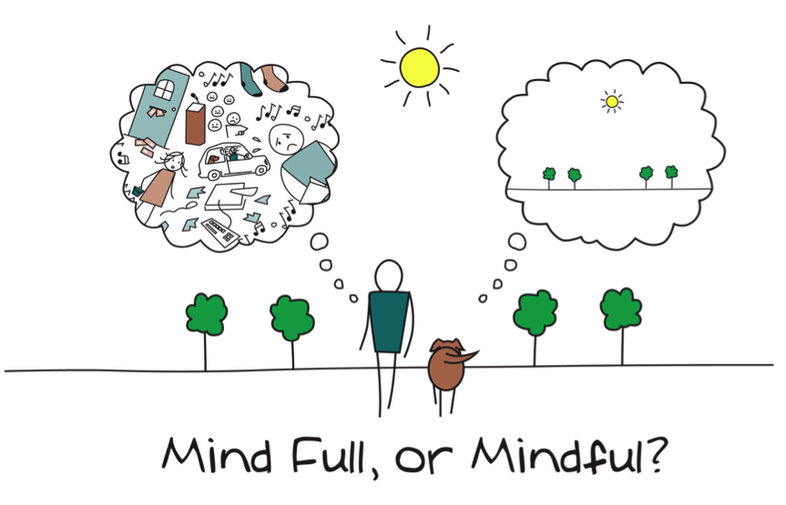
Mindfulness in the Early Years
Tameside Educational Psychology
Beth Shaw
Erica Douglas-Osborn
Notes:
Introduce selves – 1

Slide 2
What is on your mind?
Think of something that is on your mind; write it down; screw it up / rip it up and throw it away and relax and enjoy the session
Notes:
BS 2
In the interests of setting the scene for mindfulness
Not about getting rid of the problem. Just want to put it to one side for now so you can hopefully enjoy the next hour.

Slide 3
Aims
To understand what mindfulness includes.
To understand some of the benefits of using mindfulness with young children.
To practice some mindfulness techniques for young children.
To identify and discuss how mindfulness could be used within Early Years settings or as an EP working with young children.
Notes:
BS 1

Slide 4
Group Agreement
Respect each other
Trust/ Confidentiality
Make sure everyone gets a chance to speak
Be responsible for getting your needs met
Be willing to experiment
Bring and share your ideas
Only join in with what you feel comfortable with
Check in afterwards if needed
Notes:
BS 1
Respect each other – be mindful of what other people are sharing, listen to one another
Trust/ Confidentiality – again, safe space – don’t use identifying information and don’t share beyond this context
Make sure everyone gets a chance to speak – there is the chat function so feel free to share on there or unmute and share verbally if you’d prefer
Be responsible for getting your needs met – look after yourself this afternoon, if you need to take a break then you’re more than welcome to.
Be willing to experiment – some people might be really familiar with mindfulness, others less so, some may have tried it in the past and not like it but it would be lovely if everyone was willing to try this afternoon. And also being open when thinking about next steps and trying things in your settings.
Bring and share your ideas – some of you who use mindfulness might have some great ideas to share!
Only join in with what you feel comfortable with - safe space to share or not share as you choose
Check in with me

Slide 5
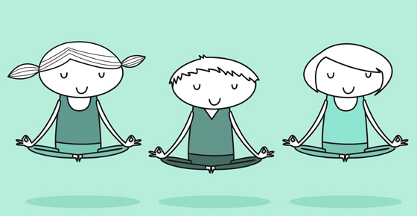
What is mindfulness?
Mindfulness refers to ‘the awareness that emerges through paying attention on purpose, in the present moment and non-judgementally to the unfolding experience moment by moment’ (Kabat-Zinn, 2003 p.145)
Notes:
BS 3
A mindful experience that most people have had is that moment when you’ve been on a walk, and you’ve reached the top of a hill where you can see for miles. And you take the moment to just look at the gorgeous view and breath. A perfect time for being in the moment and being present with what is going on around you. Smells, sight, breeze
The reason this is a great time to be mindful, is that there is nothing to distract you. You’ve put in the hard work and you’ve got time and space to be present. Mindfulness isn’t something we can do when we’re really busy. We need capacity and time and space to be mindful, and we need to give ourselves that time to do it successfully. We need to, as far as possible, recreate the experience of being at the top of a hill and thinking about nothing but the present moment.
For me, exercise is a great time to be mindful. Sometimes that’s during a yoga practice, which is more typically related to mindfulness, but any type of exercise works for me.
It’s a time to tap into the way my body feels, which parts of my body are working? Does my body feel different to when I last worked out? How does the weight feel in my hand, or how does the mat feel beneath my back, or my feet in my shoes?
Breath is important in exercise, so it makes me focus on my breath, breathing in and breathing out at the right part of movements, and being mindful of the rate of my breathing.
A great time to practice acceptance. Being mindful is also about recognising when an unwanted thought pops up, acknowledging it, accepting it and refocussing. So when exercising, there’s bound to be times when I wish the time would go more quickly, or I had fewer repetitions to do, because my legs or arms are aching. So it’s a perfect opportunity to practice accepting how I’m feeling (as long as I’m not injured!) and refocussing on my purpose for being there, or back onto my breath, for example.

Slide 6
Features of mindfulness
Attention to the present moment | Beginner’s mind
Awareness | Trust
Self-compassion | Non-striving
Non-judgement | Acceptance
Patience | Letting go
Notes:
BS 3
Attention to the present moment – focussing on what is happening, sometimes breath, sometimes surroundings
Awareness – being aware of what is going on around you (think about 5 senses)
Self-compassion – allowing yourself to appreciate who you are without criticism or blame.
Non-judgement – being impartial to any experience, i.e. thoughts, feelings or body sensations.
Patience – Being balanced within mindful practice. It might be hard to begin with, and unwanted thoughts might creep in. But accept this, and be patient, and bring yourself back to the present.
Beginner’s mind – being willing to see everything as though it is for the first time. With fresh eyes, being curious
Trust – having faith in the validity of our own experiences and trusting in your feelings.
Non-striving – not wanting to achieve anything in that moment, just letting what happens happen. Thoughts and experiences will come and go, and we can allow that to happen, without forcing things or working towards a goal.
Acceptance – Links to non-judgement, just accepting the thoughts that come and go, the feelings and body sensations you experience. If it is a negative thought, acknowledge, accept and re-focus.
Letting go – letting things be as they are, letting go anything from earlier in the day or things you have to do next week.

Slide 7
How are you mindful?
What do you do in your daily lives whereby you may be practicing mindfulness (consciously or unconsciously)?
How could you be more mindful?
It is really important to practice being mindful in order to teach it.
Notes:
BS 3

Slide 8
Mindfulness in schools/ organisations
Recognised by NICE and is increasingly used in preventative and well-being programmes
Ofsted Framework (2015)- schools have a duty to support children’s well-being and mental health.
Recent large scale systematic literature review (Maynard et al., 2017) indicates benefits to children’s cognitive skills (e.g. executive function, memory, attention) and social-emotional wellbeing (e.g. reductions in anxiety, stress, internalizing behaviours, improved social skills, self-regulation, self-esteem and engagement).
Notes:
BS 3
Mindfulness is recognised by the National Institute for Health and Care Excellence who produce evidence based guidelines and recommendations for heath and care in Endland.
Used in preventative and well-being programmes – delivering EFS whole-school wellbeing sessions and mindfulness features in that. Mindfulness for practitioners and for pupils
Ofsted Framework (2015) – we know that schools and settings have a duty to support children’s well-being and mental health. And research suggests that education settings are a great provider of this, because the children with be in school so they can access it, they don’t feel stigmatised there. So it’s a great place to be practicing preventative well-being strategies such as mindfulness.
A scale systematic literature review by Maynard et al. identifies benefits to children’s cognitive skills
(e.g. executive function, memory, attention)
and social-emotional wellbeing (e.g. reductions in anxiety, stress, internalizing behaviours, improved social skills, self-regulation, self-esteem and engagement) so it has broader impact. And, as with lots of preventative suggestions, putting the time in early can really give that time, and more, back in the long term!

Slide 9
Mindfulness in the Early Years
Growing attention in terms of using mindfulness in the Early Years (Kindness Curriculum).
Research demonstrates increasing numbers of children with attention difficulties at a young age (DiCarlo et al., 2016; Rabiner, Godwin & Dodge, 2016). Children with attention and listening difficulties are often at risk of poorer outcomes.
Case study using mindfulness in a nursery and reception class found that staff reported the children to be calmer and more ready to learn (Holt, Atkinson, Douglas-Osborn, 2019).
A preliminary study carried out with 21 preschool children, assigned randomly to either a group accessing mindfulness or a control group, showed significant improvements in prosocial behaviour, including improvements in self-regulation. (Berti & Cigala, 2020)
Meta-analysis of 21 studies focussing on 3- to 12-year old children showed that teacher reports suggest a significant improvement in children’s overall inattentive and hyperactive-impulsive behaviour following mindfulness-based interventions. (Vekety, Logemann & Takacs, 2021)
Notes:
Half an hour left
BS 3
Growing attention in EYs
Increased number of children with a attention difficulties at a young age – and these are at risk of poorer outcomes. Mindfulness is great for practicing attending to surroundings and experiences, and the things you’re focussing on don’t need understanding so it takes away the potential barriers that cognitive ability etc has on attention on, e.g., play or learning activities. And as we know, mindfulness is great for children’s cognitive skills (e.g. executive function, memory, attention) so will help with attention difficulties.
Case study in 2019, involving Erica, found that using mindfulness in a nursery and reception class found that staff reported the children to be calmer and more ready to learn . Which again fits with the improvements on cognitive and social, emotional wellbeing (e.g. less anxious)
Preliminary study in 2020 – mindfulness led to improvements in prosocial behaviour including self regulation.
More recently – 2021 – meta analysis suggested that mindfulness led to significant improvements in attention and reduction in hyperactive and impulsive behaviours.

Slide 10
SETTING THE SCENE…
When supporting EY settings to think about developing mindfulness, need to think about:
Developing a theme – sign / picture / visual reference / music / mindfulness buddy
Developing a routine – how many times a day / when / where / how to start?
Being flexible
Notes:
EDO 4
Getting comfortable/relaxed
Theme/visual reference - In some settings a star has worked really well – ‘it’s time for mindfulness’ children recognised that’s what the star meant
Hold up the star – and say ‘it’s time for mindfulness’ – helped children prepare.
EDO tried mindfulness buddies which some say are helpful but they didn’t support the sessions in the nursery in which she carried out case study
Routine - Where children are in full time maybe just once/day – if some are in full time and some only in am/pm may want to work towards doing twice per day
Do you want it to be after a break time to help them settle down? Whatever would work best for the setting. Important to consider where – if in the classroom important other staff recognise the importance. Use of a sign on the door to ask staff not to come in. make sure it is protected time.
Eyes closed – EDO found wasn’t helpful. But different settings might find differences/have different preferences.
Flexible - Ideally want it part of a routine but some days it may not be possible and that is ok

Slide 11
Mindfulness activities
Teaching about breath
Guided imagery

Slide 12
TEACHING ABOUT THE BREATH…
What is breath?
How could we teach this?
Notes:
EDO 4

Slide 13
TEACHING ABOUT THE BREATH…
Use of the hand
Blowing windmills
Blowing bubbles
Rainbow/finger breathing
Use of scripts vs ‘making it up’
Notes:
EDO 2

Slide 14
TEACHING ABOUT THE BREATH…
Breathe on the hands
Everyone sit comfortably on your bottoms.
Let’s get ready for mindfulness.
Bring your hands up to your mouth
You should see the tops of your fingers (children may need further prompting about where to place their hands so they are in front of their mouths)
Slowly open your mouth and blow
Breathe in and blow out
Breathe in and blow out
Feel your hands get warm
**
Slowly put your hands back on your knees.
1b. **Add (once children have got used to breathing onto their hands you can extend the activity):
Blow a big breath
Feel as your hands get warmer
They might feel hot
Then they might feel cold
Then they might feel hot
Notes:
EDO 3
Start each activity with the same sentence – routine, familiarity, repetition

Slide 15
TEACHING ABOUT THE BREATH…
Rainbow breathing
Everyone sit comfortably on your bottoms.
Let’s get ready for mindfulness.
Put your hands together
Breathe in
Lift your hands together in the air
Breathe out
Make a rainbow with your hands
Put your hands together
Breathe in
Lift your hands together in the air
Breathe out
Make a rainbow with your hands
(Can do this as many times as works well)
Slowly put your hands down onto your knees.
Notes:
EDO 2
Including some movement helped the children to focus

Slide 16
Guided imagery
Short stories which create imagery – use of movement (to support children’s engagement).
Add to existing structure – breathing activities then guided imagery.
Notes:
EDO 2
Once children are able to do the breathing activities can introduce guided imagery
Help the children focus on something – seeing something in their mind. Activities can be slightly longer.
Can do a breath activity and then a guided imagery – extend the mindfulness session

Slide 17
Writing Guided imagery
Chose a topic that a child/the children may like – can link to the curriculum
Make it short and use simple language (use language that you are comfortable with)
Include movement
Add additional stimulus, e.g. picture on the whiteboard/sound/smell/related objects
Practice your scripts
Have a consistent way of introducing your imagery and in ending it
Notes:
EDO 5
There are ready-to-go guided imagery activities, e.g. in EDO’s book but you/settings can write your/their own.
When we talk to settings about this we get them to think about…
Chose a topic that a child/the children may like – can link to the curriculum – e.g. seasons, going for a walk in the woods during a particular season
Make it short and use simple language (use language that you are comfortable with)
Include movement – sitting still can be really tricky for some children, want them to be able to move in a way that helps them to be mindful
Add additional stimulus, e.g. picture on the whiteboard/sound/smell/related objects
Practice your scripts
Have a consistent way of introducing your imagery and in ending it – helps with the routine and consistency, even when doing different activities

Slide 18
Reading Guided imagery
Take a deep breath - make sure that you are feeling calm and relaxed.
Tune in where possible to the child/children working with- recognise their mood. Sometimes start louder or faster and get slower to support the class to calm down.
Leave spaces between your words to give the child/children some time.
Speak very slowly, put a slow, calm rhythm to your voice. (It may be helpful to practice)
Model any breathing and movements to the child/children in order to show them what to do.
Enjoy it!
Notes:
EDO 3
Take a deep breath - make sure that you are feeling calm and relaxed. If you’re stressed, maybe someone else could do the session on that occasion
Tune in where possible to the child/children working with- recognise their mood. Sometimes start louder or faster and get slower to support the class to calm down.
Leave spaces between your words to give the child/children some time.
Speak very slowly, put a slow, calm rhythm to your voice. (It may be helpful to practice) - automatically makes your voice more calm.
Model any breathing and movements to the child/children in order to show them what to do.
Enjoy it! – time for you to be mindful and calm.

Slide 19
Sunshine
Everyone sit comfortably on your bottoms.
5…4…3…2…1
Breathe in and out, in and out, we are going on a sunshine adventure. Pretend you are outside. It is a lovely day. The sun is shining. Lift your hands up and touch the shining sun. Stretch up high. Touch the sun. Bring your hands back down. Lift your hands up and touch the shining sun. Stretch up high. Touch the sun. Bring your hands back down. Lift your hands up and touch the shining sun Stretch up high. Touch the sun. Bring your hands back down. Your body feels warm from the shinning sun. Let’s say goodbye sun. Let’s go back to our calm, quiet, warm classroom.
5…4…3…2…1
Notes:
EDO 2
Explain the importance of the structure of the guided imagery, e.g. the count down / ‘Let’s go back to our clam, quiet, classroom…’

Slide 20
Action planning
What might you do next following this session?
When are you going to start?
Who is going to help you?
What might you do first?
Notes:
BS 3
These questions are here to help you think about that.
Who thinks they will go away and plan to do some mindfulness - where will you start?
Do you need anything else from us to support you with this.

Slide 21
BODY SCAN
Lying down breathing
Everyone lie down comfortably on the floor.
Let’s get ready for mindfulness.
Take a big breath in and out, in and out.
Feel your toes, breathe in and out.
Feel your feet, breathe in and out.
Feel your legs, breathe in and out.
Feel your bottom, breathe in and out.
Feel your tummy, breathe in and out.
Feel your chest, breathe in and out.
Feel your fingers, breathe in and out.
Feel your hands, breathe in and out.
Feel your arms, breathe in and out.
Feel your face, breathe in and out.
Feel your head, breathe in and out.
Feel your body, breathe in and out, in and out.
Slowly sit up onto your bottom.
Notes:
EDO 3

Slide 22
Thank you for listening
Erica Douglas-Osborn Erica.Douglas-Osborn@Tameside.gov.uk
Beth Shaw Beth.Shaw@Tameside.gov.uk
Mindfulness in the Early Years Book: Mindfulness in the Early Years : Douglas-Osborn, Erica: Amazon.co.uk: Books
Notes:
EDO

