Slide 1
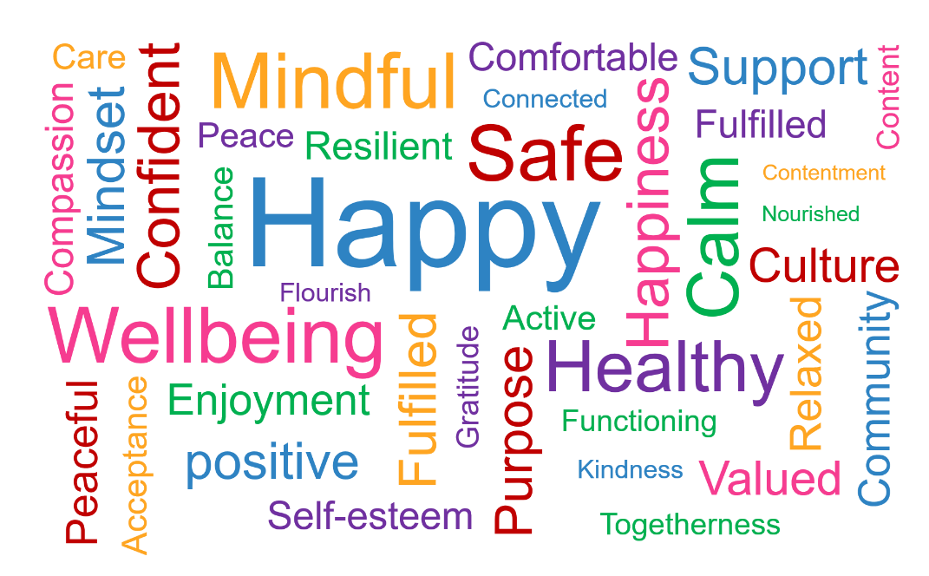
Evaluation of the EPS School Staff Wellbeing Project
Educational Psychology Service
Dr Sarah Finnegan and Dr Carol Strahan

Slide 2
Can you share an example of good support that you received from a manager? How did this support your wellbeing?

Slide 3
Origins

Slide 4
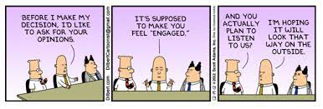

Slide 5
Rationale
In the UK 70 million workdays are lost each year due to workplace mental health issues, costing employers approximately £2.4 billion per year (Together for You, 2018)
In Northern Ireland, mental health issues are the leading cause of workplace absence, accounting for 31.9% of working days lost and 39.1% of long-term sickness leave (Action Mental Health, 2018)
Northern Ireland has the highest prevalence of mental health issues in the UK, with a 25% higher overall prevalence of mental health problems than England
A report from Education Support (2019) suggests that work-related stress appears to be rising – teachers reported increasing levels of stress over 3 consecutive years
34% of teachers reported experiencing a mental health issue in previous year, 84% of SMT reported high levels of stress, and more than half (57%) of educational professionals claimed they had considered leaving their jobs in the last two years due to health and wellbeing pressures

Slide 7
Project Aims
To identify a Health and Wellbeing Lead
To promote the emotional health & wellbeing of school communities by effectively supporting staff in creating a culture that emphasises the importance of staff wellbeing
To provide effective evidence-based training focusing on staff wellbeing
To support school staff in developing a comprehensive yet user-friendly staff wellbeing policy as a component of the school development plan
To develop a peer support network for staff wellbeing facilitated through the termly cluster groups across NI

Slide 8
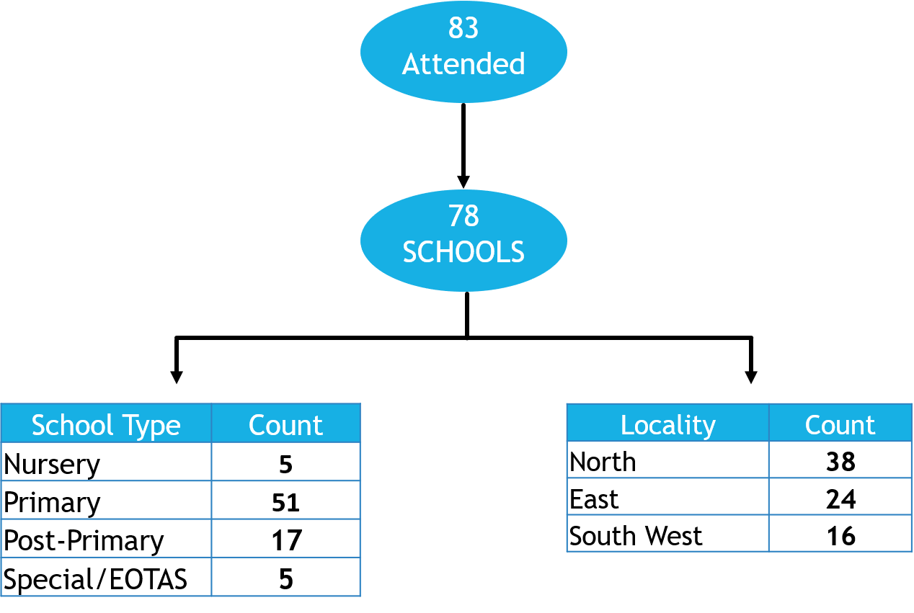
Who Attended?

Slide 9
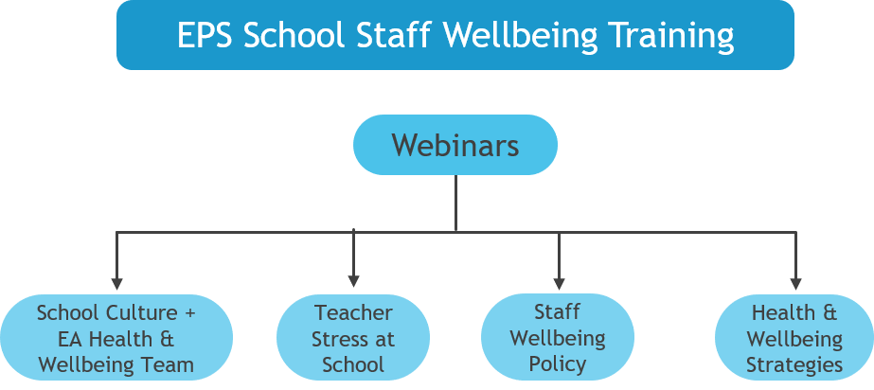
Training Design

Slide 10
Webinar 1: School Culture
An Environment of:
Trust
Safety
Vulnerability
Build a sense of collective efficacy:
Clear communication
Collaboration- Learning
Psychological Wellbeing

Slide 11
Webinar 2: Teacher Stress Within The School Environment
Teacher stress and stressors on staff
The impact of Covid-19 on teachers’ stress
Staff burnout and how to identify the signs
The Bioecological Model – Bronfenbrenner (1994)
What protective factors are in place in schools and what could be better? -discussion
Managing stress / anxiety and self-care

Slide 12
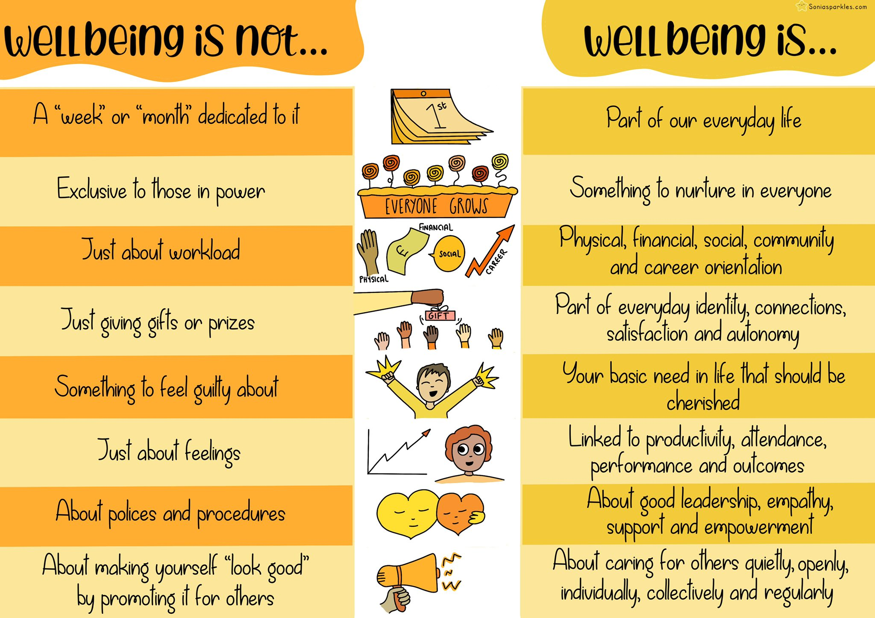

Slide 13
Webinar 3: Policy and Peer Supervision
Whole School Approach to Mental Health & Wellbeing
Whole School Approach to Wellbeing
Role of Wellbeing Lead
School Development Plan and Policy
Introduction to Peer Supervision

Slide 14
Webinar 4: Toolkit for Wellbeing
PERSONAL GROWTH: Reward and recognition, supervision, self-care, CPD
RELATIONSHIPS: Effective leadership, collegiality, communication
BASIC NEEDS: Environmental adaptations, workload, work-life balance

Slide 15
Impact evaluation – The Kirkpatrick Model (1976)
Level 1: REACTION -The degree to which learners have found the training to be relevant to the role, engaging and useful.
Level 2: LEARNING - The degree to whether the learner has acquired the knowledge, skills, attitude, confidence, and commitment that the program has focused on.
Level 3: BEHAVIOUR - The degree to whether behavioural changes have occurred after learning- if the learners are taking what they learned in training and applying it as they do their job.
Level 4: RESULTS - The impact the training has had on the broader organisational goals and objectives

Slide 16
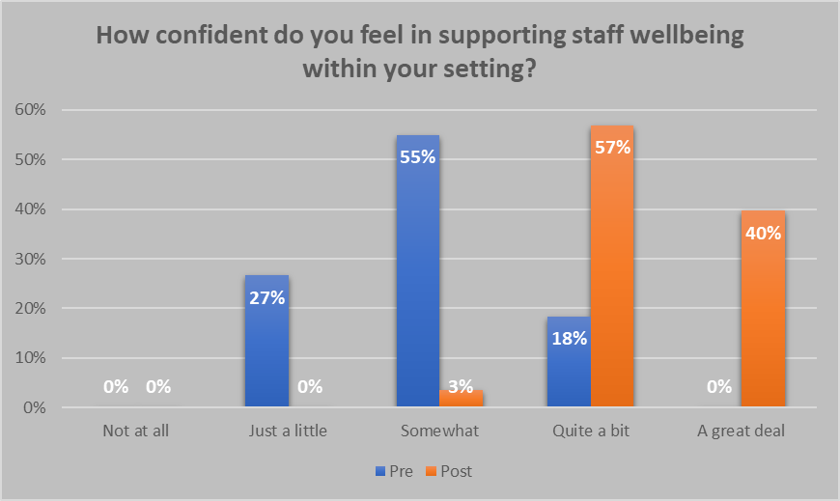
Results

Slide 17
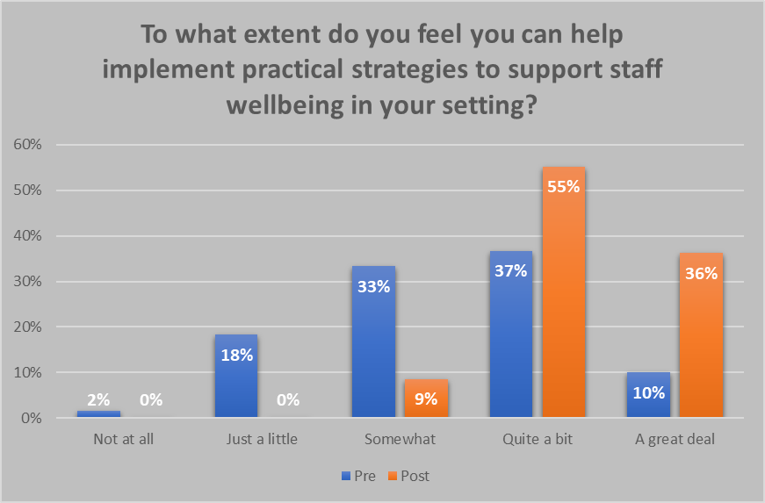
Results

Slide 18
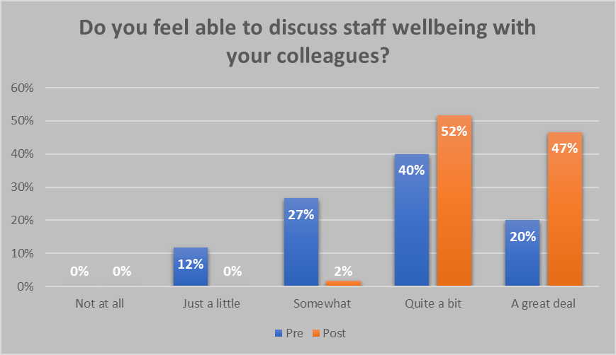
Results

Slide 19
Thematic Analysis
Thematic Analysis
Learning
Confidence/ Motivation
Transfer of Learning
Support
Training Format

Slide 20
Conclusions and Limitations
The evaluation of the training indicates that participants increased:
their knowledge and confidence in supporting staff wellbeing and developing a staff wellbeing policy.
more confident in talking to SMT about staff wellbeing and implementing practical strategies to support staff wellbeing in their setting.
participants felt supported and encouraged throughout the training. It is anticipated that this support will continue through the facilitation of cluster groups
Time Constraint

Slide 21
Next Steps
Training will be delivered to more schools and nurseries in 2023
Elements of the training should be expanded and developed in response to participant feedback and cluster group suggestions e.g. focusing more on peer supervision models
Appreciative Inquiry in September 2022
Cluster groups will continue to run

Slide 22
Loughshore Education Resource Centre – Wellbeing Tree

Slide 23
EPS session 4: General Wellbeing Strategies
“It must be emphasized that wellbeing is the right but also the responsibility of every single member of staff; no one person should bear the burden.”
Identify a ‘Health and Wellbeing Lead’ – collaborating with all staff, SMT, and external Agencies e.g., Women’s Aid, Inspire, Light House, Mind, E.A , Carafriend, E.A Wellhub, Restorative Practice, University of Ulster Relational Learning Initiatives.
Enshrine staff wellbeing in policy – draft policy to be ratified.
Promote openness – Anonymous staff surveys / findings were shared, and action plans based on these.
Offer supervision –Post Serious Incident Buddy System (4 respected staff members)
Consider communication – Email only during office hours, ongoing staff consultations e.g. Nurture Analysis for a Nurture Action Plan. Termly Student Voice

Slide 24
EPS session 4: General Wellbeing Strategies
Foster relationships – Ongoing Wellbeing Wednesdays and now occasional Fat Fridays (serving cooked Breakfasts for staff by staff) We have completed University of Ulster Taking Boys Seriously Relational Learning Programme (see final slide).
Raise awareness – Online shared staff/student newsletter promoting Wellbeing, Wellbeing Noticeboards.
Reconfigure workload – ongoing shared ideas using a Wellbeing and Nurture based approach.
Appraise and appreciate – Ongoing celebration and collaboration, Restorative Practice culture
Adapt the environment – We are developing a Nurture, restorative practices and Wellbeing Based School culture.

