Slide 1
The AEP’s diamond jubilee: a celebration of 60 years as an association and an exploration of where we should go next
AEP Annual Conference
10th November 2022
@AEPsychologists #AEPConference22
Kate Fallon General Secretary Association of Educational Psychologists

Slide 2
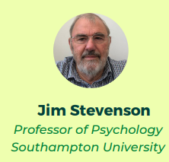
This year’s conference…

Slide 3
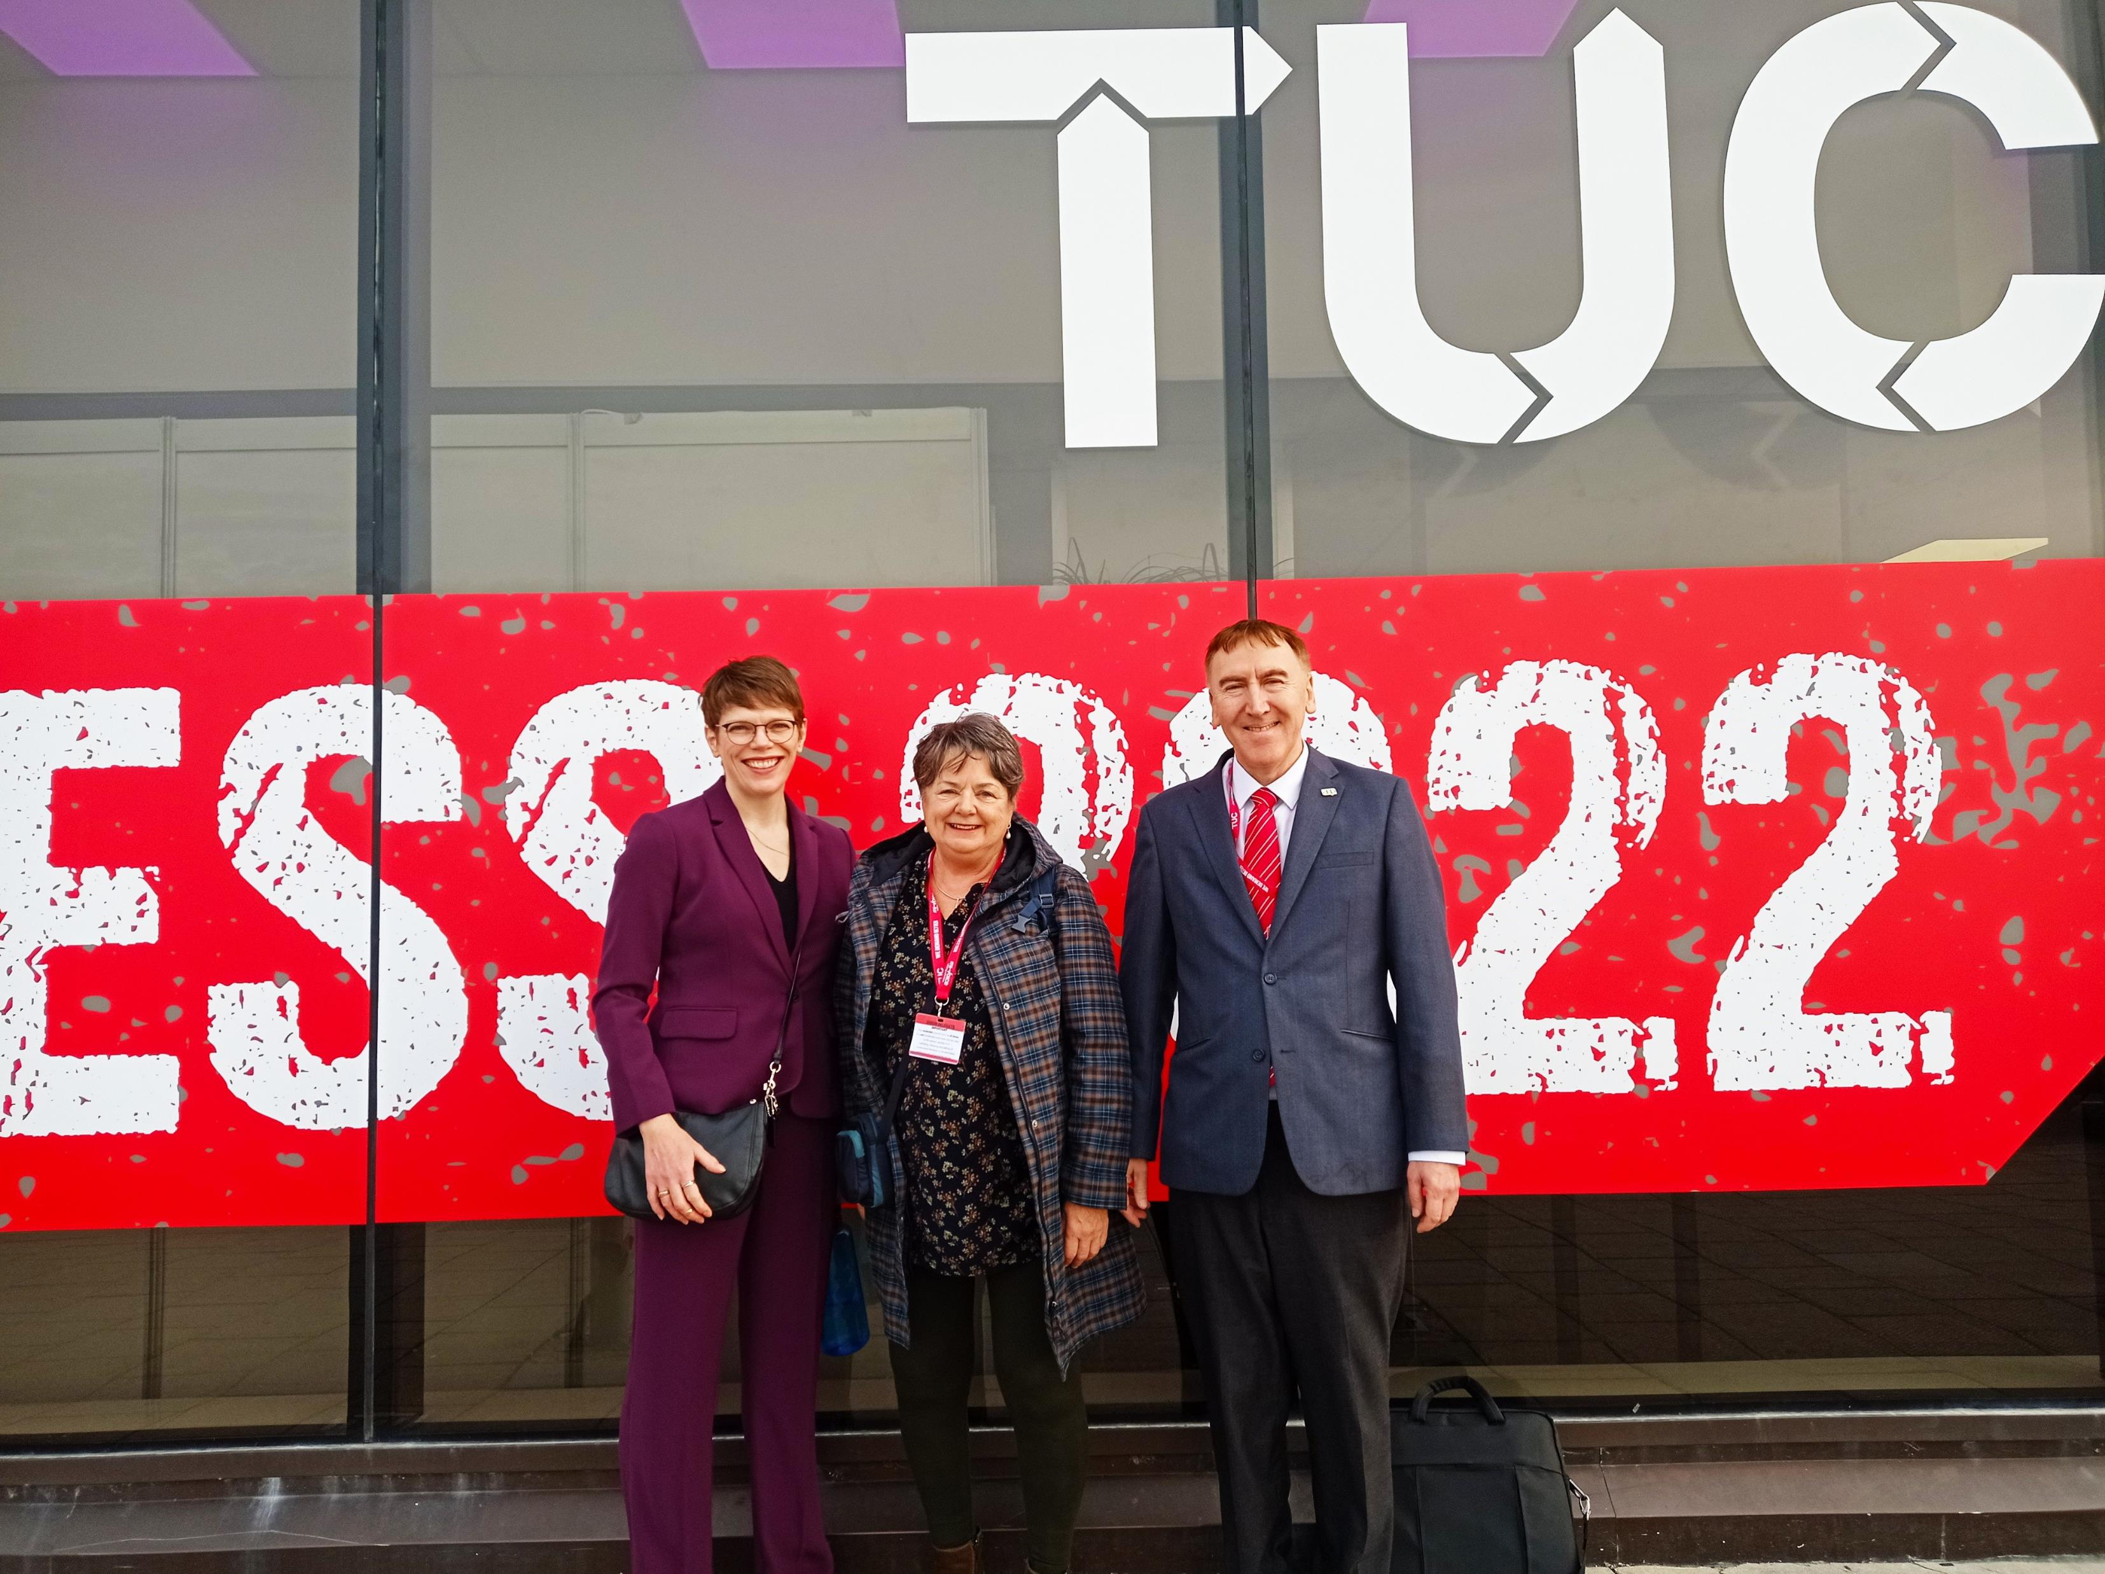
The AEP: 2009 – Present…
TEPs & NQEPs in the AEP
Assistant EPs in membership
A new AEP website
204 training places in England
Connect Public Affairs
TUC Congress motions
Growing staff team
TEP Conference
Annual conferences nationwide
Campaign for Equal Protection for Children – legislation in Wales
Digital Communication & CPD

Slide 4
“Hope” is the thing with feathers –
That perches in the soul –
And sings the tune without the words –
And never stops – at all
Emily Dickinson

