Slide 1


Restrictive Practice: The Experiences of Children and Young People and School Staff
Katherine Stothard, Kirsty Mullowney, Bethany Hodgkiss and Ellen Quinn
Notes:
KS Hi,
Intros for all, aep commissioned research at uni of Mcr

Slide 2
Overview of research
Katherine Stothard and Kevin Woods – Understanding the experiences and views of children and young people who have experienced physical intervention in school.
Bethany Hodgkiss and Emma Harding – Further exploring the experiences of children and young people, including their ideas around alternative strategies to physical restraint.
Kirsty Mullowney and Catherine Kelly – My research has focused on the advice available to schools about positive handling practice, and how they are implementing it in real world practice.
Ellen Quinn and Emma Harding – exploration of the views and experience of seclusion, from the perspective of secondary school staff and students in a pupil referral unit.
Notes:
KS

Slide 3
Presentation overview
Why research the use of restrictive practices in education settings?
Definitions of restrictive practice
Voice of the child – existing research, data gathering processes, current research and exploration of alternatives.
Voice of the education professionals.
The role of relationships and perceptions in the context of restrictive practice.
Notes:
KS

Slide 4


Rationale for research
• Education Act – introduction of reasonable force
• Confusing government guidance and discrepancies between the systems in place for children’s care settings vs schools.
• Lack of laws – reporting and recording, specific to restraint and seclusion. (ABH, GBH, Human Rights)
• High stakes nature of the issue for schools and local authorities – allegations, pupil wellbeing, staff wellbeing and safeguarding.
• Challenging Behaviour Foundation 2019/2020
Gap in research
Notes:
BH
2013 – ed act outlined use of reasonable force in schools e.g. preventing harming self or others. But also includes "professional judgement" and preventing "disruptive behaviour."
Challenging beh foundation – surveyed families of pupils who had been restrained – they found that reasons behind restraint use were sometimes vague, not always recorded. Also physical and emotional harm to pupils. 71% respondents experienced isolation and common themes included lack of reported action after isolation to reduce future incidents.
Lack of laws around recording and reporting physical restraint – it is encouraged as "best practice", but not legally enforcable. Instances in media where parent/carers haven't realised restraint had been used until later on in the year.

Slide 5
How do we define restrictive practice?
Go to:
www.menti.com
and use the code:
5202 8929
Name the different types of restrictive practice.
Notes:
KM

Slide 6
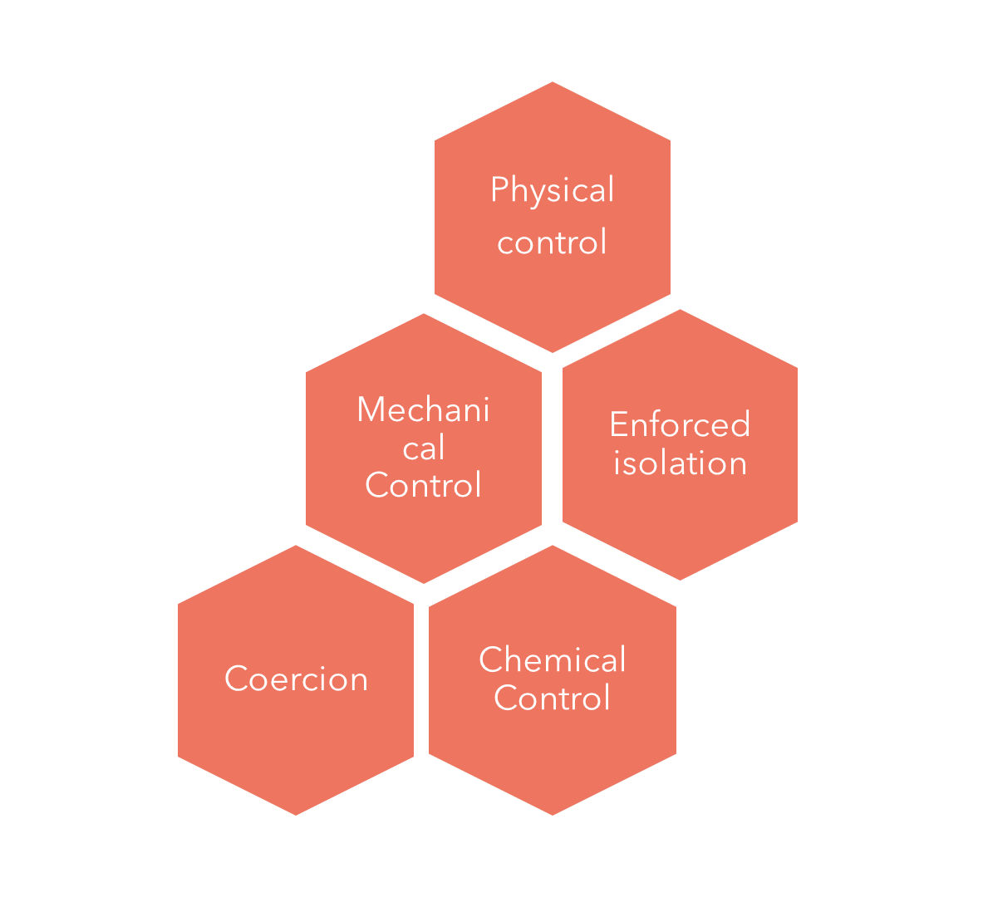
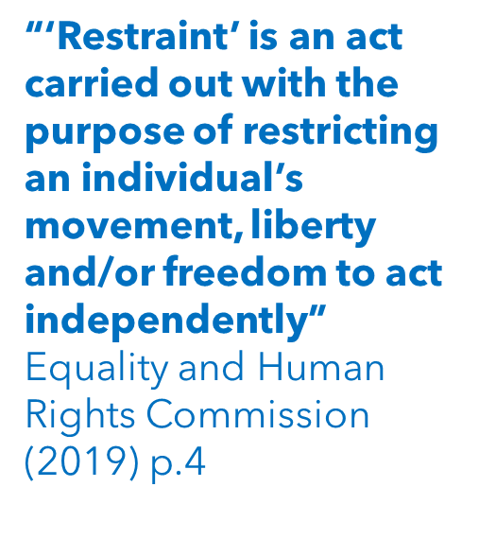
How do we define restraint?
Go to:
www.menti.com
and use the code:
5202 8929
Name 3 different types of restraint.
Notes:
KM

Slide 7
ACCESSING THE VIEWS OF CHILDREN/YOUNG PEOPLE WHO HAVE EXPERIENCED RESTRAINT IN SCHOOL
Notes:
Thesis structure –slr, then empirical – talk about slr first

Slide 8
Children and young people’s views and experiences of physical interventions in non-residential education settings: A systematic literature review
Seven studies: mixed quality; mixed methodology; mixed focus
Notes:
-Anecdotally – lots of research – referring to social care/residential settings where there is lots of research (Morgan – ofsted reports), interesting minimal research in mental health where restraint used with CYP (Nielson). Diff expereinces?
- usual methodology -
- inclusion criteria: cyp up to 25yo, school setting, restraint/physical intervention, views
- 4 UK, 3 US
Limitations
– US restraint allowed diff – able to generalize?
Limited age ranges 10-15
Boys!
Some didn't state ethnicity – particularly UK ones – higher rates of exclusions for black caribbean students – ethnicity is important....

Slide 9
Findings
Negative impact on CYP
Some reports of positive impact
Only to be used in last resort situations
Definitely not as a classroom management strategy
Impact on relationships with teachers and peers
Power differential between adults and children in school
More, high quality research needed!
Notes:
Narrative synthesis (bearing in mind limitations...!)

Slide 10
Questions left with....
Can we access the views of children/young people who have been restrained?
What is the best way of accessing these views?

Slide 11
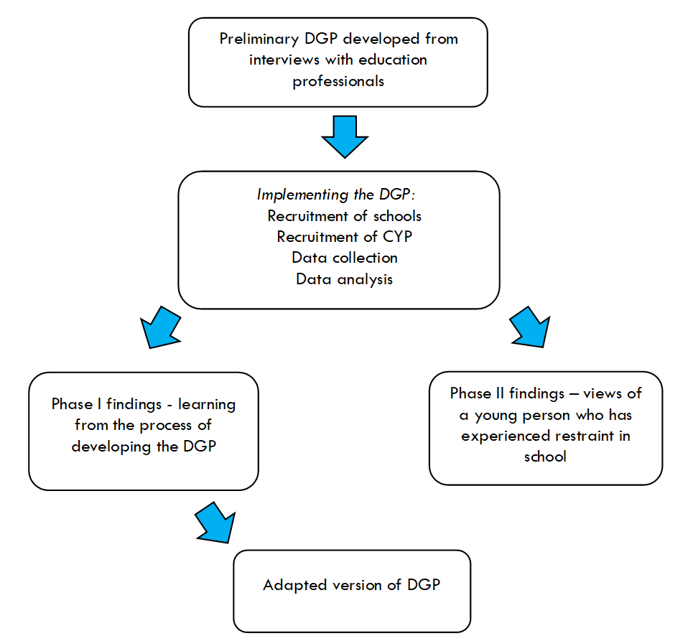
Developing a Data Gathering Protocol
Notes:
Process talk through
Impact of covid – recruitment nightmare, but allowed to hone in and look at process in detail that wouldn’t have otherwise.
11 schools
12 children identified
1 child!!!
Additions following development phase:
- Original was school staff focused – preliminary research
Development phase allowed CYP views and real world things we hadn't thought of:
choice of activity for data collection,
cyp needs – hard to reach – additional needs - additional sessions to allow research relationship to develop, close process (emotions – trauma?,),
how would like to get feedback on analysis for member checking (pictures...!),
Adapted version – used more widely, parents and teachers? Ellen – seclusion. Available for other sensitive topics.
how would like adults to see results: art and my words
Chose pseudonym – Tony Stark :)

Slide 12
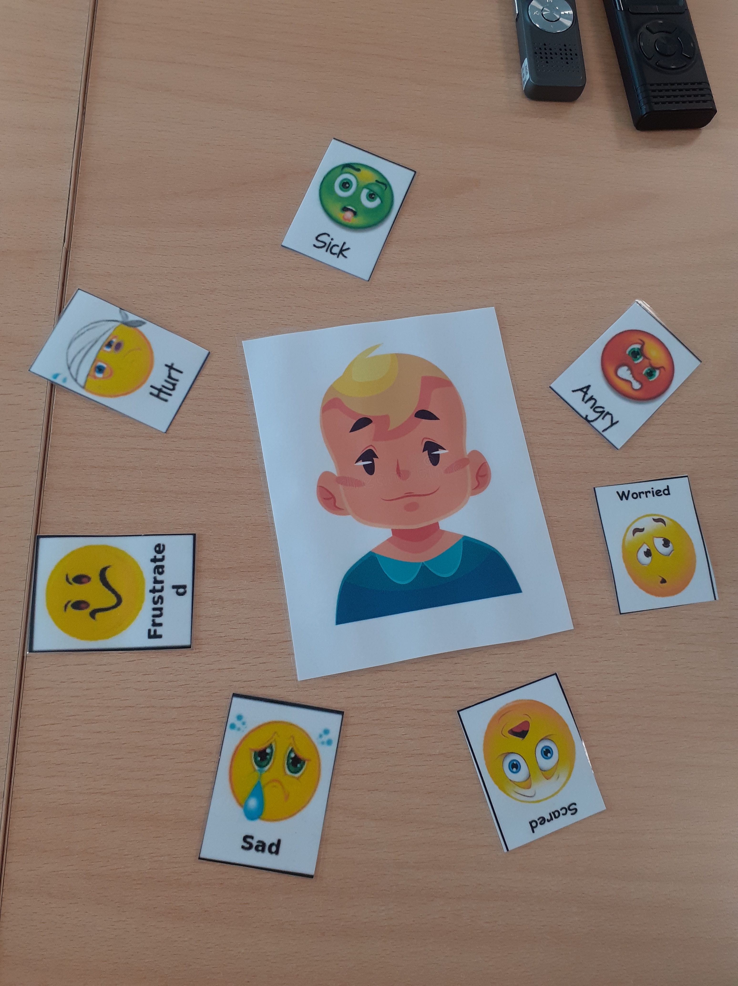
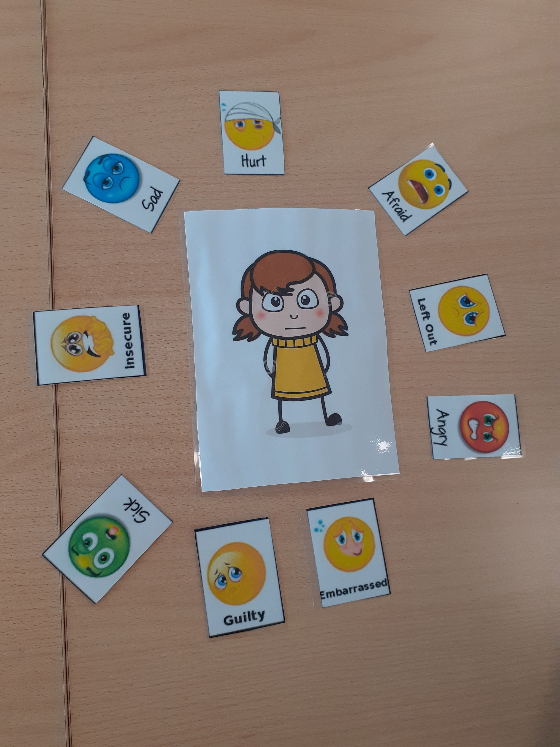
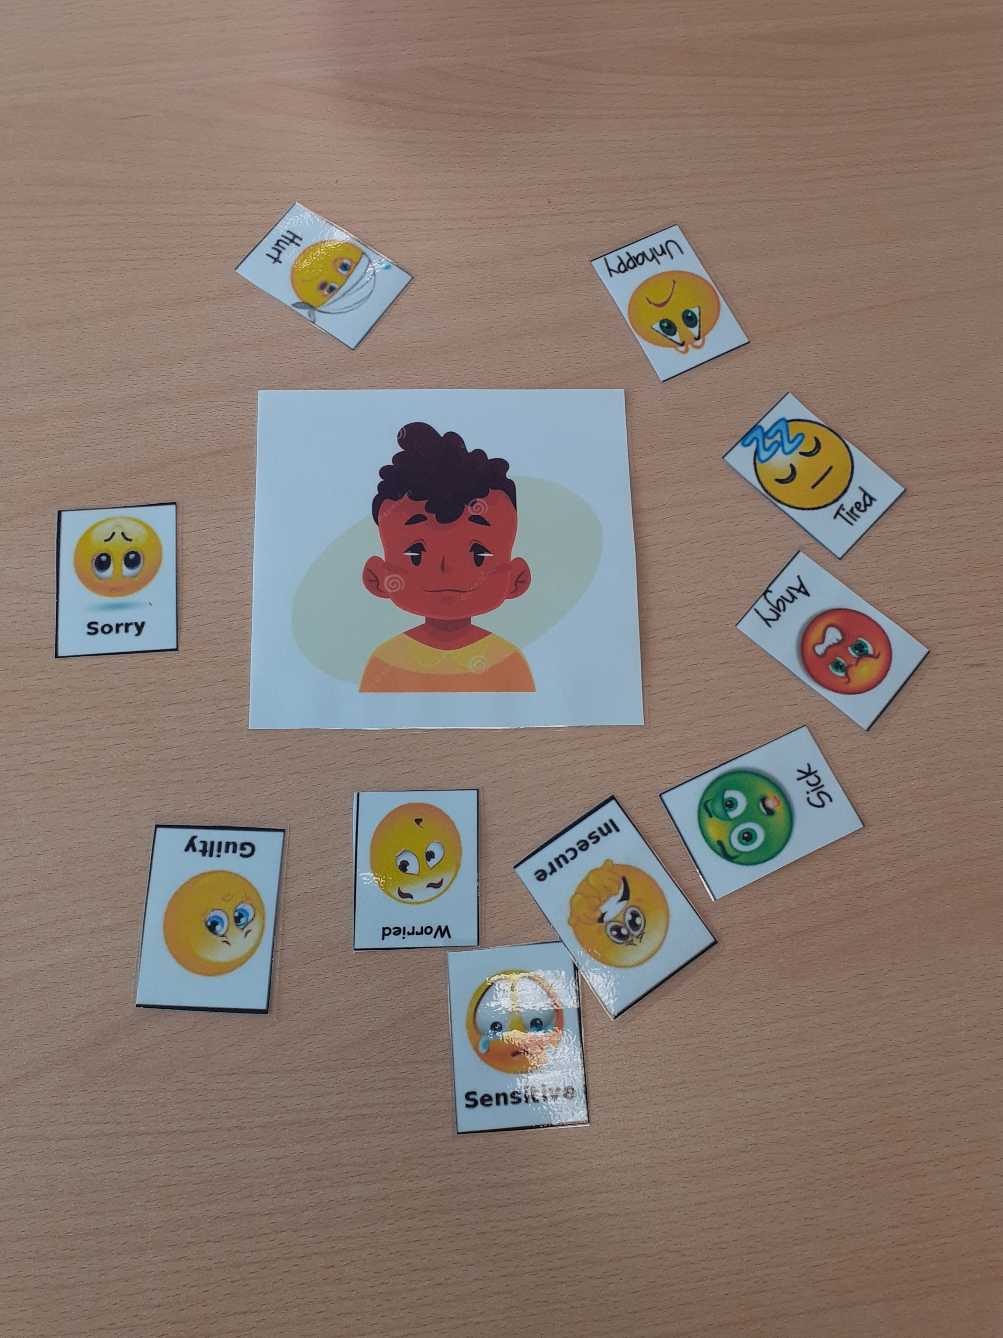
Emotions before/during/after restraint
Notes:
Process
Anger
Sadness
Guilt
Embarrassment and worry - in front of friends
Worry/fear/uncertainty will it happen again
Long lasting – after restraint – forgotten incident but remember emotions. Trauma?

Slide 13
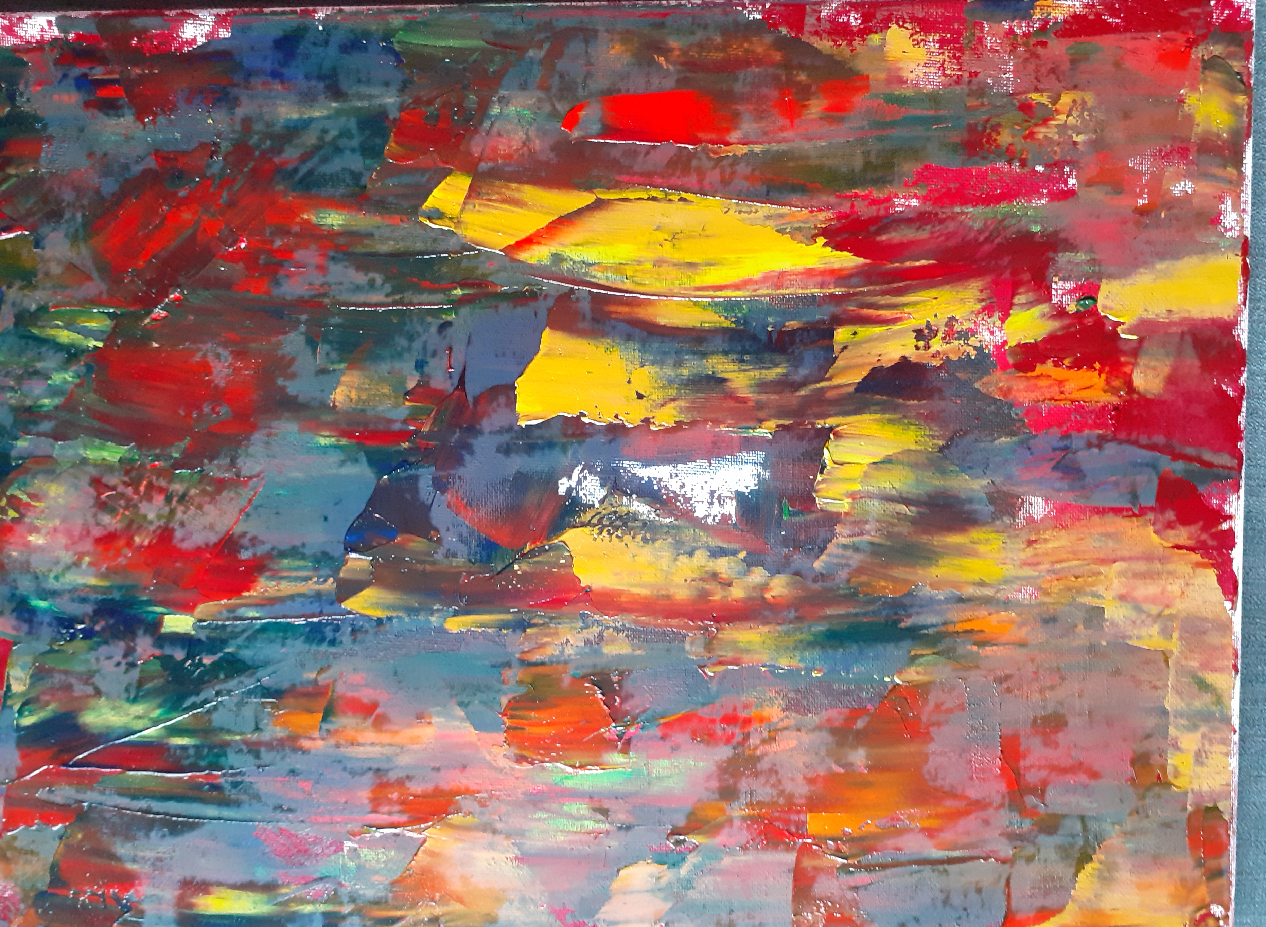
Experiences expressed through art
'I’m going to make it look beautiful…so that art can talk for itself….instead of me talking for it.'
Notes:
Red surround to represent his anger, with different shades or red and textures of oil paint showing the different ‘textures’ of anger ‘running through’ his head.
Tony left a small white oval at the centre of the painting, surrounded by an oval of dark paint, to represent the emptiness he felt.
When questioned further, Tony linked this to the uncertainty and insecurity he felt ‘The thing that push through your brain...like what’s going to happen next?’ and also the absence of thought when he was angry.
Tony allowed small patches of white to show through the paint which he identified as the bits of other emotions that were felt through the overwhelming anger.
During the second painting session, Tony added a layer of different brighter colours which he explained as being different emotions, such as humour, that he used to cover up his other more negative feelings about restraint (control).
Diffusion strategies – allowed to talk about very tricky subject safely.

Slide 14
What would you like adults to know about restraint
That it hurts….It definitely hurts….it feels like you’re in asylum and how it feels too, it feels like you’re in asylum…some teachers, that’s why I don’t like them…because they only think about what they’re doing and trying to keep themselves safe…instead of keeping the child safe.
Notes:
About restraint – it hurts,
teachers just do it – don’t think of the consequences,
Used when no options – for 'physical things' not verbal confrontations, not as classroom management technique
Better relationship with teacher, feel better about restraint
Teachers need to understand cyp as individuals - communication
Research process:
- choice – activities, pseudonym
- kind researcher
- being listened to
- Ask parents about restraint
- Don't ask teachers – they just do it to children with no thought

Slide 15
Findings
Relationships
Communication
Control

Slide 16
Useful takeaways for EPs
Talking about the use of restraint with schools is part of our role as EPs
Use of research evidence to back up conversations
De-escalation strategies
School policies
Whole class strategies, including training and support
Additional emotional support for children who have been restrained
Importance of relationships, communication and control.

Slide 17
Children's views on their experiences of physical restraint in school, relationships with staff and alternative strategies

Slide 18
Methods
Pilot study: Virtual interviews with a KS2 pupil who had been physically restrained in school. Established methods of best-practice when gaining the pupil's views, including: rapport-building, flexibility, and choice of expression.
Research project: Recruited 4 pupils from a primary SEMH setting
Two face-to-face sessions:
  1 - Rapport-building session
  2 – Gaining their views
Notes:
Due to hard-to-reach nature of group and ethical considerations – conducted a pilot – virtual
1 Ks2 pupil restrained a few times in the past 12 months,
Good to get an idea of two things: their views on restraint, and also how best to elicit their views. SLIDE
Flexibility – asking them what they wanted to do in between activities, focusing on bits I thought might be quite short
Rapport building session meant that I could incorporate things they liked in the second session e.g. rush hour. Personalisation to help keep engaged and make them feel listened to.

Slide 19
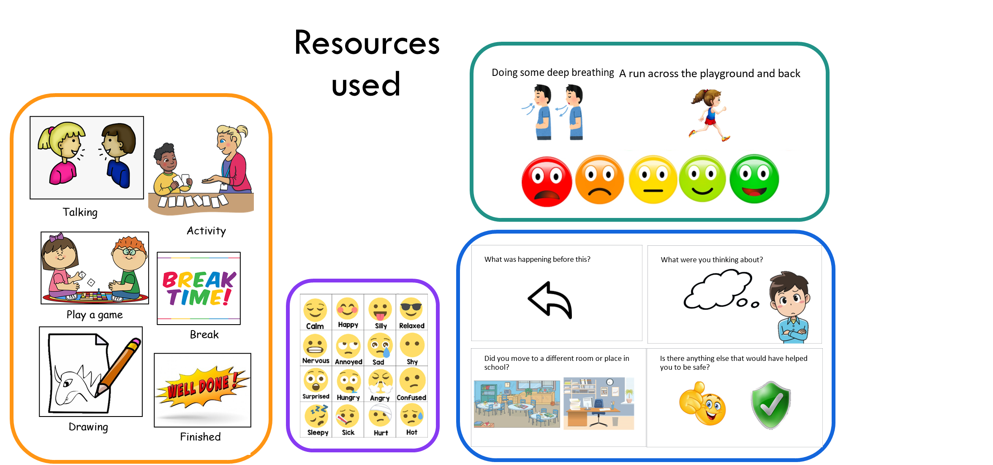
Notes:
Practical activities with room to incorporate their interests and a visual timetable that they had choice over.
Scaling activities for different strategies as well as restraint
Asked about their experience of restraint and their relationship with staff

Slide 20
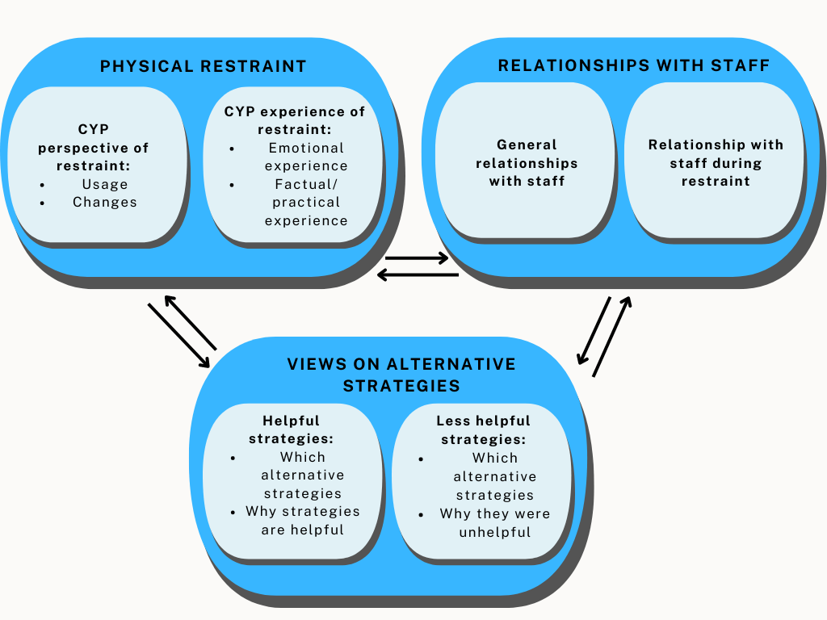
Findings
Notes:
Used thematic analysis to find three broad themes with smaller sub-themes within these. Give a bit of an overview of each, including CYP direct quotes where possible to ensure I'm expressing their views accurately.
Physical restraint: usage/experience: CYP – restraint as unhelpful “ends your personal bubble,” “last time it felt like they broke my wrist,” “stresses me out more.”

Slide 21
Physical restraint
"like if I’m fighting, but not if it’s something silly like swearing,"
Usage
• Restraint should be used when needed to stay safe.
Should not be used for incidents such as disruptive behaviour
Experience
• All described negative feelings whilst being restrained.
• Most pupils ranked physical restraint as ‘unhelpful.’
"angry...hot"
"last time it felt like they broke my wrist"
"stresses me out more"
"ends your personal bubble"

Slide 22
Relationships with staff
"having a favourite teacher….nice and calm, and won’t shout,”
General relationships
Pupils seemed to have a good relationship with staff.
Pupils valued having a trusted adult they could work with.
Relationships during physical restraint
Pupils had negative feelings towards staff restraining them.
Some felt better towards staff after the restraint, others didn't.
"I hated them,"
“felt angry [towards them]”
“letting go…got rid of all my stress”

Slide 23
Views on alternative strategies
"fidget toys"
Helpful strategies
All pupils could identify alternatives that supported them.
3 suggested ideas on strategies that would work in place of being restrained/before things escalated.
Less helpful strategies
They could explain why certain strategies were helpful or unhelpful.
"[makes them feel] calm"
"giving me a warning before taking me out of the room"
"helps me to get my anger and energy out,"
"just gets me more stressed"

Slide 24
Summary
Pupils saw physical restraint as something that should only be used when absolutely necessary.
Pupils had clear ideas on alternatives/de-escalation strategies.
Some pupils could separate negative feelings around physical restraint from their relationships with staff, others could not.
Implications for how we gain pupil views and share them in relation to physical restraint.
Notes:
All CYP were very talkative and felt comfortable sharing their views, I was very lucky to work with them!
The pupils did not necessarily see physical restraint as something that should not happen, but as something that should only be used when absolutely necessary.
Some of these were already accessible to them in school.
Implications:
More pupil voice is needed
Definition of when restraint is used is vague in guidance, but CYP often have a clear idea around when it should be used.
Relationships could be impacted by restraint, as negative feelings generated during the holds/restraint could last afterwards.
Implications for how we collect CYP views generally as well as how we work with settings who use restraint. EPs are well placed to facilitate discussion between the adults and CYP around the use of different strategies e.g. in RAMPs or similar plans.

Slide 25
Research around advice and guidance available to schools

Slide 26
Research overview
My current project is a scoping review of the literature on positive handling in school exploring: What does it say schools should be doing/thinking about?
I looked at 59 pieces of data
I adopted a Content Analysis approach to make sense of the data.
Podcasts
Journal Articles
Government Guidance
Reports from organisations
Videos
Training Provider Websites

Slide 27
10 Areas of practice identified
Are there any that surprise you?
Is the order of them surprising?
https://www.canva.com/design/DAFOrB4O8tQ/FmywdXoFXuacP8GFTGJwyA/watch?utm_content=DAFOrB4O8tQ&utm_campaign=designshare&utm_medium=link&utm_source=publishsharelink

Slide 28
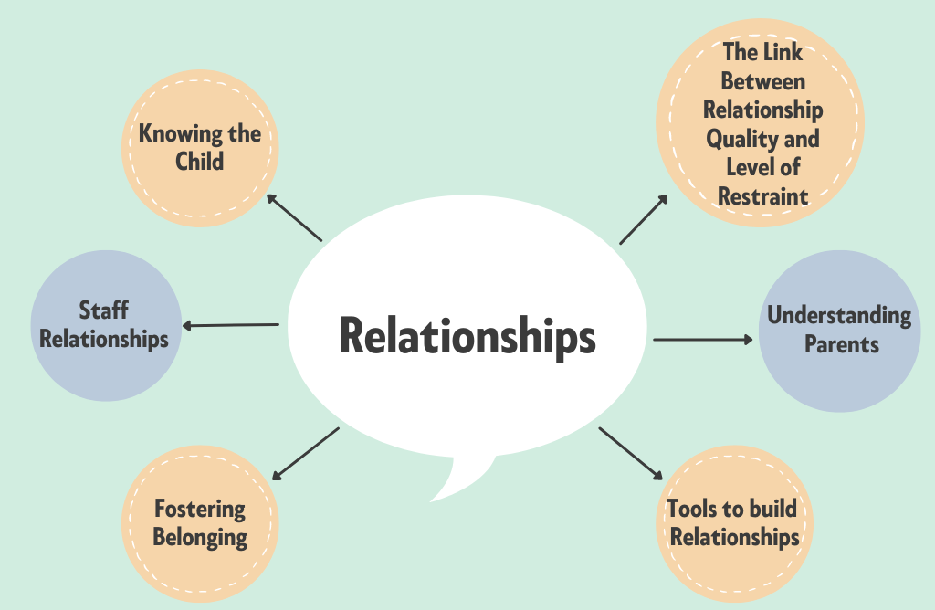
“Ideally staff should be given time to develop relationships with the children and young people before they might have to use Restrictive Physical Interventions”(Association of Directors of Children’s Services Health, 2009)
“The context in which restraint is used should also recognise that, as a result of past experiences, children will have a unique understanding of their circumstances which will affect their response to restraint by adults responsible for their care” (Department of Education, 2015)​
​
“treat children and young people with learning disabilities, autistic spectrum conditions, and mental health difficulties whose behaviour challenges as full and valued members of the community whose views and preferences matter” (DHSC, 2019)​
Notes:
The link between relationship quality and level of restraint was presented as a multi directional relationship. The better the relationship the more successful prevention and de-escalation is and the less levels of restraint occur. The more restraint happens the less strong the relationship.
Knowing the child was talked about mainly from the perspective of knowing the child's history, what their triggers are, what helps them. Knowing how to connect with them when calm to prevent a crisis and knowing how to adapt that communication within a crisis.
Fostering Belonging was very briefly referenced and it focused on including children with SEND being given a voice in school and a role within the school community.
Tools to build restraint at child level included the use of de-escalation, humour, communicating a 'humanness' in the teacher, creating safety in the relationship so children feel they can open up, creating trust, demonstrating unconditional positive regard, taking time to listen to the child.
At whole school level it looked at promoting positive relationships, using attachment aware practices, adopting Positive Behaviour Support approaches which are reported to have been successful in Scotland.
In terms of staff relationships it was looking at ensuring good communication between SLT and class teachers, strengthening relationships so that staff feel safe to go to SLT with difficulties and problems and knowing that they will be supported rather than disciplined.
In terms of understanding parents there was brief reference to recognising the impact of challenging behaviour on parents not just from the perspective of coping with their child's difficulties but also from a perspective of the wider impact e.g., parents being isolated from other parents on the playground as a result of their children's behaviour; parents dreading the phone call where they have to drop everything to come into school, potentially having to quit their jobs to be available.
Post incident support is key to maintaining positive relationships – emotional support for both the teacher and pupil is important. Engaging in debriefs following incidents and near misses and consulting all parties within this debrief process is key to both repairing relationships and improving practice.
What wasn't as explicit or under emphasised was the HOW. How do we create time to build relationships? What do we do within in this time? How can we be check if our perception of the relationship is the same as the child's? How do we foster belonging? How do we strengthen staff relationships? How can we make efforts to try and understand parents and help parents feel understood?

Slide 29
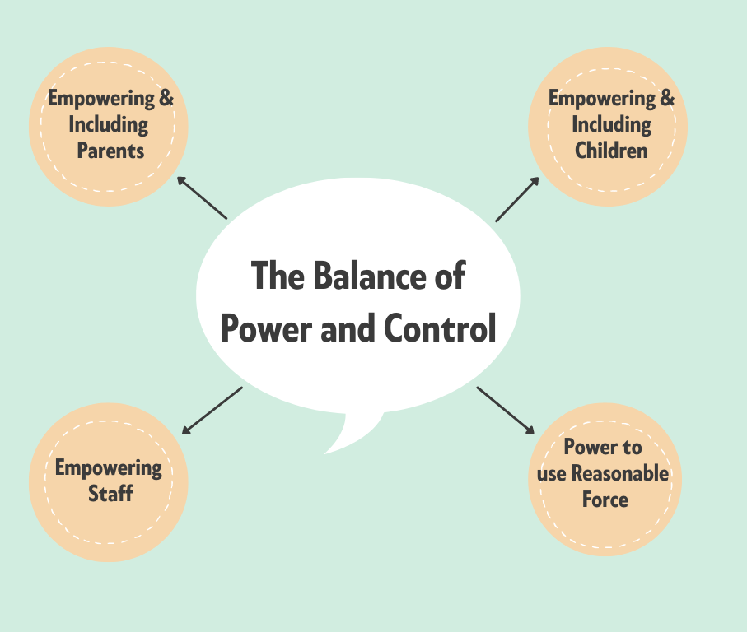
​“We teach the children that they have a choice when they feel frustrated…they have a choice when they feel anxious or angry, and we teach them they're in control of those choices.” (Eley & Smythe, 2018)​
​
“The way in which an adult uses their superior power, strength and status to impose their will on children is a signiﬁcant measure of a society's approach to children's rights.”(Davidson, Steckley, & Warren, 2005)​
​
“All we want to do is empower people to speak up and do the right thing, i.e., talk to your colleague or your supervisor or manager and say this person is causing me to feel this way or that we can't manage the situation. We just want to be more empowered that somebody else knows about it. We feel more empowered.”(Dawes, 2020)​
Notes:
Multiple references that spoke about:
Sharing policies, procedures, plans and records with parents and children.
Not simply sharing but involving parents and children in the development of policies and procedures, individualized support plans, and in debrief and reviewing procedures.
A reflection I have made with restraint that wasn't listed in the literature is around the implications of restraint upon a child's sense of control. Are some children getting the message that they are incapable of controlling their own behaviour and need to be physically held in order to be kept safe? What implications does this have in terms of their risk of being in unhealthy relationships that may include domestic violence?
Some references talked encouraged teachers to reflect on how they use their powers: both in terms of following the law and in terms of recognising the potential impact on using their power of reasonable force. I wonder if teachers also need to be considering the use of language as well as actions. Thinking about the impact of the words we use with children about the use of restraint both before, during and after.
In terms of empowering staff the literature referenced the importance of creating an enviornment where staff feel empowered to speak up when they are finding it difficult to manage a child who struggles to regulate, helping them to feel competent and confident in supporting children, consulting them when looking at training needs, policies, and individual plans for children, allowing them the freedom to use their initiative and supporting them to feel safe to report all incidents in which the use of force has been used.

Slide 30
Next Steps in my research:
To use focus groups to:
explore education staffs' experiences of trying to implement these elements of practice within the real-world contexts.
consider where practice is currently.
Elicit ideas for moving practice forward.

Slide 31
“It’s all about relationships”
Pilot study exploring the use of isolation rooms/booths from a staff perspective

Slide 32
Seclusion in UK schools
- “the supervised containment and isolation of a child or young person away from others, in a room/area from which they are prevented from leaving” (HMG, 2019, p.43-44).
The naming issue
  Common term = isolation booths
Comparable to prisons and psychiatric hospitals
Behaviour in Schools (2022) guidance
  80. Parents should be informed the very same day
  81. a) Restore stability

Slide 33
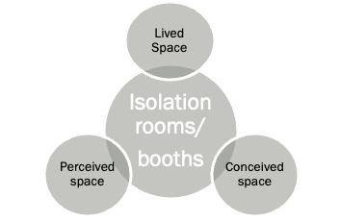
RQ1: School context
A space of care
"Where they're understood"
Without friends
Limited access and participation
Setting: Large secondary school in NW
Methodology: Semi-strcutred interview with one participant
"Horrified"
"it has a bit of cache...(it) can also be seen as a good thing sometimes"
"I'd rather be in there anyway"
Behaviour management tool
Notes:
Conceived space
Perceived space
Lived spaced

Slide 34
RQ2: Staff perspectives
Control v Empathy
Consider the context
Teacher
“that control element kind of translates more to them being in agreement...because they know that if there's a situation where you're not in control of it, then it can really affect behaviour in the whole class.”
Teaching assistants
“especially…, if they're in there three or four times in one year, a lot of TAs often feel that, you know well, that's not working for that child. So... what else? What else should we be doing?”
Family relationships
"Short sharp shock"
Reasonable adjustments
"well, this is our reasonable adjustment for this student…this is what they need, they need something additional to or, different from
COVID-19
"not had the experience of being socialised…as much”.

Slide 35
RQ2 Staff perspectives
Connection is key
Paradoxical positives
Staff and students
“they’re looking for that person that they've got the relationship with… because that person understands them, knows what's happening in their life, they've got all the background information, the teachers don't have.”
“That relational aspect is absolutely key for compliance"
Peer groups
“I tend to find it's the not going out at breaks and lunches is the kicker, rather than being in that particular room”
Reduction in internal and external exclusions
Benefits of smaller learning space
  Increased concentration
  Staff ratio

Slide 36
Summary
Reflections
  Stakeholder views
  Children's rights – individual vs collective
  Important of relationships
Schools as caring spaces
Responsibility of inclusion
Notes:
s

Slide 37
Future research
So what? Is it all about relationships?
Next..
  Systematic literature review on the (bi-directional) impact of relationships on restrictive practices .
  Research project gathering the views of young people from alternative provisions/PRU and their experience of seclusion in a mainstream setting.
    The current schedule includes reflections on their relationships at school.
    Data gathering protocol

Slide 38
Key takeaways
Importance of relationships within school
The role of the EP
  Training opportunities
  Encouraging relationship-led practice
    Bridging parents and school
    Supporting with school specific needs e.g. improving belonging, de-escalation and debriefing
  Facilitating difficult conversations
Welsh Government - Reducing Restrictive Practices Framework (October, 2022).
No Safe Place: Restraint and Seclusion in Scotland’s Schools (December, 2018).

Slide 39
Thank you
Any questions?
katherine.stothard@postgrad.manchester.ac.uk
kirsty.mullowney@postgrad.manchester.ac.uk
bethany.hodgkiss@postgrad.manchester.ac.uk
ellen.quinn-2@postgrad.manchester.ac.uk

Slide 40
References
Challenging Behaviour Foundation . (2020). Reducing Restrictive Intervention of Children and Young People: Update of Case study results. Chatham, Kent: Challenging Behaviour Foundation.
DfE. (2013). Use of reasonable force Advice for Headteachers, staff and governing bodies Online Retrieved from https://www.gov.uk/government/publications/use-of-reasonable-force-in-schools
DHSC & DfE. (2019). Reducing the Need for Restraint and Restrictive Intervention. Online Retrieved from https://www.gov.uk/government/publications/reducing-the-need-for-restraint-and-restrictive-intervention
EHRC. (2019). Human rights framework for restraint. Retrieved from Online: https://www.equalityhumanrights.com/en/publication-download/human-rights-framework-restraint
EHRC. (2021). Restraints in schools inquiry: using meaningful data to protect children's rights. Retrieved from Online https://www.equalityhumanrights.com/en/publication-download/restraint-schools-inquiry-using-meaningful-data-protect-childrens-rights
Sellman, E. (2009). Lessons learned: student voice at a school for pupils experiencing social, emotional and behavioural difficulties. Emotional and Behavioural Difficulties, 14(1), 33-48.

