Slide 1
NAPEP – Cymru AEP Conference November 11th 2022 Joy Mitchell, PEP Wrexham Dr Alun Flynn, PEP Powys

Slide 2
Working in Wales
The new Curriculum for Wales
Hwb.gov.wales
Based on the review by Professor G. Donladson
The purpose of every school’s curriculum will be to support our children and young people to be:
ambitious, capable learners, ready to learn throughout their lives
enterprising, creative contributors, ready to play a full part in life and work
ethical, informed citizens of Wales and the world
healthy, confident individuals, ready to lead fulfilling lives as valued members of society

Slide 3
Whole School Approach to Emotional Wellbeing and mental Health
Framework on embedding a whole-school approach to emotional and mental wellbeing | GOV.WALES
The Framework is intended to support schools, including pupil referral units (PRUs) and education settings in reviewing their own well-being landscape and in developing plans to address their weaknesses and build on their strengths.
It recognises that the school alone cannot meet all the needs of a complex population of children and young people, and sets out the role of regional bodies, the NHS and others such as the third sector, in supporting the school.
It is meant to support and complement the new national Curriculum for Wales and in particular the Health and Well-being Area of Learning and Experience.of good practice.

Slide 4
ACE Support Hub - Wales
about – Ace Aware Wales
Sharing information and knowledge about ACEs, listening and working with partner agencies who engage with communities, children and families to find solutions that will work.
Sharing evidence about what organisations can do differently to help prevent and mitigate ACEs, and how they support those who have experiences ACEs or trauma.
Developing knowledge and skills among professionals, for them to challenge internal and external networks and drive change.
Learning from each other, sharing information and providing expertise that leads to action.
Driving change by challenging ways of working, throughout Wales.

Slide 5
Welsh Language Act 1993
Welsh medium schools
Welsh in the community
…so far as is appropriate in the circumstances and reasonably practicable,
to the principle that the Welsh and English languages should be treated equally in the conduct of public business in Wales.

Slide 6
Code of Practice on the delivery of autism services ( Welsh Government)
Code of Practice on the delivery of autism services | GOV.WALES
Schools must have support services for autistic children.

Slide 7
Cardiff Doctorate in Educational Psychology
This programme is underpinned by a psychologically informed framework for educational psychology practice called COMOIRA (The Constructionist Model for Informed and Reasoned Action: Rhydderch & Gameson, 2008; 2010; 2017) which was developed within the Cardiff DEdPsy Programme itself;
Fully funded by the Welsh Government, with trainees receiving a bursary for all three years

Slide 8
ALN Reform IDPs: Key underpinning principles
All CYP with an ALN (determined because they require an ALP) will have an Individual Development Plan (IDP)
The IDP will be used for CYP 0-25 in education.
The IDP replaces a Statement an IEP or a Learning and Skills Plan (if attending college).
The IDP will state what the CYP needs to be able to learn and what will be done so that the CYP is properly supported in school or college.
Notes:
Recap on the ALN reform. Put into context
ALN = if a CYP has
-A significantly greater difficulty in learning than the majority of others the same age
-has a disability which prevents and hinders from them making use of facilities for education or training of a kind generally provided for others of the same age in schools, colleges or settings
Clarify that a pupil has an ALN if there is a requirement for an ALP (additional Learning Provision). Therefore the CYP requires an IDP. If the provision required can be offered universally or thorough differentiation (e.g. short term provision) at school then an IDP would not be provided.
An IDP will be used instead of different plans for different ages and different types of ALN.

Slide 9
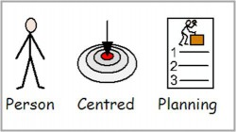
ALN Reform (cont)
What the CYP thinks, feels and wants must be thought about for this plan.
Their parents or family carers must be part of all the decisions that are made for this plan.
The LA, schools or colleges will prepare the plan, but everyone will be part of writing it.
If the school or college do not think that they can support the CYP’s ALN they can ask the LA to maintain the plan.
A school IDP will be prepared within 35 school days and an LA IDP within 12 weeks. The IDP will be reviewed at least every 12 months.
Notes:
Recap on the ALN reform. Put into context
Anyone exercising functions under the Act or this Code will need to involve
children and young people at every stage of the process, with their views, wishes
and feelings listened to. This will help the child or young person to personalise
their learning through the identification of targets that build on their strengths using
a person-centred approach rather than a service centred approach. It is the learner’s needs that are the starting
point when considering the support to be provided, rather than starting with what
support is available and then how the learner can be fitted into it.

Slide 10
ALN Reform (cont)
The LA can prepare and check the IDP at the same time as other plans are being written or checked.
If the IDP states that the CYP must have health services to help them with their learning the NHS must make sure that they are provided to the CYP. An IDP is an ‘education’ plan and unlike an EHCP there are no statutory requirements on the NHS.
If the child is too young to attend school and health staff feel that he/she has an ALN then they can bring this to the attention of the Early Years ALN Officer.
Final CoP was produced in 2021 and went live in Sept 21. Implementation period of the ALN system is phased over 3 years. Currently it operates in parallel with the SEN system. FE will be included in September 2023.
Notes:
PEP (personal education plan for LAC) should be reviewed at the same time as the IDP and the PEP be included within the IDP.
For early years the LA prepares, maintains and reviews the IDP.
Collating information and developing working documents such as One Page Profiles and Individual Development Plans (IDPs).
Monitoring and reviewing the plan using a PCP approach.
All appropriate people can be involved in developing a holistic plan for each learner.
SEN system (Education Act 1996) operates in parallel with the ALN system until August 2024.
NHS DECLO has been appointed as a point of contact with the NHS.
Two systems running side by side. SEN: Statements, ALN: IDPs.

Slide 11
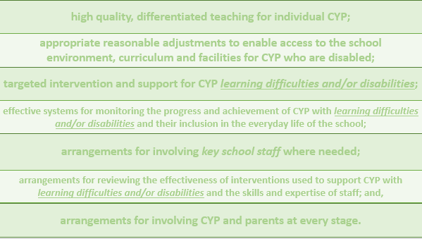
Starting Point
Concern Raised
Gather Evidence
On-going process - everyone’s responsibility.
Person-centred Review
Identify Needs/Barriers
OPP for ALL
CYP Does NOT Have ALN
Emerging needs?
Short term provision?
NO
Does CYP have a Learning Difficulty and/or Disability?
Identified key Adult - PLAN/DO/REVIEW
Evidenced
Does CYP have a Learning Difficulty and/or Disability?
Does CYP have a Learning Difficulty and/or Disability?
YES
Person-centred Review
Impact assessment to review effectiveness of provision on CYP progress. Revise plan in light of progress/
outcomes.
DO
Implement plan. Teacher/s remain responsible for working with CYP and evidencing impact of plan.
PLAN
ALNCo/Teacher parent and CYP agree provision/support and expected outcomes.
CYP Does NOT Have ALN
Needs can be met with good inclusive provision.
Short term provision?
Does the CYP Require ALP?
Does the CYP Require ALP?
NO
Does the CYP Require ALP?
ALP Required
YES
CYP has ALN
Statutory Requirements
Develop IDP
Notes:
n.b. Slide provided by Steve Campbell, Carmarthenshire, ALN transformation Group.
Our starting point is the evidence needed for all CYP based on the draft codes aims and principles.
Points to consider
CYP not making progress. Parental concern. Teacher referral. Assessments/screening. Attendance. Behaviour.
Evidence – Reflective tool.
The process does not need to wait for a ‘graduated response’ as in reality it is more fluid than this. For example, there may be an immediate statutory requirement for an IDP (e.g. a CYP with significant ALN who has moved into county without an IDP, or the needs of a CYP has significantly changed, (e.g. a CYP experiencing a significant illness / a neurological condition or trauma where ALP is now required).
Improved outcomes for all if we get this process right.

Slide 12
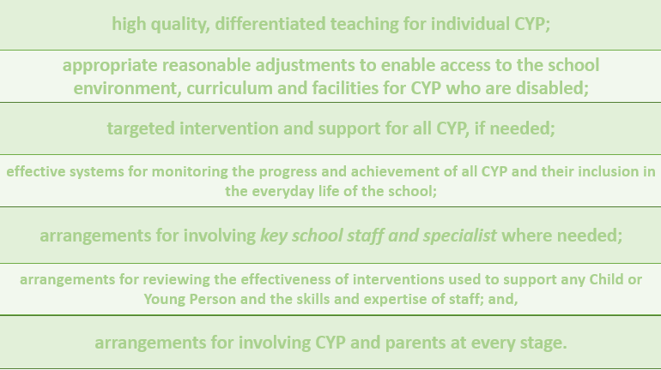
DECISION MAKING PROCESS
Gather Evidence
Person-centred Information, learner assessment and additional information, depending upon the line of enquiry.
Decision Making
Collaborative decisions to be made regarding actions and next steps. If continued support is required, then The Support Sequence or IDP (for CYP with ALN) will be updated and shared with key stakeholders, family and the CYP and a review date set.
01
Person Centred Meeting/Review
Identified member of staff calls meeting.
Person centred principles adhered to.
CYP and family included.
07
02
Person Centred Review
Facilitated by the identified member of staff on set date.
Person centred principles adhered to. CYP and family included. The Support Sequence or IDP (for CYP with ALN) will be reviewed.
Universal
Elements
06
03
Decision Making
Collaborative decisions to be made to remove barriers to support the CYP.
05
04
Do
The Support Sequence or IDP (for CYP with ALN) will be implemented by teacher/tutor and monitored by the identified member of staff.
Evidence impact for review.
Planning
‘The Support Sequence’ is used to identify how best to support the CYP and records the agreed decisions, actions and provisions (ULP or ALP). If it is agreed the CYP has ALN then an IDP would be prepared. The Support Sequence or IDP (for CYP with ALN) will be shared with key stakeholders, family and the CYP. Review date set.
Notes:
When considering whether a CYP has ALN a decision making process must be applied.
Go through each one in turn.
The Support Sequence (see 04) identifies how best to support the CYP and is explained further in the next slide.

Slide 13
1. Child or Young Person
To promote independence and resilience support the learner to think about their capabilities and what they can do to support the achievement of the agreed outcome/s. Insure the principles of the ‘Decision Making Process’ are adhered to at all times.
7. NHS Body ALP
Description and delivery of the ALP required to be provided by an NHS Body to supplement the settings Universal Learning Provision.
2. Inclusive Education
Consider if any equipment, technology, adaptations, training or targeted teaching strategies or standard targeted interventions could remove the identified barriers and move the learner towards their outcome/s.
The SUPPORT SEQUENCE
6. Settings ALP
Description and delivery of the ALP required to be provided by the setting to supplement the settings Universal Learning Provision.
3. Family and Friends
Consider what family or friends can do to support the learner moving towards their outcome/s.
5. Settings and/or Services
What actions are needed to be carried out by the setting to engage other services and what actions do other services need to do to remove the identified barriers and support the learner in achieving the outcome/s?
4. The Community
Community inclusion is important for the wellbeing of all learners. What’s available in the community that can support the delivery of the agreed outcome/s?
Notes:
Support Sequence
The support sequence is a creative way to think about different ways to support the child or young person in achieving the agreed outcome/s.
Support options 1 – 5 should be explored before agreeing if an ALP is required. This solution focussed way of working may identify support strategies that have yet to be explored, which will form part of the Universal Learning Provision offer. If these solutions do not enable the outcomes to be achieved within the timeframe specified, you would go back to the decision-making process and an ALP may result.
If a support sequence has previously been agreed, then it would need to be reviewed before changing any outcomes or developing any new ones.
Only complete the support sequence once, for all the agreed outcomes. You will find there maybe duplication of supporting actions and provisions that could support the achievement of the agreed outcome/s.
You only develop an Individual Development Plan (IDP) if it has been agreed that the learner requires an ALP.
Any agreed ALP should commence as soon as possible and not after the Individual Development Plan has been prepared.
The support sequence could be attached to the IDP as supporting evidence.
Inclusive education: High quality teaching and learning, targeted teaching strategies and standard targeted interventions should be provided by the setting. This forms the basis of the offer made by school of their Universal Learning Provision (ULP). The ULP will be quality assured by the LA.

Slide 14
Individual Development Plans(IDPs)
An IDP is formulated from a single, multi agency planning process based on Person Centred Practice
From all perspectives – the child, family, support staff, other professionals e.g. Health
If things are working – how to maintain and build on it
If things are not working – what needs to change?
Action Plan – who, what, by when?
Notes:
Assuming that it is agreed that the CYP has an ALN that requires an ALP and IDP is created.
An IDP differs from a Statement because it is person centred vs service centred.

Slide 15
Content of an IDP
Basic biographical information
Views, wishes and feelings of the CYP
Record of information used to develop an IDP
A description of the CYP’s ALN
Description and delivery of the CYP’s ALP
Intended Outcomes
Timeline of key events
One Page Profile
Action Plan
Notes:
Mandatory content.

Slide 16
Individual Development Plans(IDPs) Summary
An IDP is formulated from a single, multi agency planning process based on Person Centred Practice. From all perspectives: CYP, family, support staff, other professionals e.g. Health.
If things are working – how to maintain and build on it?
If things are not working – what needs to change?
Action plan – who, what, by when?
In particular the outcomes, actions and action plan will form the basis of the ALP.
Notes:
Queries re implementation: ALNImplementation@gov.Wales

Slide 17
2021 – A Time for Change?
The Future Role of the Educational Psychologist in Wales

Slide 18
Principles guiding practice
Person Centred Practice
Evidence Based Practice and Practice Based Evidence
Multi agency and Collaborative Approaches
Modern, accessible and action oriented towards person centred outcomes.
Reflective of Best Practice, Innovation and Creativity.
Notes:
Drawing on ‘Educational Psychologists in Wales’ 2016 updated 2022 and relevant sections from ‘Guidance for Eps preparing advice and information
For Education, Health and Care Needs Assessments (2020).
A graduated approach is a key component of best practice There are many strengths to the employment of a graduated approach, these include:
Opportunities for a contextual extended and holistic view of the CYP
An ongoing process of individualised assessments that allow for a gradual understanding of the barriers to and gaps in the pupil’s learning
Learning from reflection on different approaches t meeting the pupil’s needs
Construction of a psychological formulation and recommendations that are based on evidence that has the robustness of a depth and breadth of assessment and outcomes arrived at from the use of a wide range of interventions and strategies

Slide 20
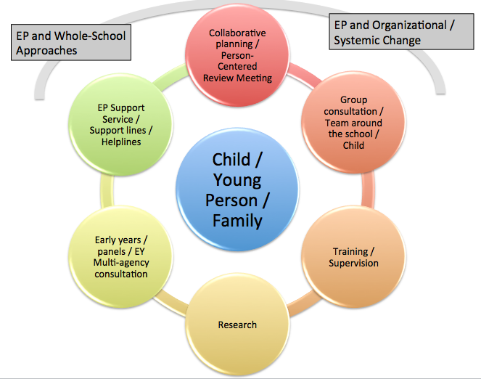
PSYCHOLOGY: Early Involvement

Slide 21
Psychology – Exploring need: Formulation and Consultation

Slide 22
Psychology:Intervention and Assessment

Slide 23
E.P. Advice and Information
REPORT FORMATS – flexible enough to allow for a range of psychological input in an ongoing formative process.
Clear and accessible language.
Avoiding duplication.
Psychological advice will be varied in approach.
Oral contributions in a person centred, co production meeting.
Brief records of consultation/summaries of EP involvement focussing on agreed actions.
Detailed comprehensive reporting based on professional judgement in specific complex casework could be considered where this is felt to be within the interests of achieving desirable outcomes for the child/young person.
Notes:
There is no statutory requirement for any particular manner or format in which psychological advice or information may be provided.
Reporting format should serve practical purposes but should not overshadow the key functions of working in a person centred and collaborative way.
We have therefore moved on from the lengthy Appendix D style of advice giving.

Slide 24
Key conclusions:
ALNET Act and new systems have allowed EPs in Wales to think afresh.
EPS have a unique and statutory role throughout the formative process of contributing to IDPs.
Reinvention of a professional role to move towards a collective vision for EPS in Wales – reasserting PRINCIPLE and PRACTICE.
Moving away from ‘gatekeeper’ role
Moving away from lengthy Appendix D style reports
Moving towards maintaining breadth depth and variety in EP work.
Notes:
Remaining faithfultothe spirit and principle of the ALNET act underlies the thinking behind the Paper.

