Slide 1


Supporting CYP struggling to attend school
Dr Adele Tobias, Brighton & Hove EPS
Seminar AEP Annual Conference 2024 10.10-11.10 Reclaiming Inclusion – research and practice that promotes inclusion
Notes:
This seminar will focus on work being carried out in Brighton & Hove to promote the inclusion of children and young people who struggle to attend school.

Slide 2
The session will focus on:
Background context
B&H ATTEND Framework: Development, theory and use
National & local projects
Next steps
Discussion & questions

Slide 3
Backgroundcontext
Persistent absence from school is widespread and growing
It disproportionately affects CYP with existing disadvantage
An insecure home life is not unusual for many CYP
It is associated with poor life outcomes
Notes:
Some helpful statistics to set the scene:
1. PA is a widespread and growing problem. To give you an idea of scale, in the 2022-23 academic year there were 1.57 million ‘persistent absentees’ in England (which the government defines as pupils absent more than 10% of the academic year), which is about 21.2% of the school population. We also know that lockdown and school closures in 2020 and 2021 exacerbated the problem. The percentage in 2018-19 was 10.9%. (Gov.uk website). Apologies for only quoting England stats today, but I did check and these are pretty representative of the other nations of the UK. Though I think in Wales the figures for PA are even higher.
2. Poor attendance at school disproportionately affects children and young people with existing disadvantage. For example, persistent absentees are statistically much more likely to be eligible for FSMs or to have SEND. In England, 36.5% of pupils who were eligible for free school meals were persistently absent in 2022/23 compared to 15.6% of pupils who were not eligible. 36% of pupils with an EHCP and 31.1% for pupils with SEN support were persistently absent in this period compared to 18.4% for pupils with no identified SEN. 39% of pupils identified as young carers were persistently absent in 2022/23, compared to 21.1% for those who had no young carer status declared. Pupils in all the key social care groups (CIN, CIC, CPP) had higher rates of persistent absence than the overall pupil population. CPP had the highest proportion of pupils (57.5%) who were persistent absentees.
3. To give you a few headline figures: Parental mental health : 1 in 4 people will experience a mental health problem of some kind each year in England and approximately 30% of adults with MH problems have dependent children.
According to the NSPCC, more than 70,000 children in England have a parent currently struggling with alcohol misuse.
The Food Foundation found that in January 2024, 15% of UK households were living in food insecurity. This is equivalent to approximately eight million adults and three million children. This means that – at some point over this period – they ran out of food and were unable to afford more, or reduced meal size, ate less, went hungry or lost weight due to lack of money.
According to the All-Party Parliamentary Group for Households in Temporary Accommodation, there are 117,450 households in temporary accommodation in England, including 151,630 children (data from March 2024). A statistic that doesn’t include 'hidden homeless' families who are not living in shelters or on the street, but move frequently, often into overcrowded accommodation or double up with other families, usually as the result of a job loss, serious illness, escape from domestic violence or unaffordable increases in living expenses.
4. Children missing education are at significant risk of underachieving, being victims of harm, exploitation or radicalisation, and becoming NEET (not in education, employment or training) later in life. They are more likely to leave with few or no qualifications, be out of work, suffer mental health difficulties, become homeless and become adult offenders. There are also links with higher lifetime alcohol consumption, drug abuse and social disengagement.
What all of that says to me is that persistent absence from school can be a safeguarding red flag and something we can use as an early warning sign that a child may not be safe at home or in their community, and that it is very worthy of our time and intervention.

Slide 4

What is the ATTEND Framework?
Early intervention for CYP (between 5 and 16/18 years) with low school attendance.
An assessment tool for systematically identifying the underlying reasons for low attendance.
A framework for setting up support plans collaboratively with families.
Notes:
So, what are we doing in B&H...
What is the ATTEND Framework?
The ATTEND Framework is an early intervention tool for CYP with low school attendance and also poor engagement. It is both an assessment tool for systematically identifying the underlying reasons for low attendance and a framework for setting up support plans collaboratively with families.

Slide 5

Notes:
Each pack has 3 assessment forms (one each for students, parent/carers and professionals) and a guidance booklet. There is also a timeline to complete and picture cards to use with younger children or those with additional communication needs.
There is also a purple version that is specific to Brighton and Hove and contains references for local organisations, charities and services. It is free to all schools.

Slide 6

How was The ATTEND Framework developed?
Notes:
A little bit of background on how ATTEND was developed.
I have worked as an EP since 2004 and felt that there was a need for a practical approach to this work, often experiencing feeling ‘stuck’ with it in my own casework. Often as an EP you become involved at a late stage, when other professionals and family members are already feeling stuck/desperate.
Variously found myself (and you may relate to some of these scenarios yourselves): having lengthy phone conversations with parents desperate for help; trying to carry out assessments with young people through the crack under their closed bedroom door, or from under a blanket. And trying to mediate between families and schools when the relationship has deteriorated and each are blaming the other for what feels like an irresolvable problem. I often felt like I didn't know how to make a positive difference.
Then between 2014 and 2017 I completed my doctoral thesis on school non-attendance. I did a systematic literature review and then I ran focus groups with Family Coaches – professionals who work intensively with families where attendance at school is problematic. My research found that, for some families, poor attendance at school was associated with a range of practical and safeguarding issues at home. This research has been published in the journal Educational Psychology in Practice and the reference is at the end of this PowerPoint for anyone who would like to read it and my thesis is available through the University of Essex repository. It made me realise that low attendance and disengagement from school was a hugely complex issue and that I hadn't always been asking the right questions.
Selfishly, I wanted a tool for my own work that would try to capture in one place (as simply as possible) all of the potential underlying barriers to school attendance and engagement, so that the right support could be put in place. I couldn’t find one that did this so I tried to create it myself.
It took several years to put together. The range of factors included in the ATTEND Framework were chosen either because a link had been made in the academic literature, or because they had been relevant in some of the several hundred cases known to the local authority teams supporting the framework’s development. In developing ATTEND I took drafts to teams of Behaviour Specialists, Primary Mental Health Workers, Educational Psychologists, Specialist Teachers, Family Coaches, Education Welfare Officers, SENCOs, teachers, The Virtual School, and safeguarding leads in order to ask about their own experiences working with families and used their feedback to shape the framework. I also, of course, consulted with many children, young people and their families. It is very much a co-production.
The resulting ATTEND framework was published in 2020 and it is now used quite widely in schools and services across the city.

Slide 7
STEP 1
Information gathering
STEP 2
STEP 3
Supporting and regularly reviewing
Action planning
Notes:
The idea of ATTEND is that it follows an Assess, Plan, Do, Review approach
Step 1 is information gathering
The facilitator completes the ATTEND form for Professionals, using the other assessment tools to support information gathering.
You use the timeline to understand the student’s school and family history, including periods of low attendance in the past and possible trigger events.
The Student and Parent/Carer forms contain checklists of possible barriers to school attendance under the headings: Worry, Health and Wellbeing, Sensory overload, Fitting in, Schoolwork and teachers, Changes, Things at home and Other. They also contain a checklist of secondary factors that might have become part of the problem after a period of not going to school and space to also explore some resilience factors.
The process is to work systematically through every item and if an answer is not known, to seek out the relevant information as this could identify an unknown contributing factor.
Its important to stress that the forms are not intended as closed checklists but a way to frame a conversation, or series of conversations, with a family. It would never be appropriate to send the parent form home to be completed without any explanation.
For younger children, instead of using the form, you can use the picture cards to do a card sort exercise. Ask children if they feel like any of the cards describe them and sort them into piles of Yes, No and Maybe, then arrange the Yes pile in order of priority.
Step 2 is action planning
You set up a meeting with the family and use the forms to frame a discussion about what the underlying issues are. On the back of the professional's form there is a proforma that can be used for recording action planning.

Slide 8
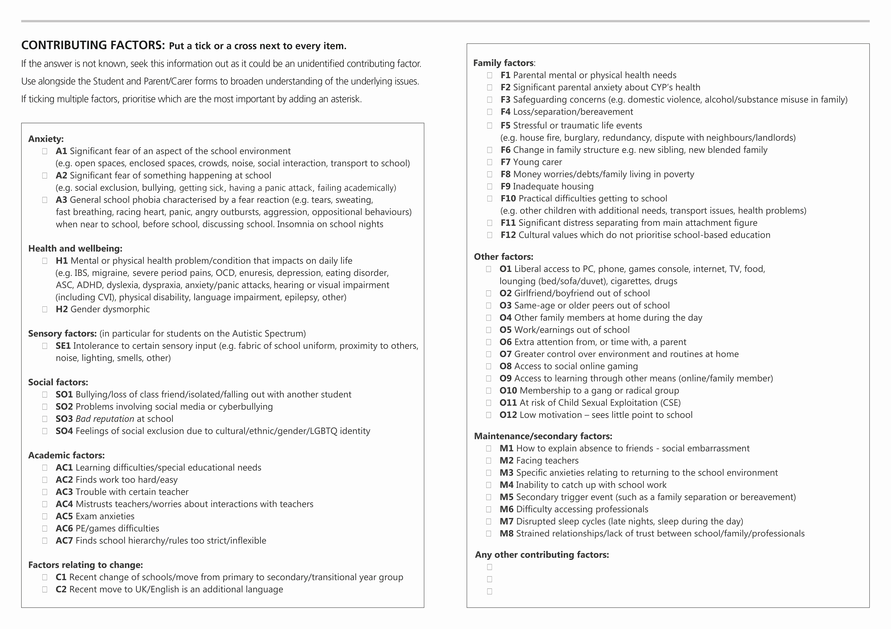
Notes:
Each factor on the professional’s form is coded. The guidance booklet contains lists of relevant support strategies organised by each code, so once you have identified an issue, you can look up ideas that will contribute to the support plan. There are a lot of ideas, but its not exhaustive - the most effective support plan will be bespoke to the student, creative and collaborative - agreed with the family as helpful and drawing on the resiliency factors and resources available in that particular family/setting.

Slide 9
STEP 1
Information gathering
STEP 2
STEP 3
Supporting and regularly review
Action planning
Notes:
Step 3 – Support and review
Put in support and set regular review dates and evaluate how each strategy is working. Alter the plan and support as needed. The idea of ATTEND is not necessarily to 'fix' everything but to put in enough support in enough areas that being at school becomes possible again – the idea of widening the window of tolerance.
As well as working on a case by case level, the codes can also be used to explore reasons for low attendance across groups. Professionals in a school or the wider local authority might like to identify the most common reasons for low attendance within their student populations in order to inform larger-scale interventions.

Slide 10
Risk Factors
Maintaining factors
Predisposing factors
Precipitating factors
Notes:
The theory behind ATTEND.
One principle is that the information gathering is set up the way it is because it can sometimes be helpful to think about the risk factors in terms of predisposing, precipitating and maintaining factors.
Predisposing factors are concerned with who is most at risk because of a range of personal, family, school or community factors. We've already talked about some of those in terms of the context and statistics.
Precipitating factors are concerned with sudden or traumatic life events that might trigger a period of poor attendance. Examples might include a bereavement or marital break up, or an incident at school such as a clash with a teacher or a period of bullying, or simply making the transition from primary to secondary school. A precipitating factor might also be a larger scale event, like a global pandemic!
Maintaining factors are circumstances that prolong the problem and lead to the feeling of ‘stuckness’, which often characterises attendance difficulties. Examples might be - getting very behind with the curriculum, social embarrassment about explaining absence to peers or staff or disrupted sleep cycles where YP have fallen into a pattern of very late nights and sleeping during the day.
The forms and timeline used together try to capture all of these different factors.

Slide 11
Interactional Model
Socio-political factors
School/LA/Support service structures
Family circumstances
Peer relationships
Personal psychological factors
Maintenance Factors
Notes:
And another main principle of ATTEND is that low attendance is often the combination of several, complex, interacting factors unique to each individual. It's unlikely to be just one thing. These include personal factors (which you might term 'within-child') but also environmental factors, such as peer relationships, family circumstances, school/LA support service structures and socio-political factors, as well as maintenance factors once a young person has been absent for some time.
This is an interactional, eco-systemic model which summarises all of the factors and is drawn from Brofenbrenner's Ecological Systems Theory (1979).
CYP themselves often can’t tell you what it is that is causing their difficulties with attendance if asked directly. Young people often say they don't know the reason but they 'just can't'. They often need help to process and understand their experiences themselves. We therefore need to capture a rich picture of what is going on for that CYP & their family in order to address it adequately.

Slide 12
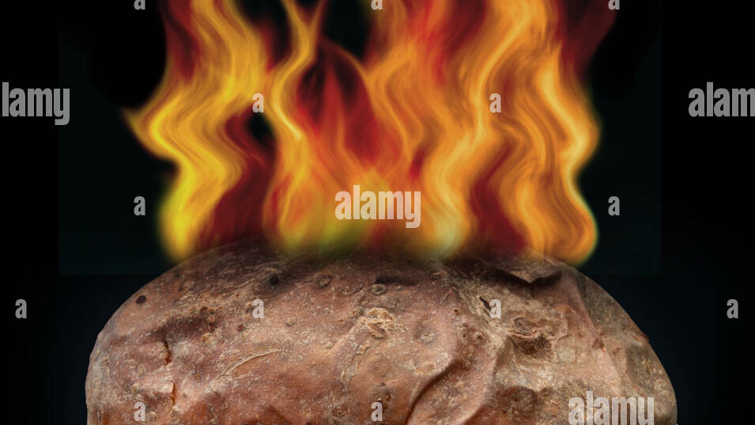
Notes:
And ATTEND also recognises that school non-attendance can be a bit of a HOT POTATO. It's an area where professionals and families can feel challenged and 'stuck' because research shows that it is a quite a hard area to have impact and so there is a tendency to want to pass the responsibility or blame. It is also an area where individual parents may hold shame – because they feel they 'should' be able to get their kids to school.
I noticed in my literature review that research undertaken with parents/carers often locates the reasons as within-school. School-based research often places the cause within families. I also see this in my own EP work.
In my research, families were often passed between services (e.g., adult social care saying it was a child social care issue and vice versa) or everyone 'on hold' waiting for CAMHS because other services were saying they couldn't help until there had been a medical diagnosis.
The ATTEND ethos is that the most effective intervention is when everyone works together in a team approach. The idea is to use a consultation approach to ensure everyone's voice is heard, as much as possible without judgement or blame, and then to arrive at a shared understanding which contributes to an agreed plan.

Slide 13
Who is the ATTEND Framework for?
Persistent absenteeism
EBSA, EBSNA
EBSR
School phobia
School refusal
Children Missing Education
Truancy
Separation anxiety
Notes:
And the final principle of ATTEND is that the framework is universal. There are quite a lot of labels associated with low school attendance. These are a few you may have come across. The ATTEND Framework is a tool that can be used with any of these labels because it is based on the theory that the underlying reasons are often complex and cross over. And it is the underlying reasons we need to address and support.
I think we spend a lot of time on the semantics of attendance – putting children into categories, which can sometimes actually be unhelpful in terms of the varying support offered. I can see the good intent behind this (getting the label right for a child, e.g., the label 'EBSA' trying to highlight that this is not an active choice and comes with a high level of emotional distress). However, I think labelling can sometimes end up being overly pathologising or criminalising. We might define one young person as a ‘school phobic’, view their needs through a 'mental health' lens and sympathetically refer them for medical and therapeutic support and home tuition. We then might define another young person as a ‘truant’ and refer them to the youth offending service with a series of fines for the parents. I would argue that many of the reasons for truancy are also emotionally-based.

Slide 14
Who is the ATTEND Framework for?
Persistent lateness
Distress at school gates
'Internal truancy'
Disruptive behaviour
Feeling unwell
Leaving school site
Notes:
And it isn't just about physically being in or out of the school building, its also about engagement and readiness to learn. So it doesn’t matter if you are persistently late to school but attend well for the rest of the day, show high levels of distress separating from a parent at the school gates, have reasonable registered attendance but spend time walking the corridors or hiding in the school grounds or toilets or sitting in the medical room rather than being in class or demonstrate disruptive behaviour designed to provoke ejection from class. The ATTEND Framework is appropriate to use in all of these circumstances, because they are all a probable communication that there are unaddressed, underlying needs.

Slide 15
There’s a family that… I was working with some time ago, who used to have their week structured into, this is our food bank day, and that was the priority on that day, and that could be the only priority that they could manage. So, that day would definitely be a day when people wouldn’t go to school.
She should have been in care, without a shadow of a doubt. Home was so unsafe. …I’d go round, and mum’s face would be pouring with blood, and a client had just left, and she’d be out of it.
It was a sort of co-dependent relationship where mum would often feel not well and so she’d keep the daughter at home to look after her, and then sometimes she’d make it very sort of cosy and nice, and they’d sit in their dressing gowns all day and watch television.
Notes:
These are just a few quotes that I wanted to share from my research with family coaches that illustrate some of the family based factors and led me to think much more broadly about the barriers to school attendance.

Slide 16
…(it) looked like we were getting somewhere, and then mum had a new partner who moved in very quickly. And there was a question mark over his safety really. And it just became total school refusal. What I really learnt from that was how if a young person feels unsafe and feels like their mum is going to be unsafe, there’s just no way they’ll go back. And I really remember feeling like there’s nothing that can be done here, because it was like an elastic band back to home again.
Notes:
This quote from my research illustrates that some children and young people have really strong reasons to stay out of school. If you don’t understand the reasons, you can’t put in place successful support.
For this 15-year-old boy who is staying at home because he is worried about his mother, who has a domestically abusive new partner, all the CBT sessions and part-time timetables in the world, won’t work to get him to come back to school. He will only return once he feels sure that his mother will be safe. And depending on other factors he may express this in several different ways (e.g., truant and hang around the local neighbourhood, act out in class to get sent home, feel that he is unwell, show signs of panic at the school gates etc).

Slide 17
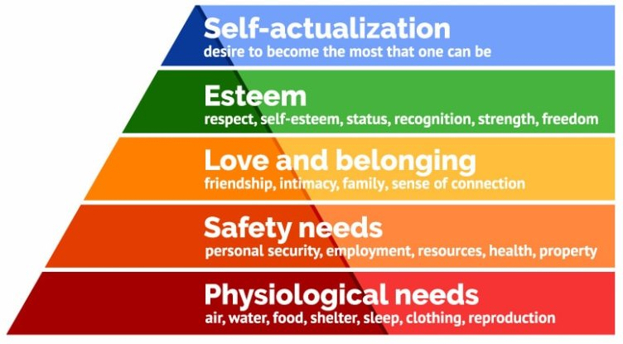
Notes:
It’s a good mental exercise to think about where education fits here?
You could argue that it is right at the top. It can only be a priority for families when some of their more pressing needs are being met - when the shift is made from short-term thinking about necessities to longer term thinking about future prospects.
Equally, for some neurodivergent children, you could argue that the cognitive load of: managing sensory differences in the school environment, masking, the requirement to control the physical urge for movement, the social pressures, managing a myriad of unpredictable changes (e.g., seating, supply teachers, timetable changes, inconsistency of rules) is so high that they no longer feel 'safe’.

Slide 18
I'd be under my duvet, ignoring the world...
Notes:
And why I feel that we should generally avoid medicalising and certainly criminalising school non-attendance is because I believe it is a behaviour which often makes perfect sense given the circumstances.
Illustrated beautifully by this comment from one of the family coaches, several of the coaches I interviewed for my doctorate expressed feeling unsurprised at a young person's absence from school which was seen to be more of a 'coping mechanism' than a disorder. We would all struggle given similar circumstances.

Slide 19
How is ATTEND being used?
Brighton & Hove
National pilot group
DFE
Attendance research project 24-25
Notes:
This slide gives an overview of how the framework is currently being used.
B&H - all schools have free copies and we offer central training for school staff and other services including social services, who have started to use it this year.
A group of EPSs have formed a national research group and are currently piloting ATTEND. incl. Derby City, Nottingham City, Nottingham County, Lancashire and Coventry. Mainly it has been rolled out to all schools through a comprehensive training programme.
DFE - interested but require an evidence-base and a 'train the trainer' system in place before taking it any further. It would be nice to see EP work influencing wider policy here.
Small pockets of research nationally e.g. TEPs focusing on ATTEND for their doctoral research.
I am running a research project In B&H this year with 3 of our large mainstream secondary schools, commissioned by the Schools Mental Health Service. Focus: Year 8 students with less than 85% attendance for the previous academic year. Each child will complete an ATTEND form with a key adult from school during the Autumn Term. I will analyse data for themes during the Spring Term, collate and feedback to schools and the LA to suggest some possible larger scale intervention models.

Slide 20

Next steps
Extend the evidence base & make improvements
Digitisation
Link to wider issues in education
Notes:
And finally – what next? I'd like to see some robust, independent research which extends the evidence base and looks at ways to improve and amend ATTEND.
I have also been asked frequently to digitise it. An electronic resource would enable local authorities to adapt the guidance to signpost to local resources and services. It could be regularly updated and collect data centrally to support with research. I'm very open to ideas on how to take this forward, as I have found it much harder than expected.
More widely – there needs to be more creative thinking about education. I am really interested in the debate about the function of education and how we can think more flexibly about what this looks like. We've seen for example that a hybrid model can work for some children during the pandemic. Does the physical school building model work for all our young people? For lots of our neurodivergent students schools can be a sensory nightmare. Equally, does school need to extend its remit to be more of a hub for social and community services, where some of the family-based issues can be addressed? We would benefit from revisiting the purpose of education and whether our current model is in fact fit for purpose.
I am really interested to hear your views. I have left a little time at the end for any comments, questions, thoughts or feedback and for those who would like to come and have a look at the packs, I have a couple with me.

Slide 21
Contact/references
The ATTEND Framework - this link takes you to a purchasing information page and a free 35-minute webinar
BHISS@brighton-hove.gov.uk - for general enquiries
Tobias, A. (2019). A grounded theory study of family coach intervention with persistent school non-attenders, Educational Psychology in Practice, 35:1, 17-33
Tobias, Adele (2018) Raising a ‘red flag’ by not going to school: A grounded theory study of family coach intervention with persistent school non-attenders. Other thesis, University of Essex and Tavistock & Portman NHS Trust. https://repository.essex.ac.uk/21406/
Pupil absence in schools in England, Autumn term 2023/24 - Explore education statistics - GOV.UK (explore-education-statistics.service.gov.uk)
Notes:
Thankyou for listening. Here are some references and helpful contacts if you are interested in hearing more.

Slide 22
References cont’d
Bronfenbrenner, U. (1979). The ecology of human development: Experiments by nature and design. Cambridge, MA: Harvard University Press.
https://www.ncbi.nlm.nih.gov/pmc/articles/PMC6456127
https://www.mind.org.uk/information-support/types-of-mental-health-problems/statistics-and-facts-about-mental-health/how-common-are-mental-health-problems
More than 70,000 children in England have a parent struggling with alcohol misuse | NSPCC
Families stuck in food insecurity are buying less fruit and veg as UK’s health divide widens | Food Foundation
Households in Temporary Accommodation, APPG
Maslow, A. H. (1943). A theory of human motivation. Psychological Review, 50(4), 370–396

