Slide 1
To what extent can 'imagined contact' be used to improve children's responses towards their disabled peers?

Slide 2
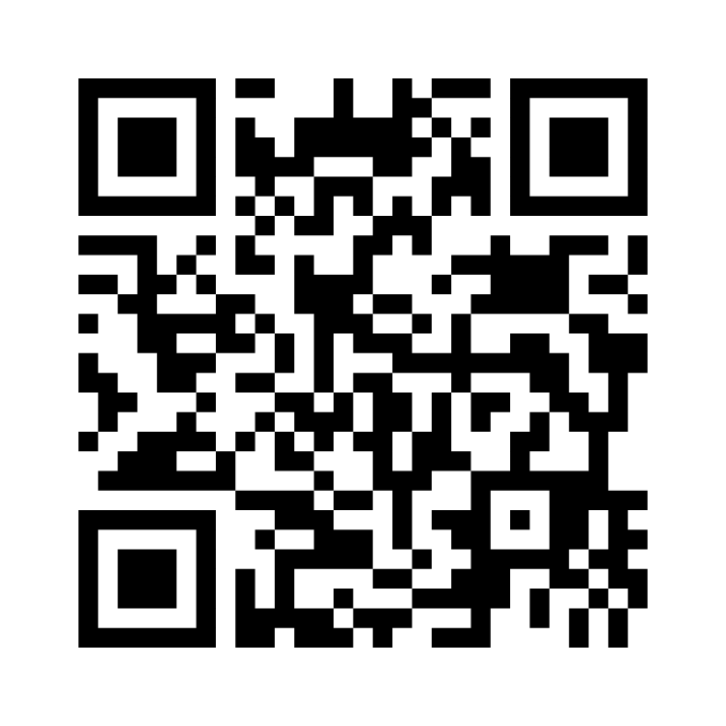
Hello!
Hello, I am Dr Soraya Khanna!
Trained at University of Southampton from 2020-2023
Started as a qualified EP in September 2023 at Wokingham Borough Council
Interested in exploring children’s social preferences and experiences through a neuroaffirming lens
menti.com 3193 3631

Slide 3
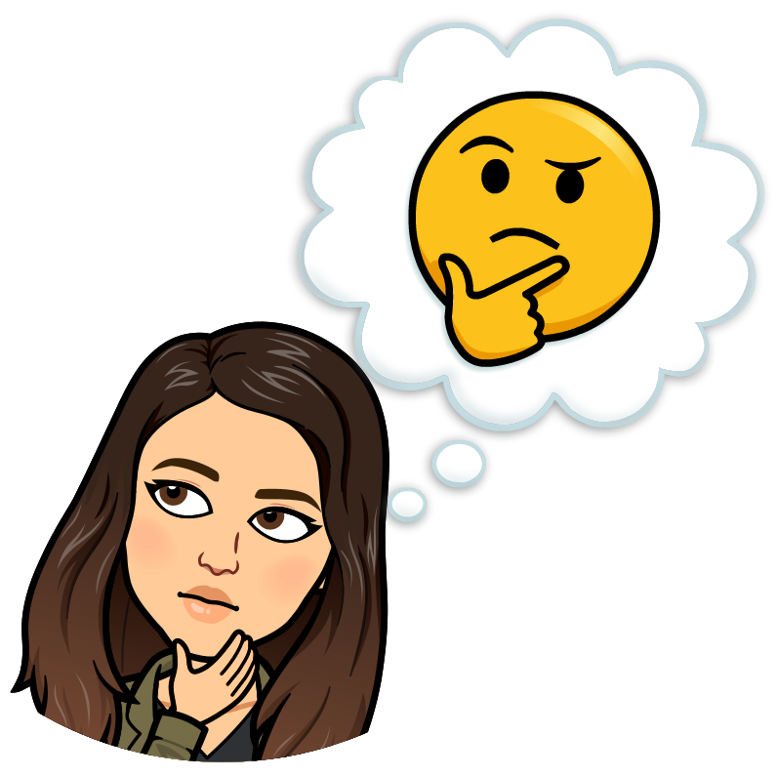
My perspective and language choices
Framing of
disability
My personal identity
Use of identity-first
language
Notes:
Firstly, I believe that reflecting on my own identity is essential before diving into this workshop. I want to acknowledge that I do not identify as disabled, and I am therefore mindful of the biased and limited perspective that I bring to this area. However, I’ve had the privilege of working with my supervisor Sian, who identifies as disabled. Her involvement has really enriched this research, not only grounding it in the evidence base but also her lived experience.
It’s important to explain how I’m framing disability here. Given this is a conference about inclusion, I know many of you are familiar with the models, so this is more about sharing my stance rather than defining them. My view aligns closely with the social model, seeing social, environmental, and attitudinal factors as what’s disabling when they create barriers. I also draw on the affirmative model, which celebrates disability as a positive identity, emphasizing disability pride, agency, and social justice, and viewing disability as a valued aspect of diversity.
Lastly, I will be using identity-first language—such as 'disabled person rather than person-first language, so person with disability’. I understand that this preference aligns with the views of many within the disabled community, as it reflects that disability is an integral and valued part of identity, not something separate, but of course, I do this with the understanding that every person has their own preferences.

Slide 4
Setting the scene
~ 1.3 million disabled children under the age of 18 in the UK, which is around 9% of the disabled population.
Research shows that disabled children face higher rates of bullying and exclusion than their non-disabled peers.
(Beckman et al., 2020; Jones, 2021; Nowicki et al., 2014; Obrusnikova et al., 2010; Oksendal et al., 2019; Pinquart, 2017)
(Department for Work and Pensions, 2021)
These negative responses impact disabled children’s lives, often leading to fewer social opportunities, feelings of loneliness and isolation.
(Woodgate et al. 2020)
Notes:
In the UK, around 1.3 million children under 18 are disabled, representing about 9% of the disabled population (Department for Work and Pensions, 2021).
While efforts have been made to promote acceptance and inclusion in educational and community contexts, and policies like the Equality Act, SEND Code of Practice, and Disability Strategy, challenges persist with children’s responses toward disabled peers. Research indicates higher rates of peer victimisation for disabled children, both face-to-face (Oksendal et al., 2019; Pinquart, 2017) and online (Beckman et al., 2020), and that non-disabled children may exclude disabled peers due to perceived ‘differences’ (Nowicki et al., 2014) or fear reactions from others if they befriend them (Obrusnikova et al., 2010).
As you can imagine, these negative responses can have harmful effects. For example, Woodgate et al. (2020) found in a systematic literature review that some disabled children report limited access to typical activities, feelings of loneliness, and self-imposed isolation, despite many desiring meaningful friendships.

Slide 5
Outline of the session
Setting the scene
Children’s material culture
Research
Implications & Next Steps
Notes:
Now that we've set the scene, I’ll be using a social and affirmative lens to explore how we can improve children’s responses to their disabled peers.
We’ll start by briefly considering why contact with disability matters, then look at how children engage with disability through their material culture in their day to day lives - books, tv shows and toys.
My wish is for positive disability representation to become more mainstream as the evidence base suggests how important this representation is, and therefore I am really excited to share my thesis research focusing on imagination and play as an example of how we can do this.

Slide 6
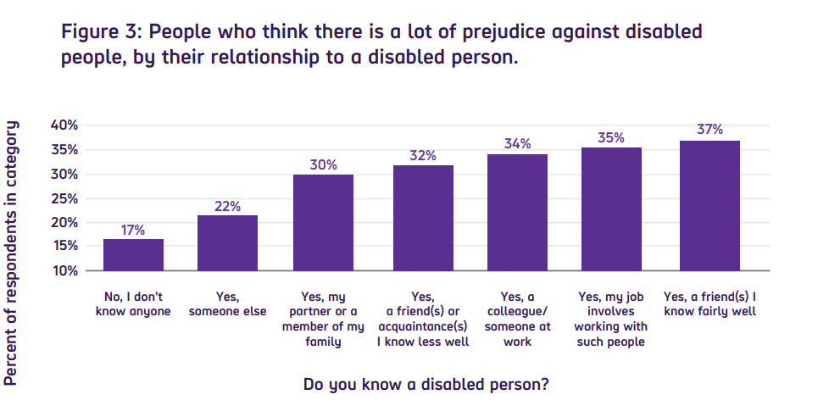
Contact matters
Contact Theory (Allport, 1954)
Notes:
One of the key theories behind this work is contact theory, originally proposed by Gordon Allport in 1954. Contact theory suggests that direct, positive contact between people from different groups can help reduce prejudice. This theory is particularly relevant when it comes to attitudes toward disabled people, as research suggests that knowing someone who is disabled has a strong impact on how much disability prejudice is perceived.
For example, only 17% of people who don’t know anyone with a disability recognize significant prejudice toward disabled people, but this figure jumps to 37% among those who have a close disabled friend. This shows that personal connections make people more aware of the barriers and biases disabled people face.

Slide 7
Direct contact interventions
Increased contact self-efficacy and empathy, reduced anxiety
Children aged 6–14 years
Various countries
Positive, meaningful contact with disabled peers
Increased favourable attitudes towards these children
(Armstrong et al., 2017; Chae et al., 2019; Freer, 2021; Macmillan et al., 2014; Morina & Carnerero, 2020)
Notes:
There is increasing agreement within the literature that positive interactions between non-disabled children and those with disabilities are necessary to promote positive attitudes towards disability. Recent systematic reviews and meta-analyses have found children’s positive, meaningful contact with disabled peers (including those with physical and learning disability) is strongly associated with an increase in favourable attitudes towards these individuals. These studies included children aged six to fourteen years in various countries, including the UK. These findings were mediated by factors such as increased contact self-efficacy (which refers to a person’s confidence in their ability to interact effectively with members of different social groups), increased empathy, and reduced anxiety towards interacting with disabled individuals.

Slide 8
Direct contact interventions
Some schools have low populations of SEND pupils
Not always possible!
Psychological barriers e.g., anxiety, low confidence
(Crisp & Turner, 2012; Ioannou, 2019; Mazziotta et al., 2011)
Notes:
Whilst positive direct contact has been shown to be an effective way of improving children’s attitudes towards disabled peers, it can be challenging to implement and achieve in practice (Crisp & Turner, 2012). This is particularly true for educational settings, as some schools contain limited opportunities for pupils to interact with disabled children due to small populations of individuals with SEND. Even when disabled children are present, there are psychological barriers that may reduce children’s willingness to positively interact with their peers with disability (Ioannou, 2019), such as anxiety or low confidence (otherwise known as low ‘contact self-efficacy’; Mazziotta et al., 2011).

Slide 9
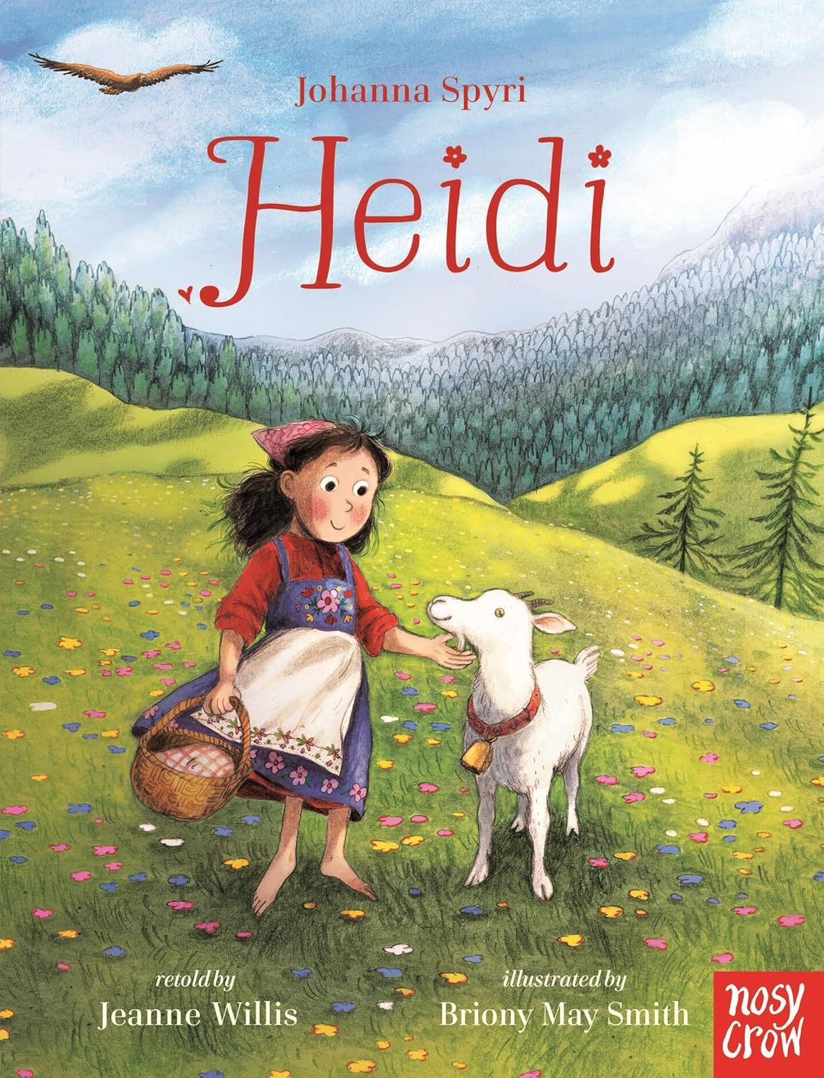
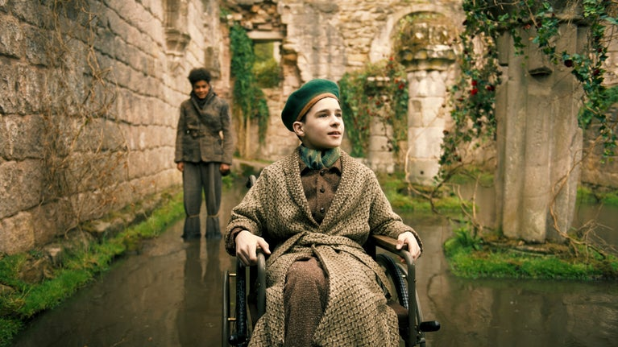
Older representation in literature
“I shall get well! I shall get well!” he cried out. “Mary! Dickon! I shall get well! And I shall live forever and ever and ever!”
Notes:
However, children don’t only encounter disability through direct interactions. They also experience disability indirectly through the media and material culture around them.
Representation of disability in children’s literature has been around for quite some time. When I was younger, I read stories like The Secret Garden, Heidi and What Katy Did. Through these stories, I learned about disabled characters like Katy, Colin, and Klara who all strive to 'get better' by the end of the story. These narratives often follow a ‘tragedy’ model, implying that disability is something to be overcome. This reflects an outdated model of disability that suggests a person isn’t whole until they are ‘cured’ or ‘better.’ Here is a quote from Colin in the Secret Garden…

Slide 10
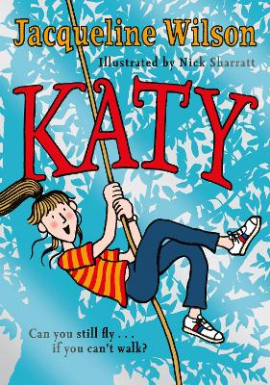
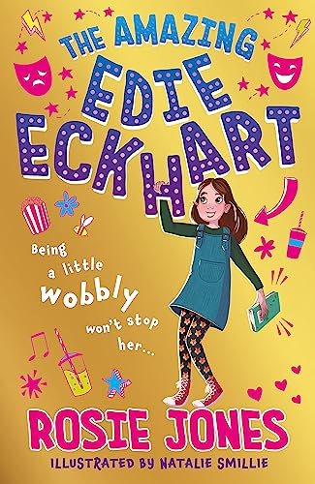
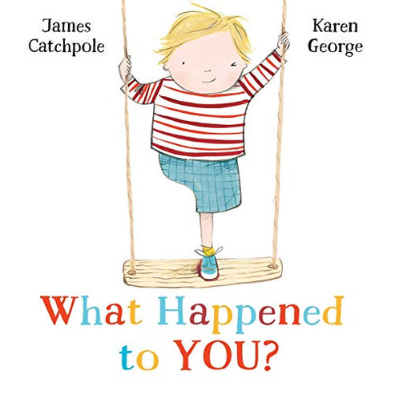
Newer representation in literature
“Me and Oscar became best friends on the first day in Reception class when he walked straight up to me and asked what was wrong with my legs. I told him nothing was wrong with them and that I had cerebral palsy … Oscar was silent for about five seconds. ‘Okay,’ he said. ‘Do you want to play Lego?’ We’ve been best friends ever since!”
Notes:
Today, we’re seeing a shift toward the social model of disability in children’s literature. In newer stories, disabled characters navigate the world with their impairments rather than being miraculously cured. They use friends, aids, and other supports to access the world around them.
For example, What Katy Did has been reimagined by Jacqueline Wilson, providing a more positive take. Books like James Catchpole’s What Happened to You?, Can Bears Ski?, and Rosie Jones’s The Amazing Edie Eckhart, which features a main character with cerebral palsy celebrate disabled characters and portray them positively, with a quote to illustrate this from Edie Eckhart.

Slide 11
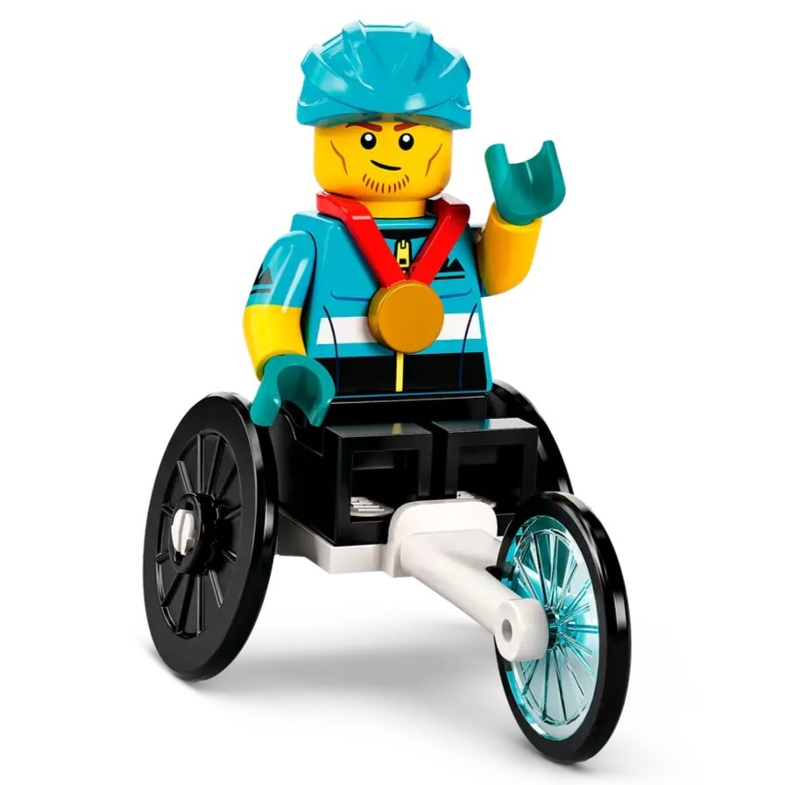
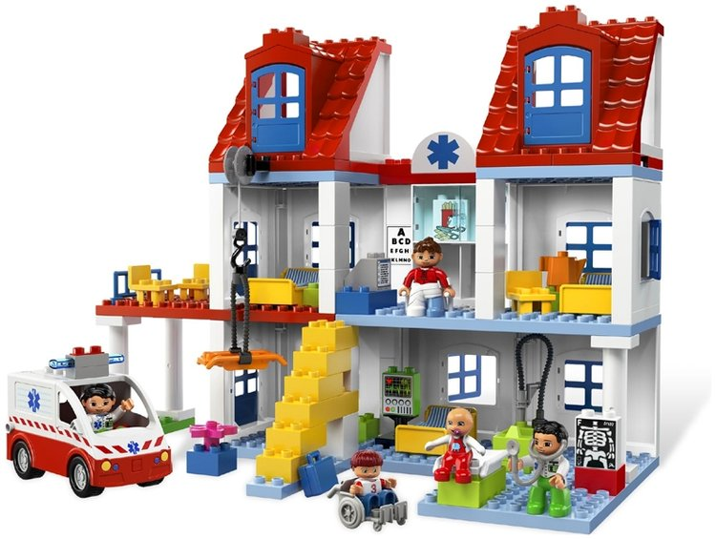
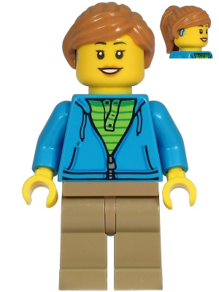
Representation in LEGO
“We understand the importance of representation in toys ... [we] want everyone to imagine themselves as part of the action. We are committed to developing our LEGOCity sets in away that ensures they are representative of the world in which children are living. We will continue to include mini figures that portray people with diverse ages, professions, genders, and characteristics.” (LEGO, 2020; 2022)
“Any minifigure in our assortment can be deaf if the child decides to play that it is” … “We have recently introduced a LEGO element that resembles a wheelchair. We have not as such launched a disabled minifigure.” (LEGO, 2016)
Notes:
So I’m not just interested in books but in material culture more broadly - especially toys but I won’t be able to show all examples now for the sake of time! In 2016, LEGO’s stance was that 'any minifigure in our assortment can be deaf if the child decides to play it is.' They had also introduced a LEGO element resembling a wheelchair but hadn’t launched a specific disabled minifigure.
I appreciate that some might feel that making disability visible in toys risks ‘othering.’ But it is my view that actually, it’s the lack of visible representation that does this - by implying that disability is something we can ignore or hide. Including clear, visible disabilities in toys reflects real life, affirms disabled children, and helps all children see disability as a natural part of human diversity.
Fast forward to 2020 and 2022, and LEGO’s message has evolved and echoes this view. They’ve stated a commitment to making LEGO sets that represent the diverse world children live in. This shift means we’ve moved from virtually zero disability representation, except in hospital settings, to greater visibility of disability in LEGO sets, with elements like hearing aids and ramps.

Slide 12
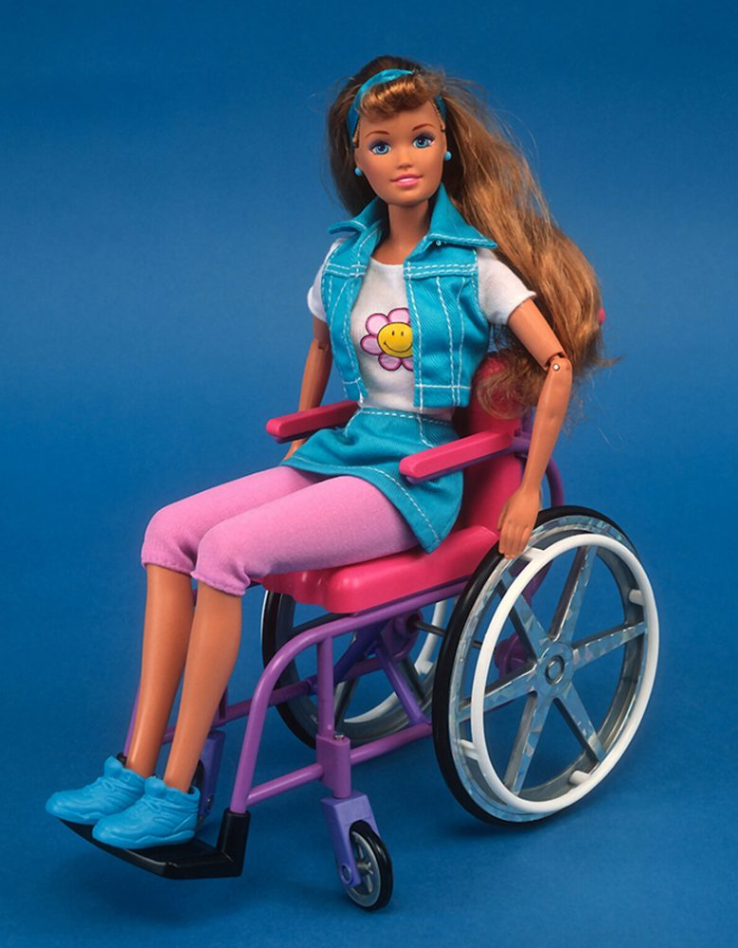
Representation in Barbie
Becky was produced in 1996
But… there was a problem with the house!
What could Mattel do?
Medical model: change Becky
Social model: change the house
Notes:
Now, let’s turn our attention to Barbie and a doll named Share a Smile Becky, introduced by Mattel in 1996. Becky was notable as one of the first Barbie dolls to use a wheelchair, which was a step toward disability representation. However, there was a major issue: Becky’s wheelchair didn’t fit through the doors of the Barbie Dreamhouse, a central part of Barbie’s world for many young children. Imagine being six years old and discovering that your Barbie’s wheelchair can’t even enter the Dreamhouse!
At that point, Mattel had two options. They could have taken a medical model approach, redesigning Becky and in particular her wheelchair to make it slimmer so it would fit through the door. Or, they could have embraced a social model approach, redesigning the Dreamhouse to make it more accessible. Unfortunately, they didn’t choose either option. Instead, by 1997, Mattel stopped producing Becky altogether, which in my view reflected attitudes towards disability that we used to see at that time.

Slide 13
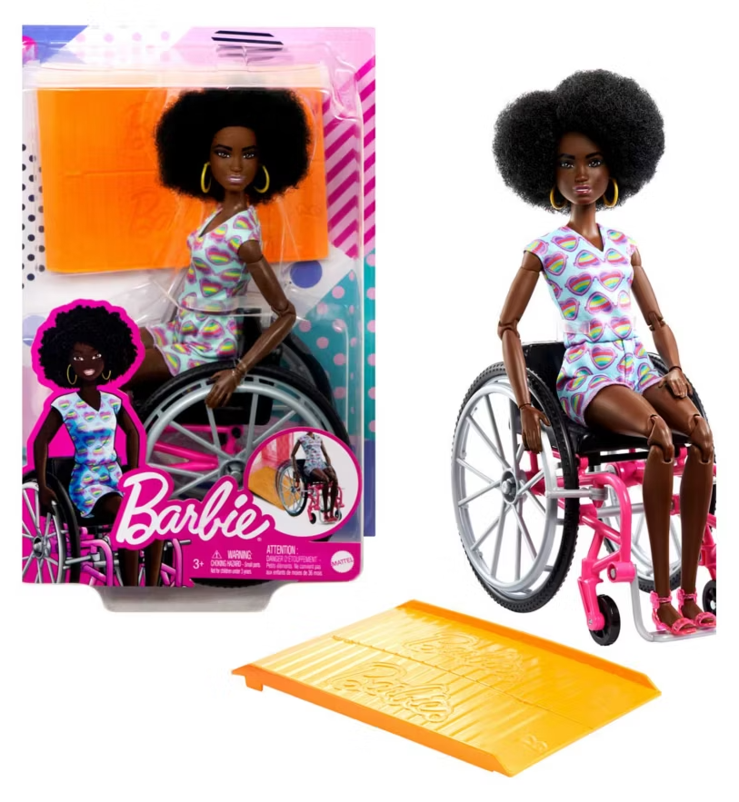
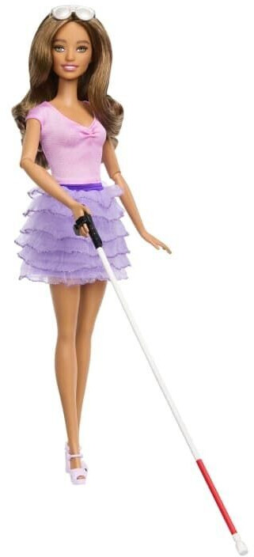
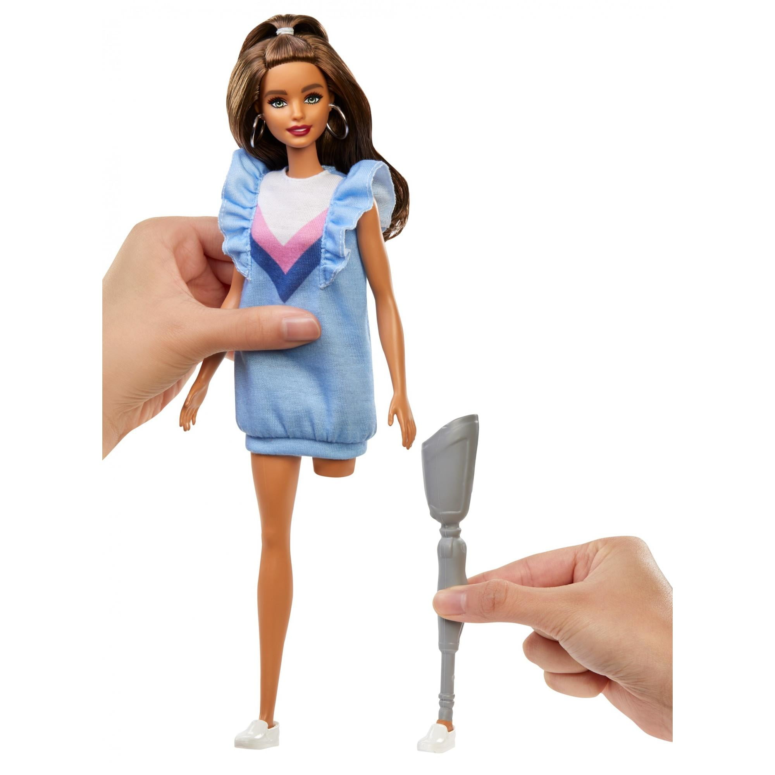
Representation in Barbie
Notes:
Since then, Mattel has made progress with disability representation in the Barbie line. They’ve now released Barbie dolls using a wheelchair, barbie with a visual impairment using dark glasses and a cane, as well as Barbie with a prosthetic leg, which shows more diverse disability representation bringing different needs and everyday aids into Barbie’s world.
It’s not clear if wheelchair Barbie fits in the newer Dreamhouses, but the houses do look bigger now, suggesting Mattel might be thinking more about accessibility but it is something that I need to look into more!

Slide 14
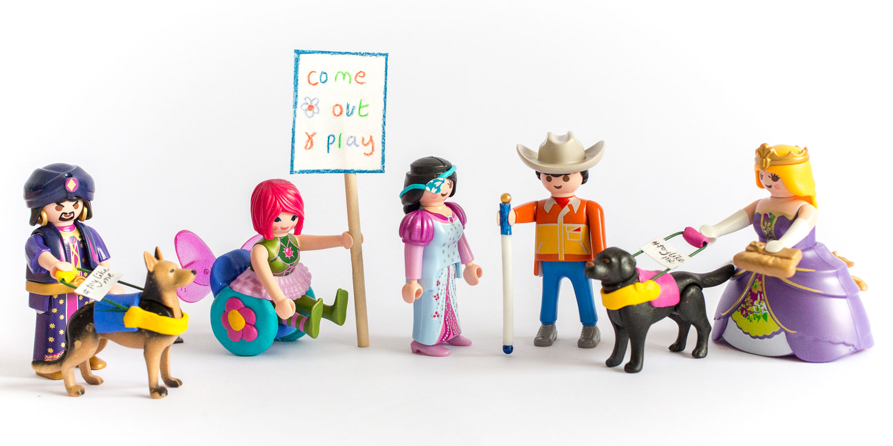
“As someone who had grown up wearing hearing aids, I remembered firsthand how it felt to be a child who never saw themselves represented by the mainstream and what that can do to a child’s self esteem. To exclude in the toy box teaches children it’s OK to exclude in real life. I wanted to change this for generations to come by getting global brands like Lego, Mattel and Playmobil to include positive representations of disability in their products (Rebecca Atkinson)”
Notes:
I’d just like to quickly highlight Toy Like Me, founded by Rebecca Atkinson who noticed the lack of disability representation in toys. Rebecca created Toy Like Me as a campaign and later as a non-profit organisation. This direct quote from her sums up her mission better than I could put into my own words. If you want to know more, they’ve created a website to house all of their knowledge in one place so you can find lots of information about creating a toy box with positive disability representation, which I’ve linked if you click on the logo.

Slide 15
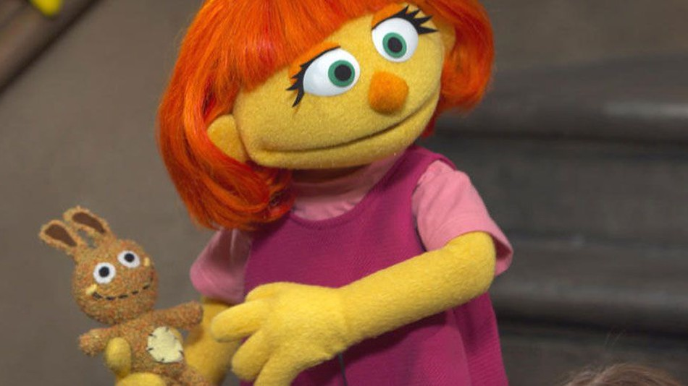
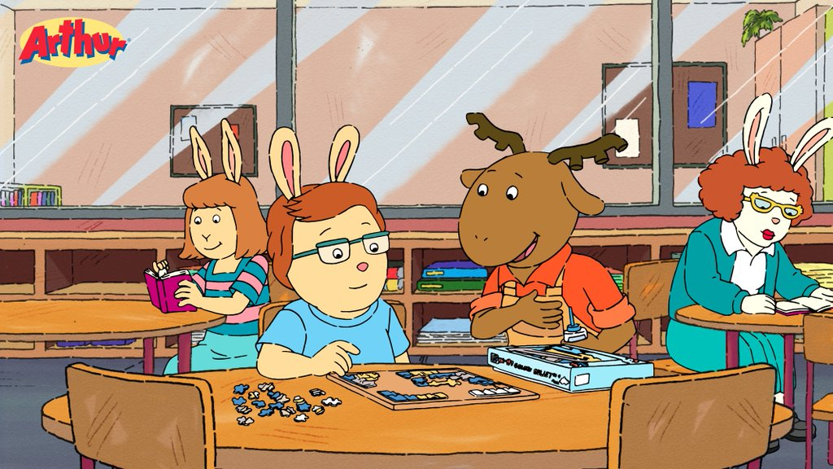
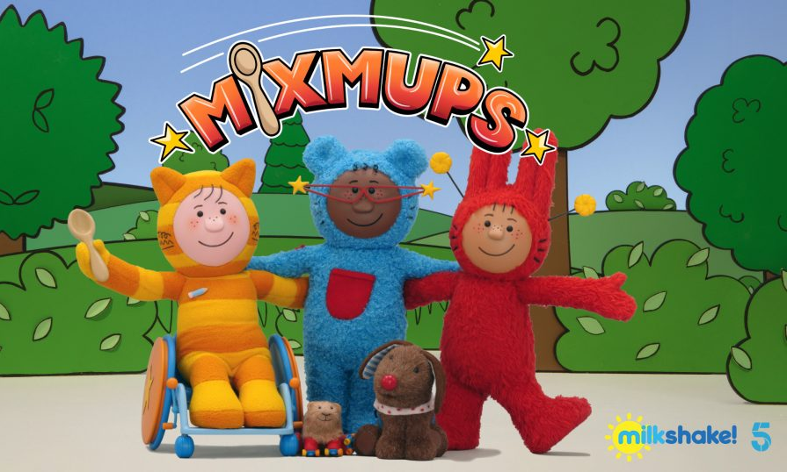
Representation on television
“So disabled children are excluded from so much, but if this show is being made by a disabled person, myself, then how do I create a small world which is how the world would be if it was fully inclusive.”
Notes:
Disability representation in children’s TV has often been limited, focusing on characters who needed help or were viewed as ‘different’. For example, Arthur featured Carl, a character with Asperger’s syndrome, with episodes centring on how to ‘work with’ his behaviours. Sesame Street initially included disabled characters in just one-off segments, but in 2015 introduced Julia, an autistic Muppet, as a recurring character. More recently, Mix-Mups, created by Rebecca Atkinson (who also founded the ToyLikeMe campaign), tackles disability representation really thoughtfully. The link here includes a BBC Sounds podcast and a video clip of a sports day episode, where Atkinson explains her approach to avoiding ableist portrayals and normalising disability representation.

Slide 16
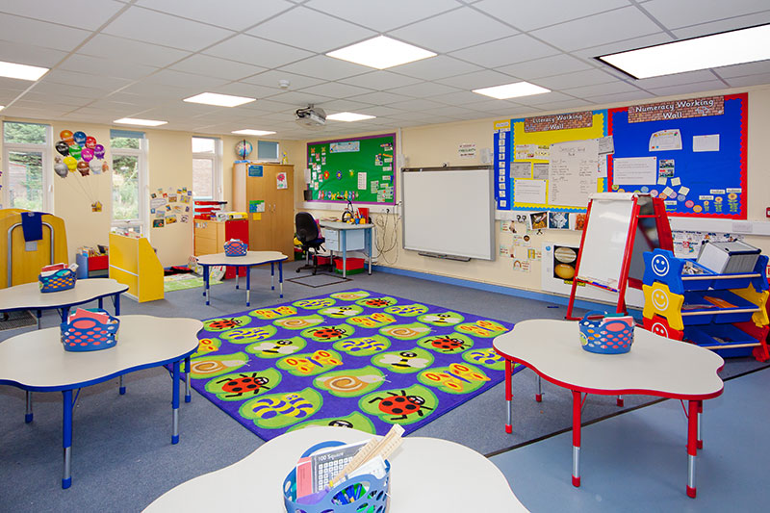
Representation in school
Disability representation in classrooms remains quite low
Favazza et al. (2017): 93.75% of 32 classrooms had little or no representation
Yu & Kim (2023): 84% of 59 classrooms had little or no representation
menti.com 3193 3631
Notes:
We’ve looked at toys and books; now let’s see what’s happening in schools, where disability representation remains low. In 2017, Favazza and colleagues used the Inventory of Disability Representation to survey 32 kindergarten classrooms. They found that 93.75% of classrooms had little or no disability representation. Similarly, a 2023 study by Yu and Kim in 59 South Korean classrooms found over 84% with limited or no visibility of disability. To my knowledge, no similar studies have been done in UK classrooms. Now, I’d love to get your observations. On a scale from 1 to 5, consider how much disability representation you’ve noticed in classroom materials and displays—not for research, just to get a sense! I know it can be hard to recall details, especially in busy nursery settings, but any insights would be valuable.

Slide 17
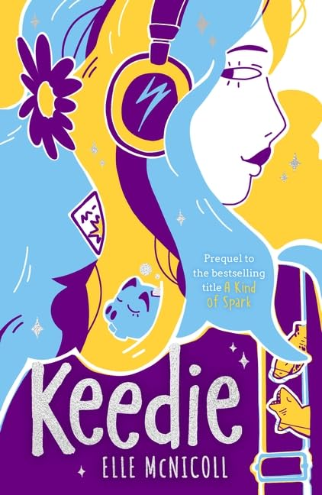
Is silence unhelpful?
Do you know what they call kids like us, in England?” she asks me.
“I can imagine”, I say, “but tell me.”
“SEND”
“SEND?”
“Yeah”
“Is it short for something?”
“No, it’s special educational needs and disabilities”.
“Why can’t they just say disabled?”
"Maybe it's because they want to send us away” Bonnie finally says quietly."
Notes:
Before I go into my research, I thought I’d share this quote with you which I think nicely illustrates what happens if disability is absent. This is an extract from a book called Keedie which is another great book by Elle McNicoll, and this is Bonnie speaking to Keedie who says …
So if we don’t talk about disability, if we treat it as a dirty word, then children are going to make their own meaning from it. If we’ve got that message of exceptionality because they’re not seeing disability in classrooms or teachers, then we have a layer of silencing taboo that I argue is unhelpful.

Slide 18
Imagined contact
Defined as the positive ‘mental simulation of a social interaction with a member of members of an outgroup’ (Crisp & Turner, 2012)
Extension of facilitating meaningful, positive ‘direct contact’ (Allport, 1954)
Enables individuals to ‘imagine’ perspectives and create/practice scripts
Other applications include:
Ethnic minoritised groups (Birtel et al., 2019)
Immigrants (Greder et al., 2020)
Refugees (Smith & Minescu, 2022)
Notes:
Research has examined how these types of indirect contact, specifically through books and TV, influences children’s attitudes toward disability. They are officially termed as extended contact (knowing someone with a positive relationship with a disabled peer) and vicarious contact (observing positive interactions with disabled peers). However, for my literature review, I focused on imagined contact, which I argued is potentially more impactful as it involves children directly in imagining interactions with disabled peers.
So what is it? Imagined contact is an extension of Allport’s contact theory and based Crisp and Turner’s work, which is defined as… it is argued to prepare individuals for real-life interactions through imagining perspectives and helping to create scripts. This approach suits children’s natural imagination and it has been suggested that it can evoke emotions they’d feel in direct contact.
While this work centers on disability, imagined contact has shown positive effects with other groups, like ethnic minorities (Birtel et al., 2019), immigrants (Greder et al., 2020), and refugees (Smith & Minescu, 2022)

Slide 19
Systematic literature review
To what extent can imagined contact interventions be used to influence children’s responses towards their disabled peers?
Promising evidence that imagined contact can be used to improve children’s attitudes and behavioural intentions … but not yet behaviour
Only two reviews to date conducted in 2017, and there has since been a rapid growth of imagined contact studies
Seven studies, 2011 – 2022
Italy, England and Greece
Physical disability (4), learning disability (2), sensory impairment (2), Asperger’s Syndrome (1), ‘behavioural difficulties’ (1)
Attitudes, intentions and actual behaviour (?)
High level of heterogeneity between studies
Lack of control for children’s previous contact with disabled individuals
Large focus on physical disabilities
Notes:
I won’t delve too deeply into the systematic literature review today, as my focus is on the empirical study. At the time of doing my thesis, there were two reviews (both from 2017) which included just one study on imagined contact. Since then, there has been notable growth in this field, so my aim was to update our understanding.
Seven studies from 2011-2022, conducted in Italy, England, and Greece, met the inclusion criteria. These primarily focused on responses towards physically disabled children, but there were also studies focusing on. Methods to elicit imagined contact in the intervention varied widely, from manipulating 2D images in a play scene, writing letters, to simply imagining scenarios, with sessions lasting 2 to 10 minutes and some with follow-ups ranging from 1 to 17 weeks. Following the intervention, their aim was to assess children’s attitudes, behavioural intentions, and, in one case, actual behaviour—though I questioned the validity of that measure, as it involved a five-minute observation of an interaction between disabled and non-disabled children.
Findings suggested that imagined contact can improve attitudes and behavioural intentions toward disabled peers, though no reliable evidence supports changes in actual behaviour. Stronger evidence exists for responses toward children with physical impairments. However, several issues emerged: So most studies didn’t control for prior contact with disabled individuals so this was a potential confounding variable, they largely focused on physical disability, highlighting a need for research on ‘hidden’ disabilities, and importantly there was very high heterogeneity between studies (e.g., participant groups and study design), so one of my main conclusions was that future studies should replicate successful elements of imagined contact to develop practice-based guidance, instead of diversifying methods further.

Slide 20
Empirical study: focus on autism
The social exclusion and bullying of autistic young people continues to be a significant concern (APPGA, 2019)
Loss of confidence, social withdrawal, school avoidance, masking = mental health difficulties (e.g., Chapman et al., 2022; Liu et al., 2022; Saggers et al., 2017)
Deficit-based perspectives could be perpetuating negative responses from peers (Bottema-Beutel et al., 2021), what about neurodiversity?
We need a shift from intervening by changing the individual to a more systemic, inclusive approach!
Notes:
So with those limitations in mind, that brings me to my empirical study. So despite growing efforts to promote inclusion for autistic young people, many still face harmful peer responses, including negative attitudes, victimisation, and bullying. This often leads to reduced confidence, social withdrawal, masking, and an increased risk of mental health issues.
In my opinion, autism is still often viewed through a deficit-based lens, implying it needs ‘fixing’ rather than recognising it as part of natural neurodiversity. My research takes a neuroaffirming perspective, arguing that instead of focusing on changing autistic children’s behaviours (as seen in some social skills interventions, which can reinforce deficit views), we need a systemic approach that addresses environmental barriers. Specifically, I believe we should focus on how children respond to their autistic peers, where imagined contact can play a role.
As my review highlighted, only one previous study had explored imagined contact to improve attitudes towards a child with Asperger’s Syndrome. However, as this term is outdated, it’s challenging to generalise those findings to individuals who identify as autistic today and there were quite a few other issues with this study which unfortunately I don’t have time to go into now but I have referenced my thesis at the end.

Slide 21
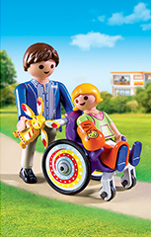
Use of toy figures
Most previous research has tended to use 2D figures, writing activities and/or imagination alone but some have explored the use of toys (e.g., Jones et al., 2017)
3D figures in pretend play might offer children a more tangible, hands-on experience of imagined contact
Mentally transforming objects and playing fictional roles allows children to explore experiences beyond their own perspective (Gleason & White, 2023)
Notes:
As I mentioned earlier, much of the past research on imagined contact used 2D images or scenarios at best but Sian and her research team have previously explored the use of toys to make imagined contact more tangible and found an increase in positive attitudes towards disabled and immigrant children populations, but the disability study wasn’t part of my literature review as it remains an unpublished project.
Even though studies haven’t compared the strength of imagined contact effects between 2D and 3D figures, I believe that using 3D figures in pretend play offers children a more tangible, hands-on experience of imagined contact. This aligns with a recent review by Gleason and White (2023), which suggests that mentally transforming objects and playing different roles in fictional worlds allows children to explore experiences beyond their own perspective. As we’ve seen, toy manufacturers are increasingly committed to releasing toys that positively represent disability but what should and could we actually do with them?

Slide 22
Research questions
Does participating in an imagined contact intervention with 3D toy figures improve children’s responses towards their autistic peers?
Hypothesised an increase in cognitive attitudes (beliefs), affective attitudes (feelings), behavioural attitudes (intentions), and self-reported behaviour
Which variables mediate the relationship between children’s participation in an imagined contact intervention and their responses towards autistic peers?
Hypothesised mediating variables: increased cognitive empathy, affective empathy and ‘inclusion of the other in the self’, decreased anxiety
Notes:
I sought to explore which variables mediate the relationship between imagining contact with an autistic peer and responses towards these individuals, hypothesising that increased cognitive empathy (the ability to adopt the perspective of another), affective empathy (the ability to vicariously experience another person’s emotion), inclusion of the other in the self (the perception of one’s degree of closeness to another person) and decreased anxiety would be significant mediators.

Slide 23
Method
Experimental (N = 31)
Imagined contact with autistic peers
2 = autistic
3 = knew autistic individuals
61 participants
6-9 (M = 7.28)
30 males
31 females
Control (N = 30)
Imagined contact with neurotypical peer
2 = autistic
1 = knew autistic individuals
Notes:
61 participants aged between 6 to 9 years from primary schools in Berkshire took part in this study and they were randomly assigned to either the experimental condition, imagining contact with autistic peer, or the control condition, imagining contact with a neurotypical peer. Four children identified as autistic and four children knew at least one autistic person.

Slide 24
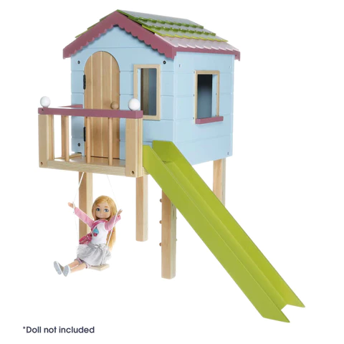
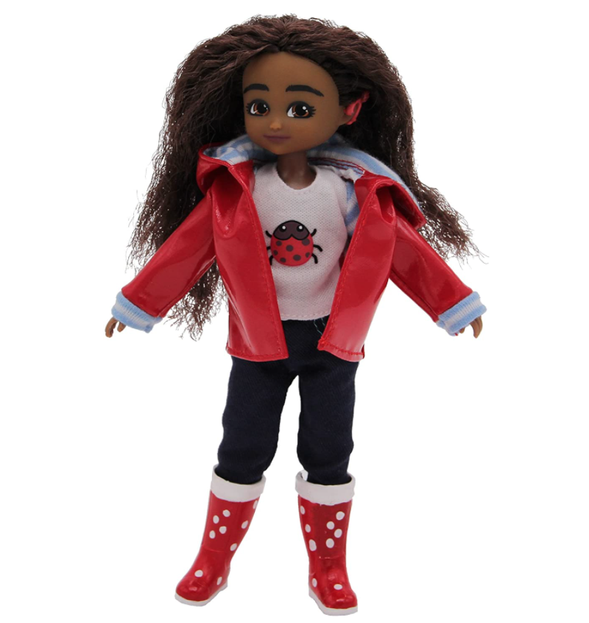
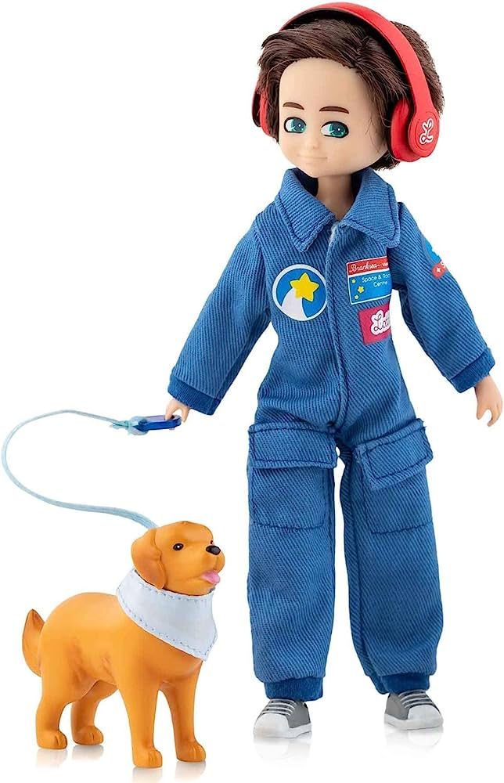
Procedure
3-minute intervention
All participants were given an age-appropriate definition of autism (from the National Autistic Society)
Notes:
All participants were given an age-appropriate definition of autism from the National Autistic Society. They were then presented with this tree house play scene and asked to choose one of four 3D figures with whom they most identified with and here is an example. They were then either presented with an autistic or neurotypical doll and a first-person introduction (i.e., Hello my name is Hayden) depending on their assigned condition, here is the autistic doll Hayden produced by ToyLikeMe, and administered the pre-intervention dependent measures which I will show you on the next slide.
After these measures, for the intervention itself, I asked them imagine they go to this park together and show me how they would have a really good time for three minutes as across the imagined contact literature with regards to all applications in children, not just disability, this seems to be the ‘golden time’, before being administered with the post-intervention measures.

Slide 25
Measures
Three attitude components towards autistic peers were measured on a 5-point Likert scale (Children’s Attitudes Towards Autism Questionnaire; CATAQ; Derguy et al., 2021)
Cognitive attitudes (beliefs)
Affective attitudes (feelings)
Behavioural attitudes (intentions)
Notes:
So for the measures, I assessed three attitude components towards autistic peers measured on a 5-point likert scale pre and post-intervention, including beliefs, feelings and behavioural intentions.

Slide 26
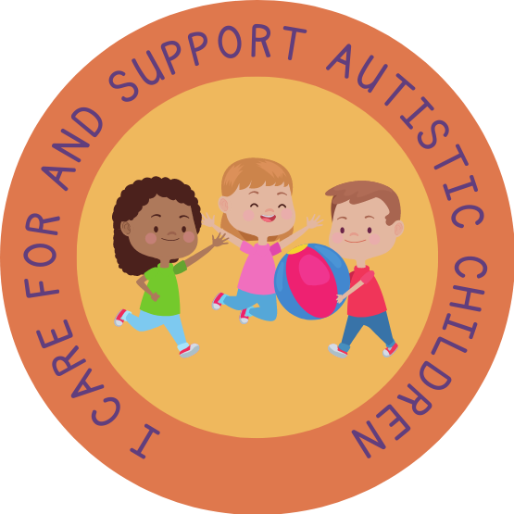
Self-reported behaviour
Pre-intervention
Post-intervention
Notes:
A self-reported behaviour measure which firstly asked participants to allocate five coins between a neurotypical and autistic hypothetical peer, and then asking whether they would choose to wear a sticker after the intervention which said ‘I care for and support autistic children’

Slide 27
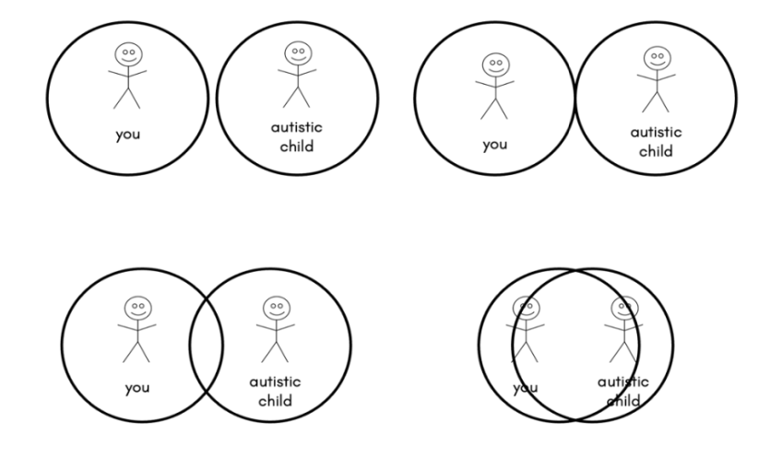
Mediating variables
Four mediating variables on a 5-point Likert scale, excluding IOS
Affective empathy:
2 questions e.g., do you feel the same emotions that autistic children feel?
Cognitive empathy:
2 questions e.g., do you think in the same way that autistic children think?
Anxiety
4 questions e.g., would you feel nervous about making friends with them?
Inclusion of the other in the self
Notes:
I also administered measures for the four mediating variables pre and post, with questions on a 5-point Likert scale apart from inclusion of the other in the self which was measured using four pairs of overlapping circles asking participants to choose one.

Slide 28
Results
Significance accepted at p < .05 level
Separate two-way analysis of covariance (ANCOVA tests)
Four covariates: age, sex, identify as autistic, no. of known autistic people
Notes:
Firstly, I did two-way analysis of covariance tests to look at group differences in the attitude components whilst controlling for four covariates, which were age, sex, whether participants identified as autistic and the number of autistic individuals they knew.
I wasn’t sure about the knowledge and experience of statistics in the audience so I have really oversimplified these findings into a visual format using just the numbers from the beliefs component, as the pattern of results was the same for all three components of attitudes. Significance was accepted at the .05 level.
For beliefs, feelings and intentions, the post-intervention mean scores (the blue bars) were significantly more positive in the experimental compared to the control group. There were no significant differences for the pre-intervention scores, indicating that the attitudes were at similar levels beforehand. There was also a significant improvement in the mean scores from pre- to post-intervention (so from red to blue) in the experimental group, but not for the control group.

Slide 29
Results
Significance accepted at p < .05 level
Logistic binomial regression (dependent variable = dichotomous)
Four covariates controlled for, as well as pre-intervention coin measure
Notes:
To test whether there was a difference in groups for the sticker measure, I conducted a binomial logistic regression controlling for the four covariates I mentioned before, as well as the pre-intervention coin measure. The model was not significant and as you can see, the choice to wear a sticker or not was extremely similar between groups. Reflecting back, I wondered if the sticker measure accurately represented their behaviour and views towards autistic peers as some children might have chosen a sticker because they saw a classmate have one, so future research should perhaps observe children’s interactions with autistic peers in more authentic and multiple contexts.

Slide 30
Results
Serial mediation model (Model 6 in PROCESS) to assess whether there was a serial mediation effect with beliefs and feelings on behavioural intentions
Positive beliefs towards autistic children
Positive feelings towards autistic children
Imagining
contact with an autistic peer
Positive intentions towards autistic children
Notes:
Finally, I did some mediation analyses but again I have oversimplified the diagram without the numbers for the purpose of this presentation but happy to share more detail if anyone wants it.
So firstly I found a serial process, almost like a chain reaction. So for those who imagined contact with an autistic peer, positive beliefs about autistic children emerged first. This suggests that understanding and knowledge played a crucial role in shaping individuals' initial attitudes. These positive beliefs, in turn, led to positive feelings, as people tend to feel more positively about something when they understand and appreciate it. Finally, these positive feelings influenced their intentions towards autistic children, creating a meaningful chain of change. Significantly, when we reversed the order, starting with feelings before beliefs, this sequence lost its significance. This emphasises the pivotal role of knowledge and understanding, represented by positive beliefs, in shaping attitudes.

Slide 31
Results
Four simple mediation models (Model 4 in PROCESS) to assess the four main mediators: cognitive/affective empathy, IOS and anxiety
Increased cognitive empathy and inclusion of the other in the self
Imagining
contact with an autistic peer
Positive intentions towards autistic children
Notes:
Next, I looked at the four main mediators separately but I have just combined two here for ease. So firstly, I found that imagining contact with an autistic peer increases positive intentions towards autistic peers through increasing cognitive empathy, so adopting the perspective of autistic children and inclusion of the other in the self, so feeling more psychologically connected.

Slide 32
Results (last results slide, promise!)
Four simple mediation models (Model 4 in PROCESS) to assess the four main mediators: cognitive/affective empathy, IOS and anxiety
Negative intentions towards autistic peers
Increased anxiety
Imagining
contact with an autistic peer
Notes:
In a surprising twist, I found that instead of reducing anxiety as I had initially predicted, the intervention actually led to an increase in anxiety among the participants. When I examined the link between anxiety and intentions in isolation, it seemed that imagining contact with an autistic peer was associated with negative intentions.

Slide 33
Results (last results slide, promise!)
Four simple mediation models (Model 4 in PROCESS) to assess the four main mediators: cognitive/affective empathy, IOS and anxiety
Increased anxiety
Imagining
contact with an autistic peer
Increased cognitive empathy and inclusion of the other in the self
Positive intentions towards autistic peers
Notes:
However, when we inputted all the mediators into one model to look at the impact on intentions, the overall impact of the intervention revealed that intentions were positive.
You’re probably thinking what is going on? Well … as there was increased cognitive empathy and inclusion of the other in the self, I have tentatively hypothesised that having a better understanding of autistic people's experiences and feeling psychologically connected might have acted as buffers against the anxiety. Think of it as a situation where you might feel a bit nervous about interacting with someone new, but because you now understand the other person's perspective and feel connected, you still want to be friendly and helpful towards them. However, I get that this has raised more questions that I had originally so we definitely need further research.
There was no significant effect for affective empathy and just to say that the analyses were run without the participants who identified as or knew someone autistic and the pattern of results were the same.

Slide 34
Limitations
Lack of follow-up
Duration of effects will vary
Limited sample
Study conducted in small region
Need for qualitative
Need to gain stakeholder voice!
Conduct more longitudinal research!
Larger and diverse samples to find out how it works/for who?
Use mixed-methods, actively collaborative with autistic youth
Notes:
Before thinking about the implications of these results, it is important to acknowledge some of the key limitations of the study.
Firstly, the lack of follow-up raises concerns about the long-term effects of the intervention as the duration of the effects could vary based on many individual and contextual factors, so we definitely need more longitudinal research.
The limited sample size restricted the ability to conduct multi-level or subgroup analysis, such as by age, sex or school, as well as more sophisticated mediation without being underpowered. The study was also conducted within a small region of South-East England, which limits the generalisability of the findings because imagined contact does not happen in a vacuum and the effects are likely to be influenced by context-specific factors. In future, we need larger and more diverse samples so we can develop the intervention’s theory of change (i.e., how it works and for whom).
Finally, there is a lack of consideration for stakeholder voice within the imagined contact literature. There is a large reliance on quantitative measures which limits the opportunity to gain rich and detailed accounts of participants’ experiences to triangulate with the quantitative data. It is also not enough to measure outcomes for children who participate in the study, but also those who we are indirectly trying to improve. We also must seek autistic individuals’ views about what would be important to and for them in this intervention, such as how autism is defined and the setting for imagined contact to occur to keep their perspectives at the heart of shaping future interventions.

Slide 35
Implications
A promising mechanism to address double-empathy problem?
Gain insights into experiences/challenges faced in relatable, safe way
Contributed to more robust, evidence-based components
Duration, tangible method, providing information about disability
Placement of toy figures representing autism/disabilities in settings
Children and staff should receive guidance about this
Notes:
At a systemic level, a broad implication of these findings is that imagined contact could arguably be a promising mechanism through which we might address the double-empathy problem, which suggests that autistic and neurotypical people struggle to understand each other due to a mismatch in their social expectations and experiences … but this intervention offers an opportunity to gain insight into the experiences and challenges faced by an autistic child in a relatable, safe and cooperative scenario, which might then potentially facilitates a deeper understanding of how autistic individuals experience the world.
When we consider the actual implementation of imagined contact in practice, it is argued that a big strength of this study is that it has contributed to the early development of evidence-based components of successful imagined contact for promoting positive attitudes and intentions in an underexplored area i.e., towards autistic peers. This is important because if you remember, my systematic review highlighted a lot of heterogeneity within the previous research which I felt made it hard for practitioners to know what imagined contact could look like in practice, so my methodology mainly consisted of replicating and finding further evidence for previous successful elements including identifying an optimal duration for imagined contact of three minutes, a tangible method that does not necessarily rely on language or written skills (i.e., playing with 3-D figures) and providing information about the disability from a social and affirmative perspective that highlights similarities, strengths and challenges faced.
At a more universal level, which I personally feel would be the best way moving forwards as it enables practitioners to use imagined contact on a little and often basis rather than just a standalone intervention that risks being tokenistic and might just get forgotten about, is imagined contact being integrated into educational settings through the strategic placement of toy figures representing autism and disability more widely. However, I feel that just placing these figures amongst other play items is not enough but rather it is recommended that practitioners provide guidance and explanations when introducing these toys, creating play scenarios where children can imagine working together on shared objectives and stressing the importance of imagining a positive interaction with these autistic figures, as research has shown that imagining negative contact can actually increase prejudice. It is also advised that educators themselves receive guidance, such as how to appropriately introduce the figures and respond to misconceptions about autism that might arise during play.

Slide 36
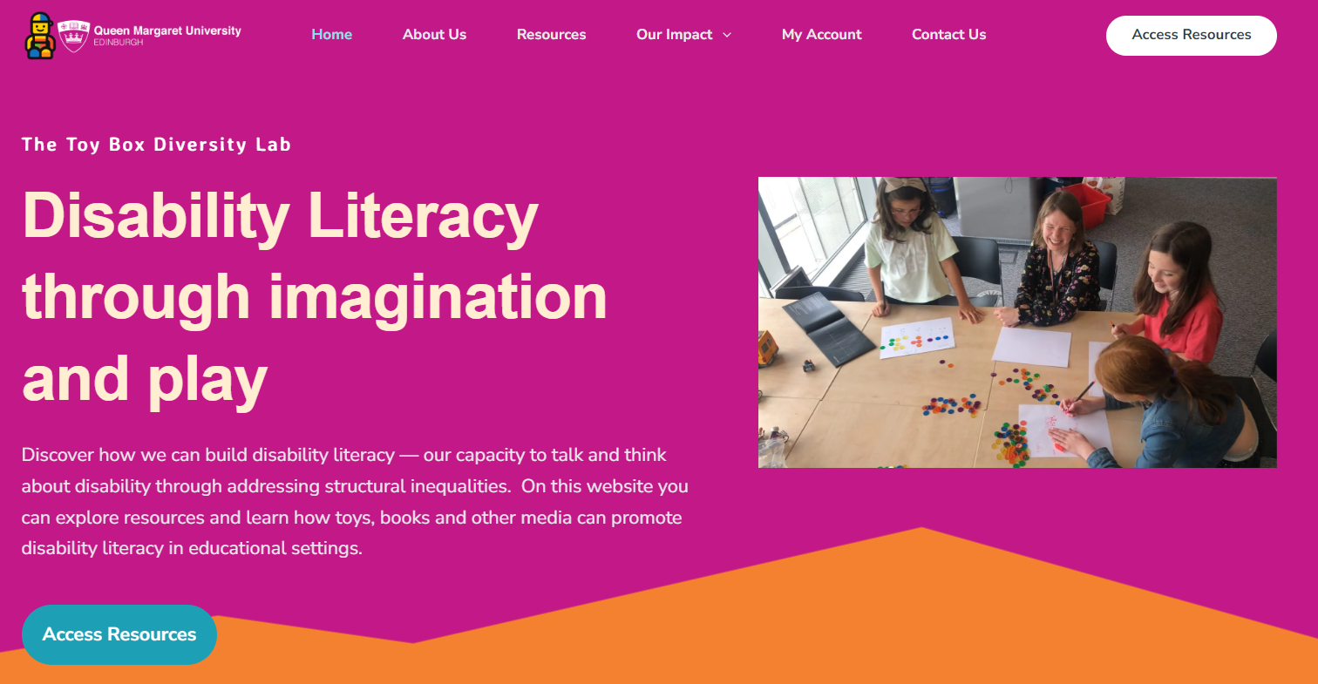
Resources
Notes:
So, you might be wondering, ‘How do we actually go about increasing disability representation and using imagination as a tool for contact with disabled peers?’ Recently, the Toybox Diversity Lab website has been set up by Sian and Clare to host a range of resources and information on disability representation and imagined contact. You can access everything by signing up for a free account. Again, I’ve added a hyperlink to the picture here.

Slide 37
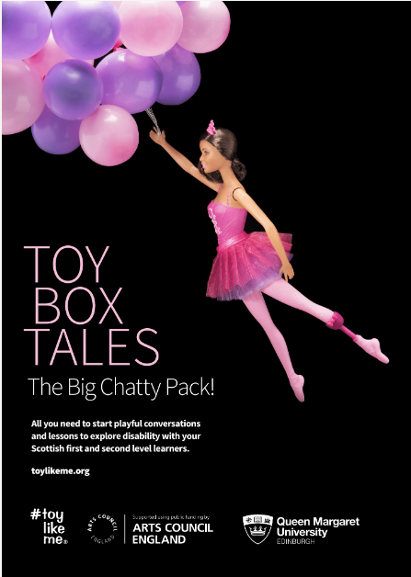
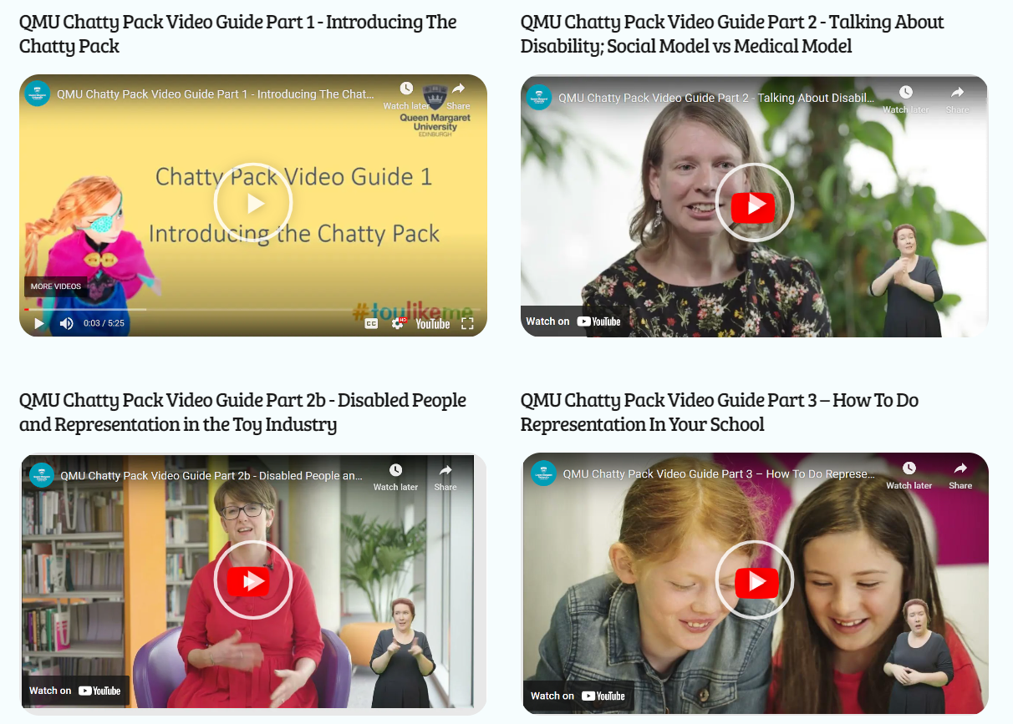
Resources
Notes:
I’d just like to draw your attention to two key resources available on the site. This is called the ‘Chatty Pack’ and it’s a resource that has been trialled in an exhibition-style setting and shown a positive impact on children’s perceptions of disability. The pack includes images like the one here to represent a disability, and it comes with information sheets, various activities and discussion points, with the aim of thinking about adapting the environment to ensure inclusivity rather than viewing disability through a medical lens. Following feedback from focus groups with key stakeholders, a series of short videos have been made to offer guidance and build confidence for practitioners when using these resources with their pupils. There was also other feedback that they are in the process of responding to, such as including more ‘hidden disabilities’ in the pack and incorporating other types of material culture as not all children want to play with toys.

Slide 38
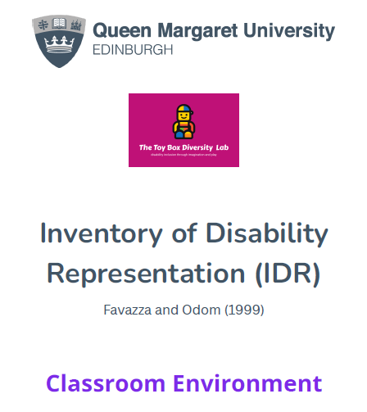
Resources
@Dr_Sian_Jones
@ClareUytman
Notes:
The website also includes a copy of the Inventory of Disability Representation that I mentioned earlier, which can be used to evaluate the visibility of disability in classroom settings and help educators reflect on representation. Sian and Clare participate in webinars and frequently share updates about their work on Twitter, so following them is a great way to stay informed about new developments and resources if you are interested.
This one isn’t on the website yet but it’s something you might be interested in, which is called CIRCLE and it is a really useful framework for schools to use to improve their inclusive practice, including support about how to set up their classroom.

Slide 39
Conclusion
Imagined contact – part of our toolkit?
Simple, low cost and minimal resources
Relevance to EP practice
Linking with ‘Reclaiming Inclusion’
Notes:
So to sum up what I’ve been talking about today, I really think that over the past few years, there is an increasing body of research to show us that disability representation through imagined contact is a promising, and in my view exciting new tool that we can explore with each other in the EP profession but also with schools as a way to improve children’s attitudes towards their disabled peers.
I know we have seen some toys on these slides that can cost money, increasing disability representation and using imagined contact doesn’t actually require expensive resources. It is something that practitioners can get creative with to suit the needs and abilities of their own pupils in a way that is simple and low cost, but like I said as long as it’s something that can be done little and often rather than just standalone lessons or just part a themed week/day.
Whilst I appreciate that EPs might not directly implement these resources themselves, I think that being familiar with them equips us to guide practitioners in creating more inclusive environments and advocating for positive disability representation. I feel that this work aligns closely with Bronfenbrenner’s ecological systems theory which underpins a lot of our practice, as it focuses on creating change in the wider systems around a disabled child to foster inclusion and belonging, rather than focusing on changing the disabled child themselves.
Finally, I just want to highlight how I think this work links to the conference theme of ‘Reclaiming Inclusion’. In discussions about inclusion in education, much of the focus is on making accommodations and adaptations to support learners’ needs and rightly so. However, I feel that sometimes a key barrier to doing this successfully is that disability is not always spoken about enough and recognised as an identity in educational spaces. Without positive disability representation and the visibility of disability as a valued identity, accommodations and adaptations risk being seen as add-ons rather than integral parts of a truly inclusive environment. I think that positive disability representation, facilitated through imagination and play, can offer something known as mirrors and windows, which is a term coined by Dr Bishop in 1990, mirrors for disabled children to see themselves positively represented and windows for non-disabled children to gain a respectful, inclusive perspective on disability. By ensuring that all identities are visible and valued, I believe that we can then make accommodations and adaptations so that disabled children are not just able to access and participate in the world around them but feel a true sense of belonging as valued members of their school communities.

Slide 40
Thank you for listening! Any questions or comments?
Get in touch!
soraya.khanna@wokingham.gov.uk
@DrSorayaKhanna
@DrSorayaKhanna.bsky.social
menti.com
3193 3631

Slide 41
References
All Party Parliamentary Group on Autism (2019). The Autism Act, Ten Years On. https://pearsfoundation.org.uk/wp-content/uploads/2019/09/APPGA-Autism-Act-Inquiry-Report.pdf
Allport, G. W. (1954). The nature of prejudice. Addison-Wesley.
Armstrong, M., Morris, C., Abraham, C., & Tarrant, M. (2017). Interventions utilising contact with people with disabilities to improve children's attitudes towards disability: A systematic review and meta-analysis. Disability and Health Journal, 10(1), 11-22. https://doi.org/10.1016/j.dhjo.2016.10.003
Beckman, L., Hellström, L., & von Kobyletzki, L. (2020). Cyber bullying among children with neurodevelopmental disorders: A systematic review. Scandinavian Journal of Psychology, 61(1), 54–67. https://doi.org/10.1111/sjop.12525
Birtel, M. D., Di Bernardo, G. A., Stathi, S., Crisp, R. J., Cadamuro, A., & Vezzali, L. (2019). Imagining contact reduces prejudice in preschool children. Social Development, 28(4), 1054-1073. https://doi.org/10.1111/sode.12374
Bottema-Beutel, K., Park, H., & Kim, S. Y. (2018). Commentary on Social Skills Training Curricula for Individuals with ASD: Social Interaction, Authenticity, and Stigma. Journal of Autism and Developmental Disorders, 48(3), 953–964. https://doi.org/10.1007/s10803-017-3400-1
Chae, S., Park, E. Y., & Shin, M. (2019). School-based interventions for improving disability awareness and attitudes towards disability of students without disabilities: A meta-analysis. International Journal of Disability, Development and Education, 66(4), 343-361. https://doi.org/10.1080/1034912X.2018.1439572

Slide 42
References
Chapman, L., Rose, K., Hull, L., & Mandy, W. (2022). “I want to fit in… but I don’t want to change myself fundamentally”: A qualitative exploration of the relationship between masking and mental health for autistic teenagers. Research in Autism Spectrum Disorders, 99, 102069. https://doi.org/10.1016/j.rasd.2022.102069
Crisp, R. J., & Turner, R. N. (2012). The imagined contact hypothesis. Advances in experimental social psychology, 46, 125-182. https://doi.org/10.1016/B978-0-12-394281-4.00003-9
Favazza, P. C., Ostrosky, M. M., Meyer, L. E., Yu, S., & Mouzourou, C. (2017). Limited representation of individuals with disabilities in early childhood classes: Alarming or status quo?. International Journal of Inclusive Education, 21(6), 650-666.
Freer, J. R. (2021). Students’ attitudes toward disability: a systematic literature review (2012–2019). International Journal of Inclusive Education, 1-19. https://doi.org/10.1080/13603116.2020.1866688
Greder, A. G., Kain, R. A., Lutz, O. K., & Miyazaki, R. N. (2020). Why Can’t We Be Friends: The Use of Imagined Contact in Changing Negative Attitudes Towards Outgroups. The Macksey Journal, 1(38), 1-16.
Ioannou, M. (2019). The week after: Do the effects of imagined contact last over time?. Journal of Applied Social Psychology, 49(7), 459-470. https://doi.org/10.1111/jasp.12597
Jones, S. (2021). Children’s understanding of disabilities. In B. Clough & J. Herring (Eds.) Disability, Care and Family Law (pp. 85-99). Routledge.
Jones, S.E., Mariezcurrena, E., Rutland, A., & McGuire, L. (2017a, April). Toying with(out) Prejudice: Pretend Play and Discrimination Towards Peers with a Disability. [Poster Presentation] Society for Research and Child Development, Austin, Texas.

Slide 43
References
Khanna, Soraya Grace (2023) Imagined contact: What role does it play in influencing children's responses towards their disabled peers? University of Southampton, Doctoral Thesis, 147pp.
Liu, T. L., Wang, P. W., Hsiao, R. C., Ni, H.C., Liang, S. H., Lin, C. F., Chan, H. L., Hsieh, Y. H., Wang, L. J., Lee, M. J., Chou, W. J., & Yen, C. F. (2022). Multiple types of harassment victimization in adolescents with autism spectrum disorder: Related factors and effects on mental health problems. Journal of the Formosan Medical Association, 121(11), 2161–2171. https://doi.org/10.1016/j.jfma.2022.03.005
MacMillan, M., Tarrant, M., Abraham, C., & Morris, C. (2014). The association between children's contact with people with disabilities and their attitudes towards disability: a systematic review. Developmental Medicine & Child Neurology, 56(6), 529-546. https://doi.org/10.1111/dmcn.12326
Mazziotta, A., Mummendey, A., & Wright, S. C. (2011). Vicarious intergroup contact effects: Applying social-cognitive theory to intergroup contact research. Group Processes & Intergroup Relations, 14(2), 255-274. https://doi.org/10.1177/1368430210390533
Moriña, A., & Carnerero, F. (2020). Conceptions of Disability at Education: A Systematic Review. International Journal of Disability, Development and Education, 1-15. doi: https://doi.org/10.1080/07294360.2020.1712676
Nowicki, E. A., Brown, J., & Stepien, M. (2014). Children’s thoughts on the social exclusion of peers with intellectual or learning disabilities. Journal of Intellectual Disability Research, 58(4), 346–357. https://doi.org/10.1111/jir.12019
Obrusnikova, I., Block, M., & Dillon, S. (2010). Children’s beliefs toward cooperative playing with peers with disabilities in physical education. Adapted Physical Activity Quarterly, 27(2), 127-142. https://doi.org/10.1123/apaq.27.2.127

Slide 44
References
Oksendal, E., Brandlistuen, R. E., Holte, A., & Wang, M. V. (2019). Peer-Victimization of Young Children With Developmental and Behavioral Difficulties—A Population-Based Study. Journal of Pediatric Psychology, 44(5), 589–600. https://doi.org/10.1093/jpepsy/jsy112
Pinquart, M. (2017). Systematic review: bullying involvement of children with and without chronic physical illness and/or physical/sensory disability—a meta-analytic comparison with healthy/nondisabled peers. Journal of pediatric psychology, 42(3), 245-259. https://doi.org.10.1093/jpepsy/jsw081
Saggers, B., Campbell, M., Dillon-Wallace, J., Ashburner, J., Hwang, Y.-S., Carrington, S., & Tones, M. (2017). Understandings and Experiences of Bullying: Impact on Students on the Autism Spectrum. Australasian Journal of Special Education, 41(2), 123–140. https://doi.org/10.1017/jse.2017.6
Smith, E. M., & Minescu, A. (2022). A test of the maintenance of the effects of imagined contact framed with supportive social norms as a teacher-led field intervention. Journal of School Psychology, 92, 324–333. https://doi.org/10.1016/j.jsp.2022.04.005
Yu, S., & Kim, R. (2023). Limited representation of disability in early childhood classrooms: data from South Korea. European Early Childhood Education Research Journal, 31(1), 106-123.
Woodgate, R. L., Gonzalez, M., Demczuk, L., Snow, W. M., Barriage, S., & Kirk, S. (2020). How do peers promote social inclusion of children with disabilities? A mixed-methods systematic review. Disability and Rehabilitation, 42(18), 2553–2579. https://doi.org/10.1080/09638288.2018.1561955

