Slide 1







Using the Resilience Ball to bridge the gap between education and health: measuring and promoting resilience at individual, group and whole-school level.
Dr Anna Doedens-Plant
Specialist Educational Psychologist
Surrey County Council & Mindworks Surrey

Slide 2
Aims for today
Situating the project in Educational Psychology and health services
Rationale for creating the Resilience Ball Questionnaire
Constructing and validating the RBQ
Implementation; supporting change and promoting inclusion
Questions
Notes:
Talk to this slide:
Apart from intro (situating the project) and questions, there are 3 parts to this presentation: why we did it, what we did, how we are going to use it.

Slide 3
Situating the project in Educational Psychology and Health services
In Surrey:
Educational Psychologists (EPs) are seconded part-time into the NHS School-based needs team with responsibilities:
    In county-wide projects
    Within Mental Health Support Teams (MHSTs)
    In schools
EPs form integral part of MHSTs, with a remit to lead on promoting whole school or college approaches to mental health and wellbeing
Notes:
Mental Health support teams work in schools, and they came about after a government Green Paper, in response to the growing mental health needs of children and young people.
The first wave of MHSTs became operational in 2019. MHST have three functions:
To support the senior mental health lead to formulate a strategy for a whole school approach to mental health and emotional wellbeing
To consult with school staff members
To deliver 1-1 evidence-based interventions, based on CBT
In Surrey, EPs are integrated into the MHSTs, rather than working alongside as is the case in some other counties. As a result, we have much closer links and are able to offer an EP perspective to discussions in the teams.

Slide 4
Rationale for creating the Resilience Ball Questionnaire
In Surrey, The Resilience Ball is introduced to schools by both the EPS and Mindworks, because:
  It allows for a coordinated approach from Educational Psychology and Health services
  For schools it means fewer frameworks to work with
  The Resilience Ball is easy to hold in mind
  The framework conceptualises resilience as contextual
  It translates well between school and home, and gives teachers and parents/carers practical ideas
Notes:
Because EPs work in both services, it has been possible to coordinate training to schools on supporting young people to thrive. For schools, it means that they get the same message from EPS and health services, which is really helpful.
There are other resilience frameworks out there, for example ‘boing boing’. Not to take anything away from that, but it is a large grid, which is harder to hold in mind. Personally, I am finding that I am drawing on The Resilience Ball frequently, to support my own wellbeing.
The narrative around mental health in our society has changed drastically. It is good to take away the stigma around mental health! At the same time, our own and each other’s emotional wellbeing is something we need to look after as a matter of course. Not all emotional distress needs to be pathologized. The danger in the current debate is that we see ill mental health as something that needs to be fixed in someone by themselves. Perhaps we risk returning to the same stigma if they fail to do so.
The Resilience Ball shows that emotional wellbeing and thriving is only possible within a certain context, when we have the right resources at the right time to thrive. Schools are part of the context of a young person, so this framework gives very practical ideas about how to support emotional wellbeing.

Slide 5
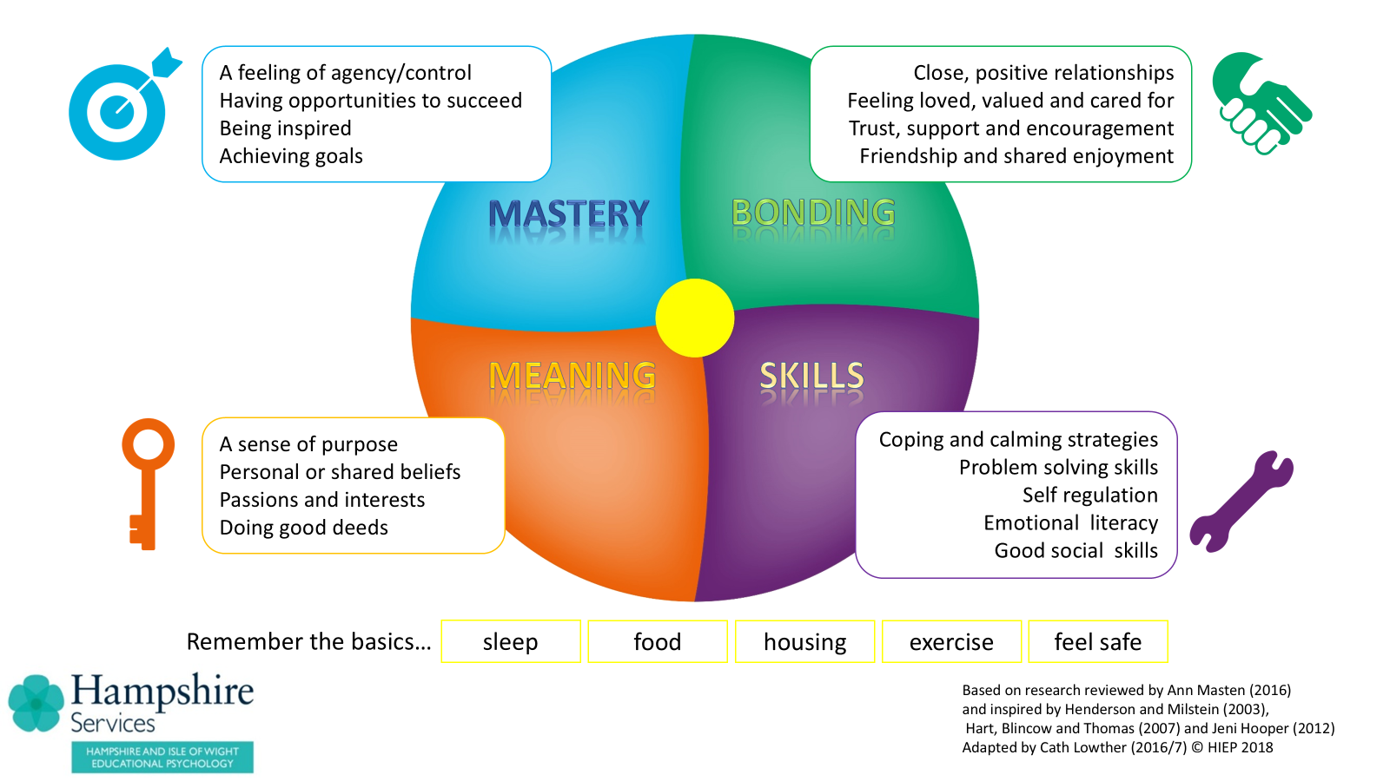
The Resilience Ball (Lowther, C. 2022)
Notes:
Give a short explanation of The Resilience Ball. I started in Hampshire, but then Cath Lowther published a book in 2022, which is where our training is based on.
In the training, bonding is discussed first, because of the central role that attachment (glue-like) relationships play in our lives.
Mastery is a verb, not a noun; it is about the processes of change, and the sense of agency in that.
Meaning is a very personal sense of mission, individual to us all.
With skills we mean those skills to manage yourself in different situations.
The basics were a real challenge for some families during COVID-19, but it is important to remember that this remains the case to this day.

Slide 6
Rationale for creating the Resilience Ball Questionnaire
Inspired by a secondary school’s request for an ‘anxiety survey’, and concerns around this request
A questionnaire with insight into how to use everyday strategies to promote young people to thrive seemed more appropriate
It encourages shifts away from medicalised, in-person formulation, based on deficit models
Other resilience questionnaires are conceptualised differently, and do not fit The Resilience Ball exactly, making ‘translating’ results into support harder
It gives opportunities for practical tools for support on whole-school, group and individual level
Notes:
When a secondary school wanted me to run an anxiety questionnaire for all students, I was really concerned that this may lead to a tsunami of reports of anxiety. After all, what we pay attention to has a tendency to grow. I was worried about feeding a vicious flower of anxiety at a school level. It seemed more appropriate to use a questionnaire about what helps young people to thrive.
This can also play a part in shifting the dialogue from pathologizing and medicalising formulations, which start with the idea that there is something ‘wrong’ with the person. That is not to say that there is no place for medical interventions at times, because of course there is. But on a whole population level we believe we need to change the conversation to thinking about what we need to bounce back from adversity. A resilience questionnaire seemed therefore more appropriate.
There are other resilience questionnaires around, and you will hear me mention some of them later. None of these scales conceptualise resilience in the same way. So for schools where staff have received training on The Resilience Ball, translating the results on a different questionnaire to identifying support according to The Resilience Ball is tricky. In the busyness of schools, we have to make sure that this translation is as seamless as possible. We believe that schools who have had Resilience Ball training, who have access to the tools that come with it, will have access to really practical tools for supporting individual young people, but also different groups. And we are seeing that it is starting to shift the language around wellbeing at a whole school level.

Slide 7
Constructing and Validating the RBQ
1. The Resilience Ball Audit
2. Re-design into The Resilience Ball Questionnaire
3. Feedback from colleagues
4. Pilot study of 4 Young People
5. Version One: data from 147 pupils in school One
6. Version Two: data from 150 pupils in schools Two and Three
Notes:
The Resilience Ball audit was the first conceptualisation of the RBQ. This started when Cath was working in Bracknell, working with adult mental health services. It was meant as a starter for an in-depth conversation, and had open-ended questions as well as questions answered on a Likert scale.
Cath and I discussed that to have a questionnaire with only questions answered on a Likert scale may have merit, as it would allow schools to do a quick ‘temperature check’. Especially as the Resilience Ball support plan had been developed in the meantime in Mindworks, which gives opportunity for a longer discussion, we felt that the RBQ would be able to play a unique role.
For content validity, we asked a range of colleagues for feedback on our items, and we discussed what they thought our items measured. As a result of these discussions, some of the items were changed.
We then ran a pilot study of 4 young people, administered by an Assistant EP, who monitored where these young people were getting stuck, which items they had questions on. She also interviewed them afterwards, and asked for more general feedback. This pilot study also resulted in some changes.
We decided to re-fashion the Audit into a questionnaire, and to validate the scale. The schools I was talking to were immediately interested and saw value in a RBQ, and we would not have been able to do this without their enthusiasm and support.
We then ran version One in the first school and based on the data, we made a further change to one of our items.
We have now just run version Two before half term, we have analysed the data, and we will need to consider our next steps. This version Two was going to be early in the first half term, but as we are doing research in the real messy world of schools, this only happened the last Friday before half term.
So, we may not be 100% there yet, but we think that the scale is now in its final stages. You have found a paper copy on your chair. Please bear in mind that this is a concept version, still in development, so please do not use or replicate yet. We are confident that we will be able to share it more widely soon.

Slide 8
Constructing and Validating the RBQ
Version 1
147 Participants
1 secondary schools (147 students)
Year Group: Yr7 x 23; Yr 8 x 39; Yr 9 x 45; Yr 10 x 40
Average age: 13.6yr
Gender: 84 Males ; 61 Females ; 2 Other
Version 2
150 Participants
2 secondary schools (School A : 88 students; School B: 62 students)
All of them are from Year 8 (Average age: 12.1yr)
Gender: 74 Males; 71 Females; 5 Other
Notes:
This is the information on the population of the three schools that took part. Head teachers were asked for written consent, parents were given the option to opt their child out of the study, and young people had to opt in by clicking the link. Those that did not want to take part were asked to do a general quiz with trivia questions, which was modelled on the research questionnaire. This was so that at a glance nobody would be able to see if they took part or not.
In total 56 pupils opted out: 39 from school one, 7 from school two, and 10 from school three. Whilst it was a shame for our study, at the same time it was great to see that the opt-out consent worked and pupils felt free to take that option.
The young people were asked to fill out the RBQ alongside four other questionnaires.

Slide 9
Constructing and Validating the RBQ
 | Version 1 | Version 2
Internal Consistency | Cronbach’s α= 0.951 | Cronbach’s α= 0.933
Convergent validity (CV) Resilience Ball Questionnaire (RBQ) vs Student Resilience Survey (SRS) | Pearson’s r = 0.77 (p-value <0.01) | Pearson’s r = 0.68 (p-value <0.01)
CV: RBQ “Bonding” vs Student Resilience Scale (SRS) | Pearson’s r = 0.73 (p-value <0.01) | Pearson’s r = 0.63 (p-value <0.01)
CV: RBQ “Mastery” vs General Self-efficacy Scale (GSES) | Pearson’s r = 0.78 (p-value <0.01) | Pearson’s r = 0.75 (p-value <0.01)
CV: RBQ “Meaning” vs The Meaning of Life Questionnaire (MofL) | Pearson’s r = 0.48 (p-value <0.001) | Pearson’s r = 0.55 (p-value <0.001)
CV: RBQ “Skills” vs Coping Self-efficacy Scale (CSES) | Pearson’s r = 0.74 (p-value <0.01) | Pearson’s r = 0.64 (p-value <0.01)
Notes:
As you can see here, the internal consistency of both versions is really high. This means that all items contribute significantly to the scale, and the consistency would not be higher if one of the items were to be taken out. You can imagine we were pleased with that.
We have looked at how the results on the RBQ compare with other scales, both for the RBQ overall, as well as the individual parts of the Resilience Ball.
The correlation of the Resilience Ball as a whole with the student resilience survey is looking good, although slightly weaker in our second sample.
What stands out is the correlation between the meaning section of the RBQ and the Meaning of Life questionnaire; in both versions it is a much weaker correlation than the other sections, or the RBQ overall. We have thought a lot about this. However, the Meaning of Life questionnaire is conceptualised very differently. It asks in different ways if you experience meaning in life, and if you are still searching for meaning of life. The fact that it has both presence and search for meaning may muddy the waters. More importantly though, our questionnaire does not ask directly about meaning of life, instead, it asks questions about those things which research has shown contributes to meaning of life.
Because of the significant difference in conceptualisation of the Meaning of Life Questionnaire by Steger and the meaning part of the RBQ, we are not too concerned about the low correlation.

Slide 10
Implementation; Supporting Change, Promoting Inclusion
Whole-school:
  Use The Resilience Ball and its tools to put the eight principles to promoting a whole school or college approach to mental health and wellbeing into practice
Notes:
Inclusion, inclusion inclusion
Seeing resilience as something that we all can only experience if we have the right resources at the right time and in the right amount, changes the conversation about emotional wellbeing, mental health and ‘behaviour’ right across organisations. Rather than locating a problem within one person, it is always about one person within the context that is being offered at that given time.
This can shift the conversation from ‘how can we make someone fit in’ to ‘how can we make sure that this person has the right context, so that they can belong’. In my mind, that is where true inclusion starts. The Resilience Ball encourages us to really unpick what is going on for someone, where they are possibly lacking resources, what is driving the behaviour that we are seeing. After all, people do not try to be a problem, but they are trying to solve a problem through behaviour which is sometimes experienced as problematic.
On this slide her you see the graphic which depicts the ‘Eight principles to promoting a whole school or college approach to mental health and wellbeing. This comes from a document released by Public Health England and the Department for Education in 2021. These are the eight areas to focus on when thinking about a whole school approach and The Resilience Ball gives us a different lens to view all of them.
Leadership and management- a shift away from locating problems in young people, towards a much more systemic approach for thriving for all.
Curriculum and teaching- the way we teach maths, history or any other subject can give young people a sense of mastery and meaning, or not, depending on how we teach. We can promote bonding within our classes if we make that a priority, or not. We can teach emotional regulation skills and social skills in the context of other subjects, if we know it is important to weave that in.
Ethos and environment- The Resilience Ball encourages us to think that we ARE the context for others, as they are for us. We can therefore foster a community of reciprocal support.
Targeted support- this could be seen through a pathologizing lens, however, the Resilience Ball encourages support which goes beyond the individual.
Parents and carers- The Resilience Ball gives parents very practical tools to support their children’s resilience, in a way which is easy to remember but backed up by research.
Staff development- The Resilience Ball has been transformational for me, as I mentioned earlier. We can support the adults in school to think in a different way about how they support their own resilience. After all, the oxygen mask principle applies; they can only support the resilience of others if they are resilient themselves.
Student voice- the Resilience Ball support plan, which I will come to in a minute, gives opportunity for student voice to take centre stage
With the RBQ, we will have a tool through which we can identify need at the earliest stage, so that intervention can take place before things escalate.

Slide 11
Implementation; Supporting Change, Promoting Inclusion
Groups:
Use the RBQ to discover why certain groups, such as Year groups or classes, do not seem to function as desired
Put interventions in place at a group level, such as
  Promoting a greater sense of belonging and inclusion
  Targeting feedback, encouragement and praise to promote a sense of mastery
  Promoting involvement in projects that are felt as meaningful
  Teaching specific skills at group level
Notes:
In every school we hear of year groups that are either going well, or ‘problematic’. It is really tricky to understand what is going on for a group of let’s say Year 8s, if you have around 100 of them. The RBQ will allow insight into patterns.
Different year groups will have different needs. I would imagine that ‘bonding’ will be a hot topic in Year 7 as pupils come into secondary school, but also in Year 8 as old friendships and bonds start to shift and disappear. In Year 10 and 11, ‘meaning’ might feature much more strongly. However, we will have to see how that shows up over time. Whatever the pattern, the RBQ can afford that insight at group level, so that action can be taken at a group level.

Slide 12
Implementation; Supporting Change, Promoting Inclusion
Individual:
Use results of the RBQ to identify who would benefit from an in-depth conversation to co-create a Resilience Ball Support plan
This allows for Young Person participation and
promotes inclusion
Examples include conversations with
Young People who are at risk of EBSNA
Voice
Audience
Influence
Space
Lundy, L. (2007)
Notes:
Participation in Surrey has now been mapped onto the Resilience Ball.
In the Resilience Ball support plan conversation, we need to take a truly person-centred approach.
How can we create a space, physically and psychologically, where young people feel safe to share their voice?
How might they like to share their voice? In the group? One-to-one?
Who needs to hear what the young person has shared? Are we sure we reach all the right and necessary people?
How can we make sure that the young person’s voice has an impact? How does the young person know that their thoughts have been taken into account?
When we can target the support for young people around what they share themselves, we have more hope to get it right for them, and for them to be truly included, rather than just as a token.

Slide 13
Case Study One
Staff received training on Inset Day
Several presentations on parents’ evenings
Head of Year 11 used the Resilience Ball for tutor time activities
Mixed response to a shift in language around resilience
  Highlights the importance of ‘buy-in’ from school leaders
  Highlights the importance of an agreed implementation plan from the outset

Slide 14
Case Study Two
Leadership team and year leaders received training on the Resilience Ball
Training was disseminated by year leaders, supported by MHST to tutors of their year group
Shift in language around resilience in school
Resilience Ball support plans were co-constructed with young people who are experiencing difficulties (e.g. EBSNA, communicating emotions through behaviour), parents/carers and staff
IN FUTURE:
The hope is that The RBQ will help to identify difficulties at a much earlier stage, so that support can be offered more timely

Slide 15
Possible Next Steps
Gather additional data to include more year groups for Version Two
Release the scale to limited number of schools and get feedback from
schools on how their experience of using the scale
Release the scale for wider use
  In training
  In next edition of The Resilience Ball book
Publish

Slide 16
Thanks to:
Dr Cath Lowther
Danny Wong
Chris Boyle
Dr Dave Damon
Chloe Gibson-Hewson
Dr Jessica Dewey
Eddy Davis-Rae
Staff and pupils in the participating secondary schools
The Resilience Ball: Amazon.co.uk: Lowther, Dr Cath, Doedens-Plant, Dr Anna, Prince, Dr Emily: 9798831187489: Books

Slide 17


