Slide 1
Reducing exclusions from school: An exploration of educational professionals’ experiences
Dr Gabi Bousfield-Parkes
gabrielle.bousfield@doncaster.gov.uk
A doctoral thesis supervised by Dr Tracey Heckels and Professor Simon Gibbs of Newcastle University

Slide 2
Aims
Share
Promote
Reflect
Share research that was my thesis as part of my doctoral training.
Promote discussions around the key themes and findings.
Allow opportunities for reflection as how we as professionals can support.

Slide 3
Conceptual Framework
Why am I doing this research?
Why now?
Increase from 2012. Drops in exclusions over COVID. Following return to school the rates continue to increase again.
In this way?
SLR: Schools are asking, “What works?”.
Professional Experiences – prior to working as an EP
Working with the pupils who have been excluded.
North-East highest P-Ex and suspensions in England.
Awareness of own bias
Empirical: Experiences of the people who are working to support pupils who may be excluded.
Notes:
Primary School – remember a YP being suspended from my class and I thought it was really unfair. Thought about the reasons and what had happened and it caused lots of discussions about when suspension is okay.
AP – pupils who had been excluded more than once, sometimes been at their mainstream for around 2 weeks before being p-ex. Often, things would not have been put in place, time for them to complete etc.
Suspended for trainers, resulted in hanging about in town, resulted in smoking, then wanting something harder, county lines, carrying a knife for safety.
‘persistent disruptive behaviour’
COVID – massive drops, less children in school, what worked for them. Remember headteacher telling us no pupil should be suspended because we have less children in school (didn’t make any difference to practice)
WHERE ARE THEY BEING EXCLUDED TO?
In this way – Ologies!

Slide 4
School Exclusion definition
Suspension
Permanent Exclusion
A permanent exclusion is when a pupil is no longer allowed to attend a school (unless the pupil is reinstated). The decision to exclude a pupil permanently should only be taken:
in response to a serious breach or persistent breaches of the school's behaviour policy; and
where allowing the pupil to remain in school would seriously harm the education or welfare of the pupil or others such as staff or pupils in the school.
A suspension, where a pupil is temporarily removed from the school, is an essential behaviour management tool that should be set out within a school’s behaviour policy.
A pupil may be suspended for one or more fixed periods (up to a maximum of 45 school days in a single academic year). A suspension does not have to be for a continuous period.
A suspension may be used to provide a clear signal of what is unacceptable behaviour as part of the school’s behaviour policy and show a pupil that their current behaviour is putting them at risk of permanent exclusion.
Notes:
Purpose of this research focus on permanent exclusion and suspension – there are other forms such as off-rolling, part-time timetables, isolations etc. which may be considered exclusions

Slide 5
Impact of exclusions
Social and economic disadvantage (Gazeley et al., 2015, Paget et al., 2018, Power and Taylor, 2020).
Low academic achievement, less stable career patterns, greater unemployment (Gazeley et al., 2015, Graham et al., 2019, McCluskey et al., 2016).
Increased mental health difficulties in adulthood (Parker et al., 2015).
Long to medium term effects across a wide range of areas into adulthood (Madia et al., 2022, Obsuth et al., 2022).
Intergenerational (Paget et al., 2018).
Notes:
And many more in the literature

Slide 7
Doncaster rates
Doncaster

Slide 8
Systematic Literature Review

Slide 9
What are the effects of educational based interventions to reduce disciplinary behaviours to decrease the number of suspensions and permanent exclusions in UK schools?
Five intervention studies in the UK were found using the inclusion criteria:
compulsory school age
in an education setting
an outcome of suspensions or permanent exclusions
The studies were considered low – medium quality.
Qualitative and quantitative data was collected.

Slide 10
The interventions and effectiveness
Study | Intervention | Effectiveness
Obsuth et al. (2017) | Engage in Education – London | Significant increase in self-reported exclusions
Rose et al. (2018) | Transferred inclusion | Suspensions decreased over time
Waters (2015) | Story Links Programme (Therapeutic Story writing) | Suspensions significantly decreased over time
Ewen and Topping (2012) | Extended New Directions (END) project | Mainstream schools excluded more than END
Rose et al. (2015) | Emotion Coaching | Exclusions, call outs and consequences significantly decreased over time
Notes:
Rose 2018 – no significance reported
Waters – 2 to 0
Ewen and topping – no significance

Slide 11
Themes from the studies
Adult to pupil relationships
Staff to pupil relationships
Pupil to parent relationships
Delivery importance
Postive or punitive
Consistency
Family Engagement
Emotions
Pupils' wellbeing
Confidence
Notes:
All four studies discuss the need for the intervention to include positive experiences.
The engagement of families within the intervention process appeared to be an aspect in three of the studies, such as improved communication.
Consistency in the approaches needed to be used.
Staff to pupil as expected
Also pupil to parent, improving the relationship and understanding was considered to support with the reduction of suspensions and p-ex
Pupils’ sense of emotion was discussed in all four papers. These included pupils feeling valued and a sense of belonging following the intervention (Rose et al., 2018), emotions being recognised and validated (Rose et al., 2015) and a sense of more positive emotions, such as improved mood (Ewen & Topping, 2012) and less anxiety (Waters, 2014).
Mixed methods: segregated synthesis, narrative for quant and thematic for qual

Slide 12
Empirical Research
Notes:
14:35

Slide 13
How do educational professionals, within one Local Authority, report the experience of supporting inclusion in secondary settings to reduce school exclusions?
Secondary School Headteachers (2 participants)
LA Inclusion & SEN Service Managers (3 participants)
Educational Psychologists (3 participants)
Narrative conversations, analysed through a reflective thematic analysis
Notes:
Focus on inclusion here, so could be on any level

Slide 14
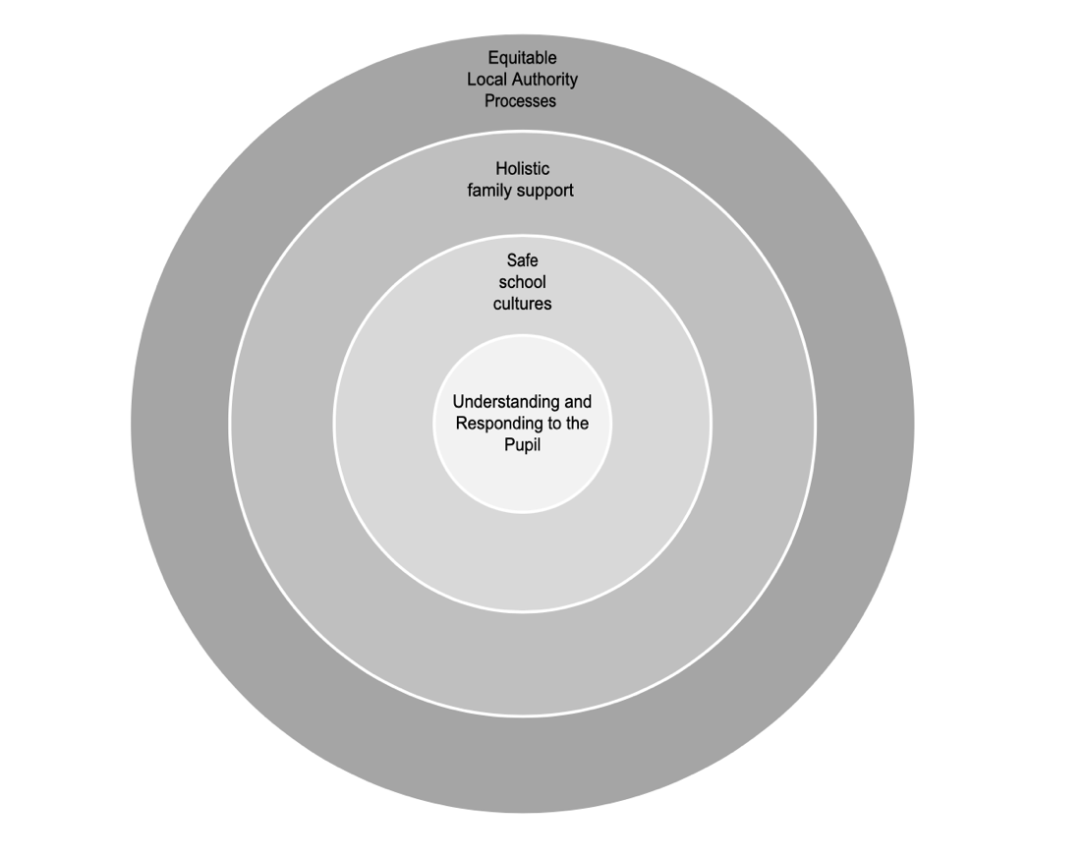
Notes:
Similar to Bronfenbrenner ecological systems – different layers and all interact

Slide 15
Understanding and responding to the pupil
LA Manager:
Staff will just shout on a walkie talkie for a child to be removed. That’s easier than actually finding out what makes that child tick, a bit of personal stuff about them and building a relationship with them.
Notes:
Staff to pupil relationships are well researched. All links to belonging which supports positive attitudes, behaviours and engagement (Graeme et al. 2019).

Slide 16
Educational Psychologist:
All my years being an EP, I have not yet met one young person, not one, that threw a chair at someone because they fancied doing it. There is always something behind it.
Notes:
Unrecognised needs or purpose of behaviour.
Having an unmet SEND increases the likelihood of being excluded (Joseph & Crenna-Jennings, 2024)
These are not always clear.
Participants spoke of staff addressing the presenting behaviour rather than considering the cause of the behaviour.

Slide 17
Headteacher:
Equality is not fair because we’re all different. We’ve focused very much on equity and if we get equity right, you strive for equality. We treat everyone differently, we treat our adults, our schools, and our kids all differently because they all need different things.
Notes:
Responding to pupils based on what they need. Taking a person-centred, individualised approach.
Research suggests that staff may aim to be fair in consequences but this can negatively impact some pupils with SEND (Emerson, 2016).

Slide 18
Reflection point:
Do these resonate with you?
What have you previously done to support staff to not only understand what is happening for the pupil, but to respond and address this?

Slide 19
Creating safe school cultures
Headteacher:
We have a pastoral system, I guess it’s teamwork, a teamwork approach to school culture… the group stays together for the five years that they’re at the school… so they’re like a sort of family. Basically, it’s like a family in school, at school.
Notes:
Working at a systemic level from the top. It is about the culture of the school and how this is in the classroom.
Safety refers to the pupils, the pupil who may be excluded and the staff. Both psychological and physical safety.
This links to policies in place but goes beyond what is seen in the classroom and link to staff values, language and experiences.
Need to be agreed by school leaders and embedded by staff into the ethos (Cole et al. 2019).
Reflectively and proactively, rather than an individual response to a pupil (Ruttledge, 2022).

Slide 20
LA Manager:
… it is totally being aware of the pressures that are in schools and knowing if you are a stressed adult, because your role brings stressors. You cannot soothe and support a child who’s stressed because you bring your own stress into that. A dysregulated adult can’t regulate a dysregulated child.
Notes:
Supporting staff wellbeing as important – focusing on what is important rather than league, poor staffing and retention rates. Supporting wellbeing will increase retention and lead to more consistency for pupils.
School ethos links to how supported staff feel in times of stress (Ruttledge, 2022)

Slide 21
Educational Psychologist:
The settings that don’t have as many exclusions or suspensions allow the practitioners to use that professional opinion when supporting children around their behaviour. Not breathing down their neck saying, why haven’t you excluded him, he threw a chair at you?
Notes:
Teacher self-efficacy – sense of belief in ability to manage a situation or behaviours. Done through training, supporting wellbeing and supervision.
Previous research about staff efficacy and exclusions (Dean & Gibbs, 2023)

Slide 22
Reflection point
Think about the most inclusive schools you work with, what helps them to develop this?
Does this theme link with that and how do we support it further?

Slide 23
Holistic family support
Educational psychologist:
Take time to maintain those relationships and that engagement to see that they all want the best for their child and the parents are being listened to, because I think lots of times, they might feel like they’re banging their head against a bit of a brick wall.
Notes:
Valuing the parent voice, listening to their views. Importance of parent – school relationship well researched. External professionals can hold a role in supporting facilitation of meetings to ask curious questions and support the relationship. Parents are often blamed for behaviours (Parker et al, 2016) so important they feel emotional support.

Slide 24
Headteacher:
There should be some intensive, intensive work done with those families and the families need to understand that they are liable as well. Not, it’s the school making the decision. They’re liable.
Educational Psychologist:
We have ASD and ADHD pathways, why is there not a trauma and attachment pathway? Where we can provide wraparound work for the school and family
Notes:
Looking at that multi-agency, focused and wrap around care
Within this, barriers were acknowledged linked to the funding cuts

Slide 25
LA Manager:
If a parent has debt issues, and they can’t buy school uniform. They need signposting to charities where they can get help. But they will also look at their whole finances with them so they’re not just addressing the school uniform issue.
Notes:
Supporting parents practically and emotionally is important.
Parents often face barriers – could include lack of communication, unknown of the expectations of them and their own barriers (Parker et al. 2016)
Lack of knowledge of systems
Exclusions have an impact on the whole family and this needs to be recognised.
Discussions included offering the practical support, wrap around support, living in poverty etc. Not just looking at the individual child but focusing on the full family. Signposting families to additional support
Making that support accessible.

Slide 26
Reflection Point
In your role, how do you currently support families and community?

Slide 27
Equitable Local Authority Processes
LA Manager:
The Local Authority should be thinking about how does it position teams around schools in a coherent way which supports clear identification of what is happening.
Notes:
Substantial changes in the last 10 years due to academisation (Greany, 2022).
Participants discussed their not being the capacity across the LA services to offer support and challenges.
Trying to get everyone around the table for discussions as not being possible, not able to have the people available that are needed in the discussions.
Accessing support proactively is not always possible due to cuts.

Slide 28
Headteacher:
Inclusion panel is not worth the paper it is written on because the bar changes, so you’ve got two kids up against inclusion panel and it’s the same criteria. Well, we’ll have that one. You, yours can’t get through and that’s a massive problem.
Headteacher:
… we have to call a permanent exclusion, even though it’s not going to get to a permanent exclusion, in order to get the support that kid needs. I wish we didn’t have to do that.
Notes:
Difficulties of schools feeling supported by the LA and the impact of the systems can break down the relationships between schools and the LA services.
Not all schools have to attend panels which may be one reason (Thompson et al. 2021)
Breakdown of school to LA relationships
Transparency – equitability

Slide 29
Educational Psychologist:
… and what are they supposed to do if it’s not a permanent exclusion? At the moment, I don’t agree with it but then what is their current alternative?
Notes:
APs were mentioned but with mixed views
Discussion about criminal offences

Slide 30
Reflection Point
Is there a way, as professionals, we can support in the overcoming of such barriers?

Slide 31
What now?
Notes:
15:00

Slide 32
Notes:
Story of Jim, non-traded service on placement, driving to a school where the SENDCo was in a total panic.

Slide 34
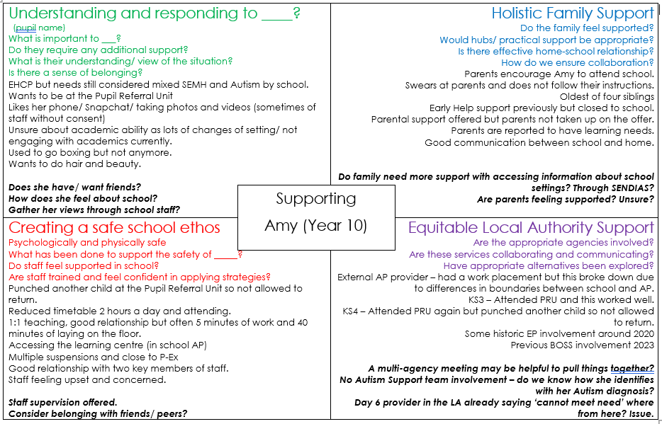

Slide 35
Questions and reflections

